Slide 1
Homelessness and housing: guest lecture for greg suttor
By Nick Falvo, PhD
February 3, 2021

Slide 2
Overview
What causes homelessness?
Responses to homelessness
What is supportive housing?
What kind of supportive housing?

Slide 3
Overview (cont’d)
National Housing Strategy
Reaching Home
Rapid Housing Initiative

Slide 4
Notes
Today’s presentation will attempt to focus on the nexus between homelessness and housing.
In other words, it will focus on how the worlds of affordable housing and absolute homelessness connect.
For referencing information, see the “notes” section at the bottom of each slide in the present deck (and if it’s not there, email me: falvo.nicholas@gmail.com).

Slide 5
WHAT CAUSES HOMELESSNESS?

Slide 6
What causes homelessness?
Three main categories of causes (also known as “contributing factors,” or “predictors”).
Structural
Individual
Systemic
Notes:
Nick says a bit about each category, including who tends to focus on each category.

Slide 7
What causes homelessness?
I recently reviewed four large studies looking at the structural causes.
Three were done in the United States, one in Australia.
Notes:
It’s in the following report that you’ll find my review: https://nickfalvo.ca/the-long-term-impact-of-the-covid-19-recession-on-homelessness-in-canada/

Slide 8
Giano et al. (2020)
This is a review of the academic literature published about predictors of homelessness in the United States between 1970 and 2017.
Notes:
Full reference: Giano, Z., Williams, A., Hankey, C., Merrill, R., Lisnic, R., & Herring, A. (2020). Forty years of research on predictors of homelessness. Community Mental Health Journal, 56(4), 692-709.

Slide 9
Johnson et al. (2015)
Australian study draws on a dataset with more than 100,000 homeless or at-risk individuals.
They also surveyed approximately 1,700 people every six months for three years.
Notes:
Full reference: Johnson, G., Scutella, R., Tseng, Y., & Wood, G. (2015). Entries and exits from homelessness: a dynamic analysis of the relationship between structural conditions and individual characteristics. AHURI Final Report Series-Project: The interrelationship between structural factors and individual risk factors in explaining homelessness. AHURI Final Report No. 248, 248, 1-67.

Slide 10
Hanratty (2017) + Byrne et al. (2013)
Both are US studies using Point-in-Time Count data on approx. 400 communities.
Notes:
Full reference for the Hanratty et al. (2017) article: Hanratty, M. (2017). Do local economic conditions affect homelessness? Impact of area housing market factors, unemployment, and poverty on community homeless rates. Housing Policy Debate, 27(4), 640-655.
Full reference for the Byrne et al. (2013) article: Byrne, T., Munley, E. A., Fargo, J. D., Montgomery, A. E., & Culhane, D. P. (2013). New perspectives on community-level determinants of homelessness. Journal of Urban Affairs, 35(5), 607-625.

Slide 11
What causes homelessness?
Note that both Australia and the US are considered to be comparable to Canada.
All three countries have relatively low levels of public social spending.
The biggies from all 4 of these studies, in terms of structural causes, are: unemployment; poverty and median rent levels.

Slide 12
Responses to homelessness

Slide 13
Responses to homelessness
In Canada, most influential thinkers agree that affordable housing is key to both preventing and responding to absolute homelessness.
But there are important debates re: which precise people should be prioritized and how they should be prioritized.
There are also debates re: what the affordable housing should look like (e.g., scattered site vs. place-based).

Slide 14
Responses to homelessness (cont’d)
And there are certainly debates re: who should pay for which components of that affordable housing.
Finally, there are fundamental debates re: how much each order of govt should be investing in social policy in general.

Slide 15
Responses to homelessness (cont’d)
And there are now emerging debates re: how much emphasis should be placed on preventing absolute homelessness vs. responding to absolute homelessness.

Slide 16
Responses to homelessness (cont’d)
Key question: how many resources do you put into the various policy responses?
Some clients will always need social work support, once housed. Some will not.
Some system-planning organizations are trying to do more with less. Experimentation—e.g., Adaptive Case Management.

Slide 17
Responses to homelessness (cont’d)
There are also debates as to the intensity of the staff support, once a person receives affordable housing.

Slide 18
Responses to homelessness (cont’d)
The Calgary Drop-In uses a tool called the Needs and Services Questionnaire (NSQ), carried out with staff who have strong knowledge of a client.
This tool guides staff to three types of policy responses: 1) Place-based Supportive Housing (PSH); 2) housing with intensive supports (scattered site); and 3) rapid rehousing.

Slide 19
Supportive housing

Slide 20
Supportive housing
Prior to the 1980s, persons experiencing absolute homelessness were not a major focus of affordable housing policy.
However, as absolute homelessness began to emerge as a pressing public policy challenge, this changed (at least in Ontario).

Slide 21
Supportive housing (cont’d)
In the 1980s, a public policy response soon emerged that focused on re-housing persons with social work support—that is, providing them with subsidized housing along with social work support.
This became known as supportive housing (today, the term Housing First means almost the same thing).
Most residents of supportive housing have been single adults without dependants.

Slide 22
Supportive housing (cont’d)
The type of social work support provided is the subject of much debate, especially at the local level.
When I provided such support while working in Toronto, I provided a lot of assistance with appointments (e.g., with family physicians, income support workers, court appointments).
I often took my clients for coffee.

Slide 23
Supportive housing (cont’d)
I helped advocate for my clients if they were brought to the rental housing tribunal.
I helped several clients relocate into new units.
I once visited one of my clients in rehab (out of town).
I once helped a client with bed bugs by prepping the unit for treatment.

Slide 24
Supportive housing (cont’d)
With place-based supportive housing, it’s relatively easy (logistically) to organize group social activities (e.g., physical exercise, art).
Place-based supportive housing also offers important assistance with guest management.
Place-based supportive housing also makes it relatively easy to have an on-site meal program.

Slide 25
Supportive housing (cont’d)
Some supportive housing providers encourage community development activities.
When I was on the Board of Directors at Houselink Community Homes (about 20 yrs. ago) half of our board members were Houselink tenants. We also made sure that, at any one time, either the board president or vice-president was a Houselink tenant.

Slide 26
Supportive housing (cont’d)
Also at that time, Houselink had a drop-in program offered at one of their buildings. Tenants could just sit and chill together (typically with some food and coffee provided).

Slide 27
Supportive housing (cont’d)
Last year, Houselink and Mainstay wanted to merge and become one larger organization.
But this was subject to a binding referendum in which tenants voted.
According to each organization’s by-laws, had the tenants voted not to merge, the two organizations would not have been able to.

Slide 28
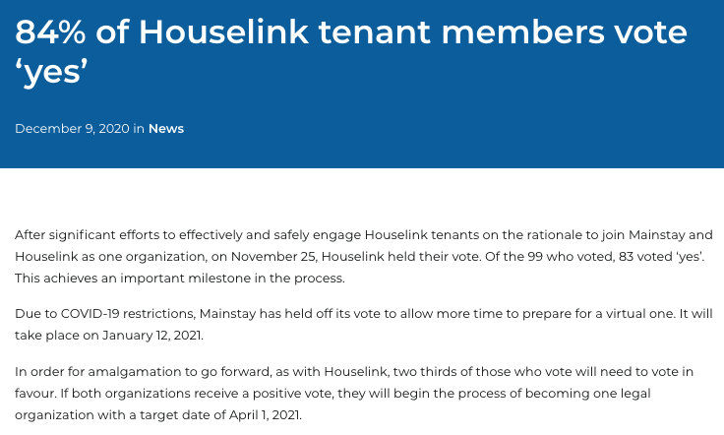
Supportive housing (cont’d)

Slide 29
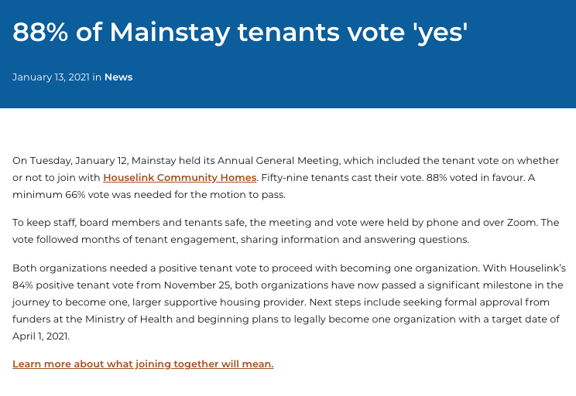
Supportive housing (cont’d)

Slide 30
Supportive housing (cont’d)

Slide 31
Supportive housing (cont’d)
In the early-1980s (and possibly before) City of Toronto officials were concerned about the fact that a large # of persons in their emergency shelters were in fact using them for much more than emergency shelters.
They were staying there indefinitely, and they needed more than just a roof over their heads. They needed some sort of social work support.

Slide 32
Supportive housing (cont’d)
In part due to this phenomenon, Ontario’s provincial government began to fund supportive housing for persons with serious mental health challenges.
Some non-profits became particularly innovative in this respect. Homes First Society (in Toronto) was particularly innovative.

Slide 33
Supportive housing (cont’d)
In 1984, Homes First Society “opened its 90 Shuter Street complex, which was Toronto’s very first government-assisted housing dedicated to homeless single people…”
Similar policy developments were taking place in Ottawa, for the same reasons.
Notes:
Source: http://cprn3.library.carleton.ca/documents/50981_EN.pdf

Slide 34
Supportive housing (cont’d)
But this didn’t all happen in a political vacuum.
Advocacy had a major impact on it.
In Toronto, this included the Singles Displaced Persons Project, the “consumer survivor” movement, the slogan “homes not hostels” and the founding of organizations such as Houselink and Homes First Society.

Slide 35
Supportive housing (cont’d)
In Canada, the Housing First narrative became popular in the early 2000s.
City of Toronto (Iain De Jong in particular) pushed this hard and effectively as it rolled out “Streets to Homes.”
The narrative had been made popular in the US by Sam Tsemberis.
Calgary Homeless Foundation picked it up quickly as well.

Slide 36
Supportive housing (cont’d)
The Housing First narrative placed (and still places) great emphasis on the importance of not requiring housing readiness as a condition of housing receipt.
But many supportive housing providers in Ontario already did not require housing readiness.
Homes First Society, Houselink and Mainstay (all based in Toronto) did not require housing readiness per se.

Slide 37
Supportive housing (cont’d)
Ideologically, Housing First wasn’t exactly left or right. It was ‘third way’ political advocacy and still is.
And largely because of that ‘third way’ approach, it’s found traction among business leaders as well as many more grassroots advocates.

Slide 38
Supportive housing (cont’d)
Because Housing First talked about providing housing with few if any strings attached (re: behaviour) it gained traction among some advocates on the left.
And because it put great emphasis on the need to re-allocate existing resources, it gained traction among many on the right (and business leaders).

Slide 39
Supportive housing (cont’d)
This was further advanced by the At Home/Chez Soi study (a 5-city randomized controlled study).
Participants with moderate needs received Intensive Case Management (ICM), while those with higher levels of need received Assertive Community Treatment (ACT).
Participants were interviewed every 3 months over 2 yrs.
Demonstrated successful outcomes and cost savings.

Slide 40
Supportive housing (cont’d)
Note: 16% of the study participants who received Housing First (i.e., help finding an apt., $ to pay for the apt., & health and social-work support) weren’t able to hang on to an apartment for any significant length of time (in fact, some of them remained homeless the entire time).
Most researchers, advocates and practitioners have been quite silent on this finding’s implications.

Slide 41
Supportive housing (cont’d)
Supportive housing/Housing First remains very popular as a policy response.
For example, the Calgary Homeless Foundation (CHF) is one of North America’s most well-respected homelessness non-profits.
More than ¾ of operating dollars disbursed by CHF to local non-profits annually are on supportive housing (though they tend to use the term Housing First).

Slide 42
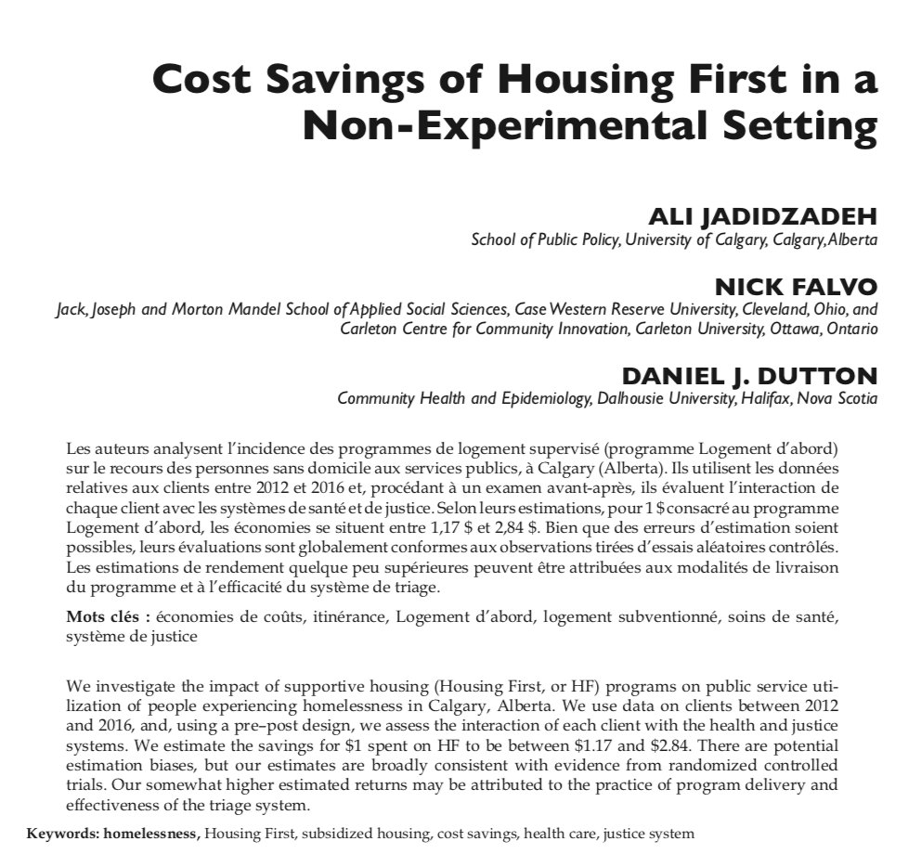
Cost savings

Slide 43
Supportive housing (cont’d)
Canada’s National Housing Strategy, unveiled in 2017, contains no specific provisions for supportive housing.
Yet, the September 2020 Federal Throne Speech includes a commitment to “completely eliminate chronic homelessness.”

Slide 44
Supportive housing (cont’d)
Debates remain on the following question:
Should a non-profit/public entity own the building, or should a for-profit entity own the building?
Should the landlord and support functions be separated (i.e., delivered by different entities)?

Slide 45
Supportive housing (cont’d)
What % of units in a building should be supportive housing units? Should it be 100% or a much smaller percentage?
For how long should social work support be provided? Should it be provided for just a few months or indefinitely?

Slide 46
Supportive housing (cont’d)
Who exactly should be prioritized for new available units and what should the prioritization process look like?
Which order of government should pay for what aspect of new supportive housing units?

Slide 47
Supportive housing (cont’d)
There are in fact many types of supportive housing.
For ex: the frail elderly, youth (including for LGBTQ2S+ youth specifically), Indigenous ppls, and veterans; also, for persons w substance use challenges, developmental disabilities and HIV/AIDS.
Yet, most public policy attention on supportive housing pertains to persons w mental health challenges.

Slide 48
What kind of supportive housing?

Slide 49
Who should own the building?
Many people think it’s important for a public or non-profit entity to own and operate housing, including housing for persons who have experienced long-term homelessness.
They argue that there are long-term cost benefits to owning the asset (especially the land).
Regrettably, there is very little research re: long-term cost benefits of owning supportive housing.

Slide 50
What should tenant demographic look like throughout the building?
Some ppl believe very strongly in scattered site housing (e.g., no more than 15% of units of one building being designated for a specific tenant demographic).
Others believe that very ‘high need’ tenants require 24-hr support (i.e., single-site, or place-based supportive housing).

Slide 51
What should tenant demographic look like throughout the building?
They point to survey research that finds most tenants prefer scattered site (Richter & Hoffmann, 2017).
Aubry et al. (2017) review tenant outcomes (i.e., housing stability and life satisfaction) for both types and find outcomes to be similar.
Notes:
Notes: An overview of the tenant survey work can be found here: https://pubmed.ncbi.nlm.nih.gov/28160182/ And the Aubry et al. (2017) research is Chapter 3 of this book: https://calgaryhomeless.com/content/uploads/Falvo-Review-of-Sylvestre-et-al-27nov2018.pdf. And

Slide 52
Should social work support be separate from the landlord function?
Argument in favour of separation is that, with separate entities serving each function, support function will be stronger (and support workers won’t acquiesce to landlord).

Slide 53
How long should social work support last?
It’s reasonable to suggest tenants with higher needs and longer shelter stays will need more intensive social work supports.
Key question: how much social work is needed for each tenant, and for how many months/years should it last?
Some system-planning organizations are trying to do more with less—e.g., Adaptive Case Management.

Slide 54
How long should social work support last?
The Calgary Homeless Foundation funds permanent place-based supportive housing (highest acuity) $35-$40K per person per year, and that does not include capital cost (i.e. up front costs on building).
This cost also doesn’t include social assistance.

Slide 55
How long should social work support last?
By contrast, Adaptive Case Management would pay $5K per year for some people and get them housed ($2,500 to get them in, including damage deposit and move-in costs + three months of rent supps.

Slide 56
Who pays for what?
Mainstream policy thinking in Canada holds that:
Fed govt should provide substantial support for development costs (i.e., capital costs).
P/Ts should be responsible for social work support.
Outstanding debate: who pays for operating costs?

Slide 57
National Housing Strategy

Slide 58
National Housing Strategy
Released in Nov 2017
Aims to lower chronic homelessness by 50% over 10 yrs.
2020 Federal Throne Speech ups that to a 100% commitment (as noted earlier in today’s presentation).
Notes:
Definition of chronic homelessness used here: ““Chronically homeless refers to individuals, often with disabling conditions (e.g. chronic physical or mental illness, substance abuse problems), who are currently homeless and have been homeless for six months or more in the past year (i.e., have spent more than 180 cumulative nights in a shelter or place not fit for human habitation).”

Slide 59
National Housing Strategy (cont’d)
NHS announced Canada Housing Benefit (CHB) at an estimated cost of $4B over 8 yrs.
50:50 cost share with P/Ts
CHB was supposed to take effect on 1 Apr 2020, yet some P/Ts have still not signed on.
Avg. CHB beneficiary expected to receive $2,500/yr.

Slide 60
National Housing Strategy (cont’d)
Just 5% of new funding under the National Housing Strategy (NHS) has been earmarked towards goal of reducing chronic homelessness.
Further, NHS has no specific provisions for supportive housing.
Notes:
Source for 5% figure: http://www.focus-consult.com/wp-content/uploads/What-will-2019-hold-for-Canada%E2%80%99s-affordable-housing-sector-Revised-.pdf

Slide 61
Reaching Home

Slide 62
Reaching Home
Across Canada, federal funding for homelessness (i.e., Reaching Home) has been rather modest.
According to a 2018 federal report, for each $1 invested federally, $13 is invested by other sources (mostly provincial and municipal dollars).
Notes:
Note: That federal report is titled “Evaluation of the Homelessness Partnering Strategy.” It can be found here: https://www.canada.ca/en/employment-social-development/corporate/reports/evaluations/homelessness-partnering-strategy.html It’s a May 2018 ESDC report.

Slide 63
Reaching Home (cont’d)
Reaching Home is the federal govt’s main vehicle for funding homelessness initiative across the country.
It started in 2000, but has had several name changes since its inception.
Initially, this funding could not be used for permanent housing; eventually, that rule changed.
Notes:
Notes: The Supporting Communities Partnership Initiative (SCPI) was announced in December 1999 and confirmed in the Feb 2000 federal budget. It started in 2000.

Slide 64
Reaching Home (cont’d)
When first announced as the Supporting Communities Partnership Initiative (SCPI), these funds were only eligible to be used for infrastructure investments (but not housing).
Ergo: they were largely invested in expanding shelter capacity (2001-2005).
Notes:
Source: Personal correspondence with Josh Evans (2 Feb 2021).

Slide 65
Reaching Home (cont’d)
The second phase of SCPI focused on supports and were leveraged for the early Housing First pilots.
Shortly after the Harper Government came into power (in 2006) Housing First became much more of an explicit focus of the initiative.
Notes:
Source: Personal correspondence with Josh Evans (2 Feb 2021).

Slide 66
Reaching Home (cont’d)
Today, Reaching Home funds can be used for place-based supportive housing, scattered site supportive housing and transitional housing.
These funds can go towards capital and operating costs (even rental and utility arrears).

Slide 67
Reaching Home (cont’d)
When the program became Reaching Home (under Trudeau) the rules were relaxed, allowing health supports to be funded for the first time (e.g., mental health case managements, addictions counsellors, etc.).
Previously, rules re: health spending were much stricter. Now, much more latitude for health spending.
Yet, Reaching Home still doesn’t like to fund health-related costs that have been consistently funded by provincial/territorial govts (the P/Ts).

Slide 68
Reaching Home (cont’d)
Prior to the COVID-19 pandemic, Reaching Home funding was slated to be $213M/yr for 2020-21, and $237M/yr. for 2021-22.

Slide 69
Reaching Home (cont’d)
The Government of Canada’s COVID-19 Economic Response Plan, announced on 13 March 2020, includes an additional $157.5M in one-time funding for Reaching Home.
This COVID-19 funding enhancement came with much more flexibility than previous Reaching Home funding (e.g., with respect to stipulation about provincial areas of responsibility).

Slide 70
Reaching Home (cont’d)
Further, on 21 Sep 2020, the Government of Canada announced an additional $236.7M for Reaching Home (another one-time enhancement).

Slide 71
Rapid Housing Initiative

Slide 72
Rapid Housing Initiative
On 21 Sep 2020, the Government of Canada announced $1 billion for modular housing, the acquisition of land, and the conversion of existing buildings into affordable housing.
This is called the Rapid Housing Initiative (RHI).

Slide 73
Rapid Housing Initiative (cont’d)
Very fast grant application
Capital costs fully covered.
Desired to make new housing happen quickly.
There may be a RHI 2.0.

Slide 74
Rapid Housing Initiative (cont’d)
Thus far, no operating costs provided.
RHI has been rather restrictive—e.g., new construction must be modular, and acquisition of exiting residential is forbidden.
Also, quick timeline for application created planning challenges for proponents (e.g., re-zoning and public hearings.

Slide 75
Rapid Housing Initiative (cont’d)
RHI was announced publicly, which may have resulted in inflated costs—it’s believed, for example, that some hotel owners decided to charge more for properties because they knew about the RHI.
Further, there does not appear to be a requirement that RHI-units be occupied by tenants who’ve experienced chronic homelessness (or even absolute homelessness).

Slide 76
Closing remarks
Homelessness policy in Canada is shaped in large part by a desire by governments to spend less, which often includes pushing another order of govt to spend.
I think the political climate for public spending in Canada has changed a great deal since 2015, and it continues to change as the current public health pandemic unfolds.

Slide 77
Closing remarks (cont’d)
When searching for solutions, don’t ask: “Why doesn’t government just do what’s right and build housing?” or “Why don’t they just do what’s right and provide everyone with enough income to live on and afford rent?”
Rather, ask: “Why do governments feel so reluctant to invest more in social programs, and how can we work to change that?”

Slide 78
Closing remarks (cont’d)
Part of that process may involve good research and the demonstration of positive outcomes associated with well-designed interventions.
Finally, when debating policy options, try not to be dogmatic. Various approaches have their strengths, even if you don’t see them at first glance. Try to see a variety of policy approaches as complementary approaches, not competing ones.

Slide 79
Thank you

