Slide 1
emerging themes
By Nick Falvo, PhD
Homelessness 101
Prepared for Canadian Housing &
Renewal Association
Apr 25, 2022

Slide 2
Overview
COVID
Aging population
Indigenous peoples

Slide 3
COVID-related developments
Let’s watch Episode 1 from the series “Homeless amid COVID,” based on Edmonton’s experience.
The five-part series is available here: http://homewardtrust.ca/homeless-amid-covid/

Slide 4
COVID-related developments
I’ve written three COVID-related homelessness reports.
Two focus on what has happened, the other on what might happen over the next several years.

Slide 5
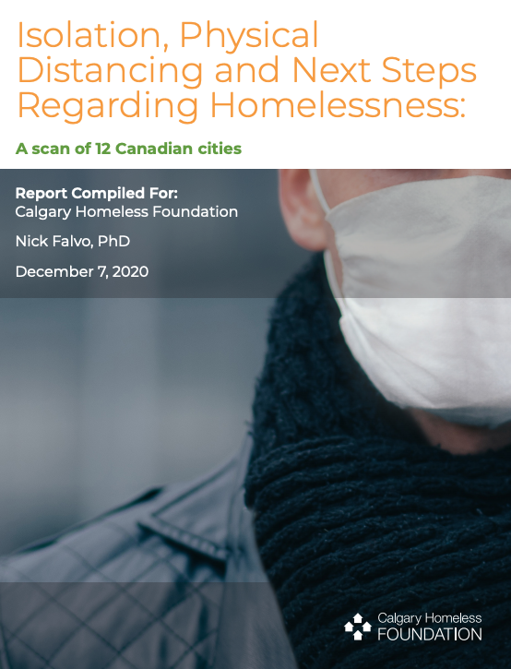

Slide 6
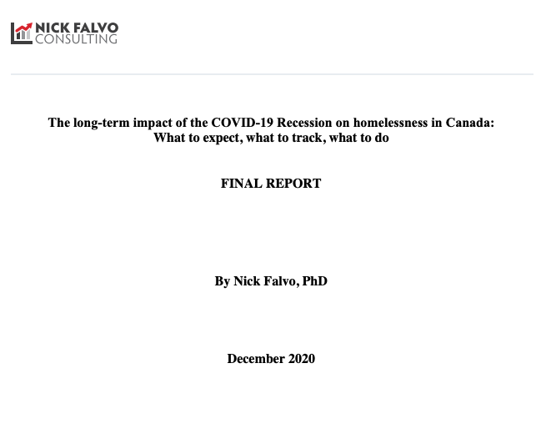

Slide 8
COVID-related developments
What has already happened?
In Canada’s major cities, there’s been increased physical distancing both at existing facilities and in newly-created spaces.
Cooperation with health officials has generally improved, while it’s typically been lacking wrt corrections.

Slide 9
COVID-related developments (cont’d)
Visible outdoor sleeping appears to have increased in many cities (stemming in part from concern over disease transmission) though most cities lack a rigorous method of enumeration of rough sleepers.
This has turned into a thorny political issue, especially in light of fire hazards, complaints from neighbours, and forcible clearings.
Especially prominent during warmer weather.

Slide 10
COVID-related developments (cont’d)
Examples of health care innovations
A larger share of Toronto’s emergency facilities are seeing primary health care—i.e., service provision by family physicians and nurses—provided on site.
Some Toronto shelters are also seeing pharmacists keep regular hours on site.

Slide 11
COVID-related developments (cont’d)
Examples of health care innovations (cont’d)
Some Calgary shelters have seen a substantial increase in the use of licensed practical nurses and paramedics on site.
Some of this funding has been quite substantial. Total nursing positions at the Calgary Drop-In have increased from 2.0 FTEs to 17.0 FTEs during the pandemic.

Slide 12
COVID-related developments (cont’d)
Examples of health care innovations (cont’d)
Nurses in shelters have provided wound care, medication administration, overdose responses and other health-related assessments.
Prior to these enhancements, such nursing services were typically provided ‘off site’ by both community healthcare providers and hospital emergency departments.

Slide 13
COVID-related developments (cont’d)
Examples of health care innovations (cont’d)
In Ottawa, supervised consumption services and a safe supply of cannabis are both offered at an isolation site designated for persons experiencing homelessness.
Finally, territorial officials in Yellowknife have distribute alcohol at the city’s isolation centre for persons experiencing homelessness.

Slide 14
COVID-related developments (cont’d)
A technological innovation worthy of attention is the City of Ottawa’s new GIS mapping system, used to both identify encampments and keep case notes pertaining to encampment residents (in order to provide better services).

Slide 15
COVID-related developments (cont’d)
In spite of so much great work, vaccination rates for persons experiencing homelessness are much lower than for the rest of the population.
That was the finding of an Ontario study, using data from Sep 2021 (see next slide).

Slide 16
COVID-related developments (cont’d)
Notes:
Source: https://www.thelancet.com/action/showPdf?pii=S2468-2667%2822%2900037-8

Slide 17
COVID-related developments
What might happen over the next few years?
Unemployment isn’t good for homelessness, but well-targeted social spending and soft rental markets can help prevent it.
So we need to monitor various indicators and plan prevention efforts.

Slide 18
Aging population
Every OECD country has an aging population—a trend not expected to taper off until at least 2040.
Four main factors are behind this: 1) the Baby Boom; 2) the Baby Boom Echo (i.e., children of Baby Boomers); 3) low fertility rates in OECD countries; and 4) people in OECD countries living longer.

Slide 19
Aging population (cont’d)
Health care spending for seniors is higher than for other age groups, as older people have more chronic health conditions (both physical and mental health conditions).
Higher health care spending on seniors makes this age group a high priority for provincial and territorial governments.

Slide 20
Aging population (cont’d)
Use of emergency shelters by older people is on the rise across Canada, including in Calgary.
In Calgary’s homeless shelter system, adults aged 55 and over accounted for just 9% of all bed spaces in 2008; by 2017, this figure had risen to 19% (these figures apply to singles without dependants).

Slide 21
Aging population (cont’d)
Across Canada, seniors stay in homeless shelters longer than any other age group.
Recently-published research by Ali Jadidzadeh and Nick Falvo found that tenants in CHF-funded Housing First programs have lower graduation rates than other age groups.

Slide 22
National Shelter Study
Notes:
Source: https://www.canada.ca/en/employment-social-development/programs/homelessness/reports-shelter-2016.html#h6

Slide 23
Indigenous peoples
Greater prominence
Rising rates of PSE participation
Part of this is because PSE institutions are offering more access opportunities (financial aid).

Slide 24
Indigenous peoples (cont’d)
Federal acceptance of UNDRIP.
This has implications for policy-making in Canada, treaty interpretation in particular.
There are hundreds of unresolved land claims in Canada.

Slide 25
Indigenous peoples (cont’d)
Notes:
Source: https://www150.statcan.gc.ca/n1/daily-quotidien/171025/cg-a001-eng.htm

Slide 26
ESDC analysis of shelter data
The Canadian Press recently gained access to results of analysis of the use of homeless shelters across Canada by Indigenous peoples.
The results are summarized in a March 2019 slide presentation obtained through an Access to Information and Privacy (ATIP) request.

Slide 27
ESDC analysis of shelter data (cont’d)
Indigenous shelter users experience more shelter stays each year, and are less likely to exit a shelter because of finding a residence.
Indigenous peoples (compared with non-Indigenous peoples) tend to cycle in and out of shelters with high frequency, rather than stay for long periods of time.

Slide 28
ESDC analysis of shelter data (cont’d)
The analysis finds that, while Indigenous men are more than 10X more likely to use a homeless shelter over the course of a year than non-Indigenous men, Indigenous women are more than 15X more likely to use a homeless shelter than non-Indigenous women over the course of a year.

Slide 29
Thank you
What’s on your mind?

