Slide 1
harm reduction
By Nick Falvo, PhD
Homelessness 101
Prepared for Canadian Housing & Renewal Association
Apr 25, 2022

Slide 2
Overview
Definition
Trauma
Emergency shelters
Evidence
Supervised consumption
BC Housing
Overdose crisis

Slide 3
Definition
Harm reduction focuses on reducing harm caused by drug use without requiring total abstinence.
Harm reduction approaches include the distribution of condoms, clean syringes and safe inhalation kits.

Slide 4
Question
Why do people use illicit substances?

Slide 5
Trauma
Traumatic events are an important factor leading people to use drugs.
A 2015 Winnipeg study among persons experiencing homelessness asked what factors made them more likely to be a person who uses drugs (PWUD).

Slide 6
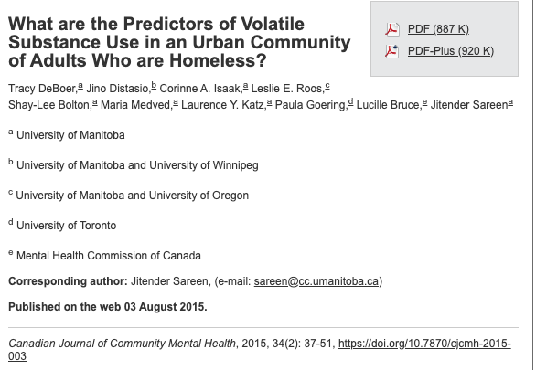
Trauma (cont’d)

Slide 7
Trauma (cont’d)
Traumatic events, especially residential school history, were found to be one of the most important factors.
Other factors identified in the study as leading a person to use drugs included mental and physical health problems (i.e., people self-medicate).

Slide 8
Shelters
Historically, it’s been challenging for staff in emergency shelters to properly engage with people who use drugs, largely because on-site use of illicit substances is prohibited.
To put it bluntly, staff have often given out supplies but forbid the on-site use of drugs.

Slide 9
Shelters (cont’d)
A 2018 study, by University of Victoria researchers found it’s very challenging for staff in emergency shelters to properly engage with PWUD, since on-site use of illicit substances is typically prohibited.

Slide 10
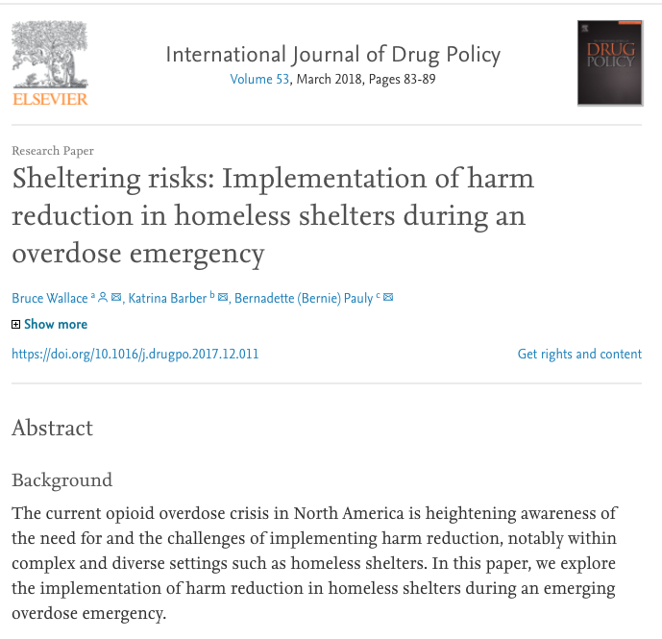
Shelters (cont’d)

Slide 11
Shelters (cont’d)
Shelter washrooms can therefore become “de facto unsupervised consumption sites” (p. 87).

Slide 12
Evidence
There is solid evidence supporting the view that harm reduction approaches: reduce risk-taking behaviour; reduce the risk of transmission of blood-borne diseases; prevent overdoses; reduce crime; and increase contact with other supports (including healthcare supports).
Notes:
Source: https://www.homelesshub.ca/resource/housing-and-harm-reduction-what-role-harm-reduction-addressing-homelessness

Slide 13
Supervised consumption services
Supervised consumption services are one form of harm reduction.
“Supervised consumption services (SCS) consist of providing a safe, hygienic environment in which people can use drugs with sterile equipment under the supervision of trained staff or volunteers.”
Notes:
Source: http://www.aidslaw.ca/site/overdue-for-a-change-full-report/?lang=en Quote is from p. 2.

Slide 14
Supervised consumption services (cont’d)
As of February 2019, 28 supervised consumption services sites were operating under an exemption from Canada’s federal government.
Supervised consumption services have proven to be very effective in Alberta. During 2018 alone, Calgary’s supervised consumption site saw nearly 52,000 visits, resulting in more than 700 overdose reversals.
Notes:
Source: https://open.alberta.ca/dataset/f4b74c38-88cb-41ed-aa6f-32db93c7c391/resource/be32cc97-4424-4933-b253-5fee0dd573bb/download/opioid-q4-infographic-2019-03-18.pdf

Slide 15
BC Housing
BC Housing tries to have some supervised consumption services in all of its supportive housing.
Staff do not directly supervise the use of illicit substances.
However, the use often takes place near the staffing area, and there are cameras in common areas.

Slide 16
BC Housing (cont’d)
Staff are aware who’s gone into a space to use.
Staff are around and aware when someone’s gone into a room to use; staff are on site 24-7.
If they haven’t come out of the room in 10 min’s, they’ll get checked on by staff.

Slide 17
BC Housing (cont’d)
Also, in response to the opioid crisis, in all BC Housing funded supportive housing bldgs with 24/7 staffing, the staff are now required to implement regular health and wellness checks of residents.
This includes the requirement to conduct unit checks when a resident has not been seen or heard from for at least 48 hours. This policy is now included in the operating agreements, making wellness checks a contractual obligation.

Slide 18
Overdose crisis (cont’d)
Notes:
Source: https://health-infobase.canada.ca/substance-related-harms/opioids-stimulants/maps

Slide 19
Overdose crisis (cont’d)
Notes:
Source: https://health-infobase.canada.ca/substance-related-harms/opioids-stimulants/maps

Slide 20
Thank you
We’ve covered a lot of ground here.
What’s on your mind?

