Slide 1
health conditions and health care
By Nick Falvo, PhD
Homelessness 101
Prepared for Canadian Housing &
Renewal Association
Apr 25, 2022

Slide 2
Overview
AV material
The Street Health Report 2007

Slide 3
Street Health Stories
http://www.nfb.ca/film/street_health_stories/
9 min’s

Slide 5
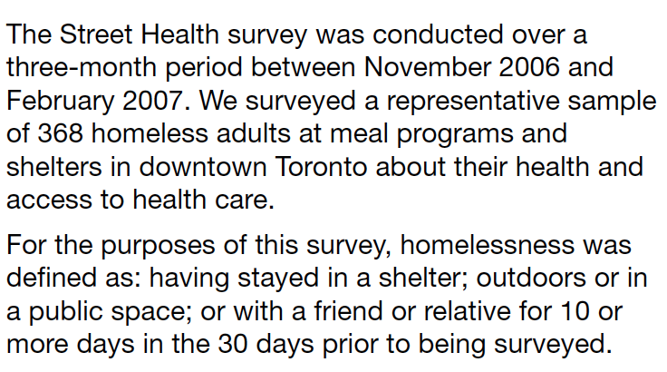
The Street Health Report

Slide 6
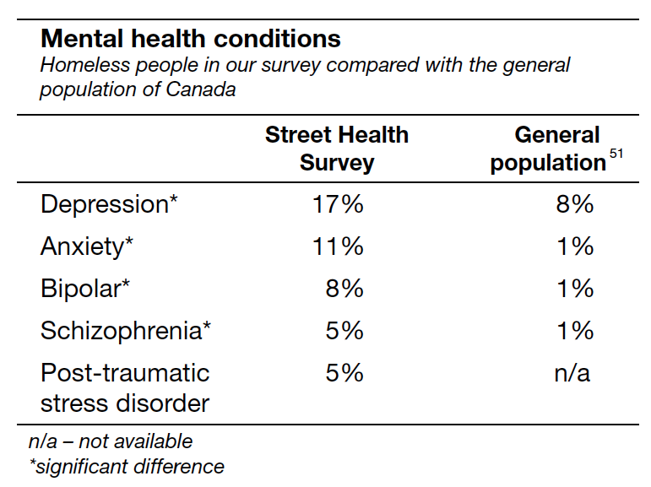
Mental health

Slide 7
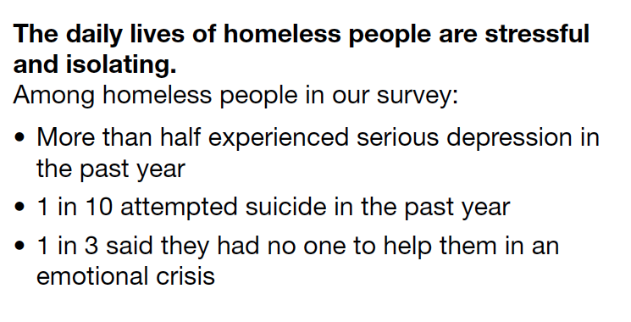
Mental health (cont’d)

Slide 8
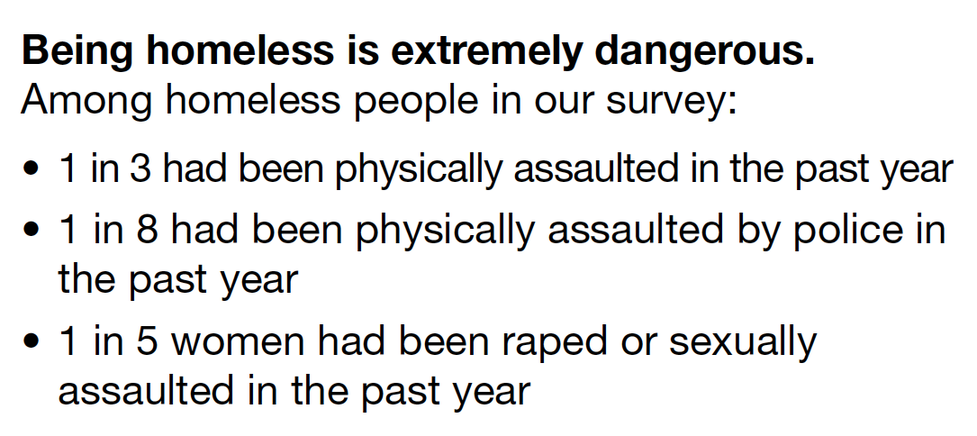
Victimization

Slide 9
Compared w general pop.

Slide 10
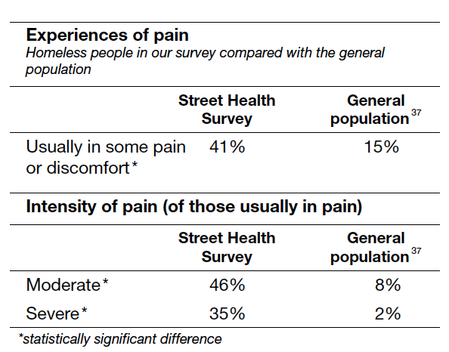
Pain

Slide 11
Thank you
What’s on your mind?

