Slide 1
innovative practices
By Nick Falvo, PhD
Homelessness 101
Prepared for Canadian Housing &
Renewal Association
Apr 25, 2022

Slide 2
Overview
We’re now going to talk about four innovative practices in homelessness, happening right now in Canada.
My intention is not to make you love them; but nor is it to make you hate them.
Rather, it is to bring you some information to which you may not have previously had access.

Slide 3
Overview (cont’d)
Modular supportive housing
Removal of rent cap in NWT
Housing-focused shelters
Artificial Intelligence
Adaptive Case Management
STARS

Slide 4
Modular supportive housing
Definition:
Modular housing is housing that is partially built in a plant, shipped to a development site, and placed on a foundation where the roof structure and exterior finishes are completed.

Slide 5
Modular supportive housing (cont’d)
This innovation getting quite popular in Canada (including with the recent Rapid Housing Initiative).
Very low vacancy rates in Vancouver, and high rents. Landlords getting very choosy.
Cost is similar to traditional way. The speed is the difference.

Slide 6
Modular supportive housing (cont’d)
This can happen in 18 months, from the time funding is approved.
Typically built somewhere else and then transported on flatbed trucks. Cranes lifts them.
Built in a factory. There’s one factory on Vancouver Island, and one in Edmonton.

Slide 7
Modular supportive housing (cont’d)
In BC, a small % of it is repurposed modular. Most is new.
Typically 325 sq ft per unit. Focus in BC has been on singles and couples.
Washroom and small kitchen.

Slide 8
Modular supportive housing (cont’d)
BC’s involve a common area and commercial kitchen, with a common meal (and continental breakfast) per day.
BC’s are all staffed 24-7.
No housing readiness requirement in BC.

Slide 9
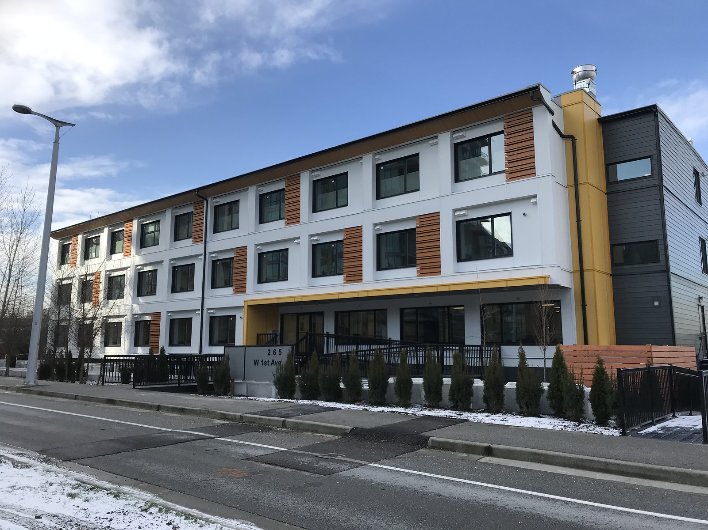
Modular supportive housing (cont’d)
Notes:
Source: BC Housing. URL: https://www.flickr.com/photos/bc_housing/

Slide 10
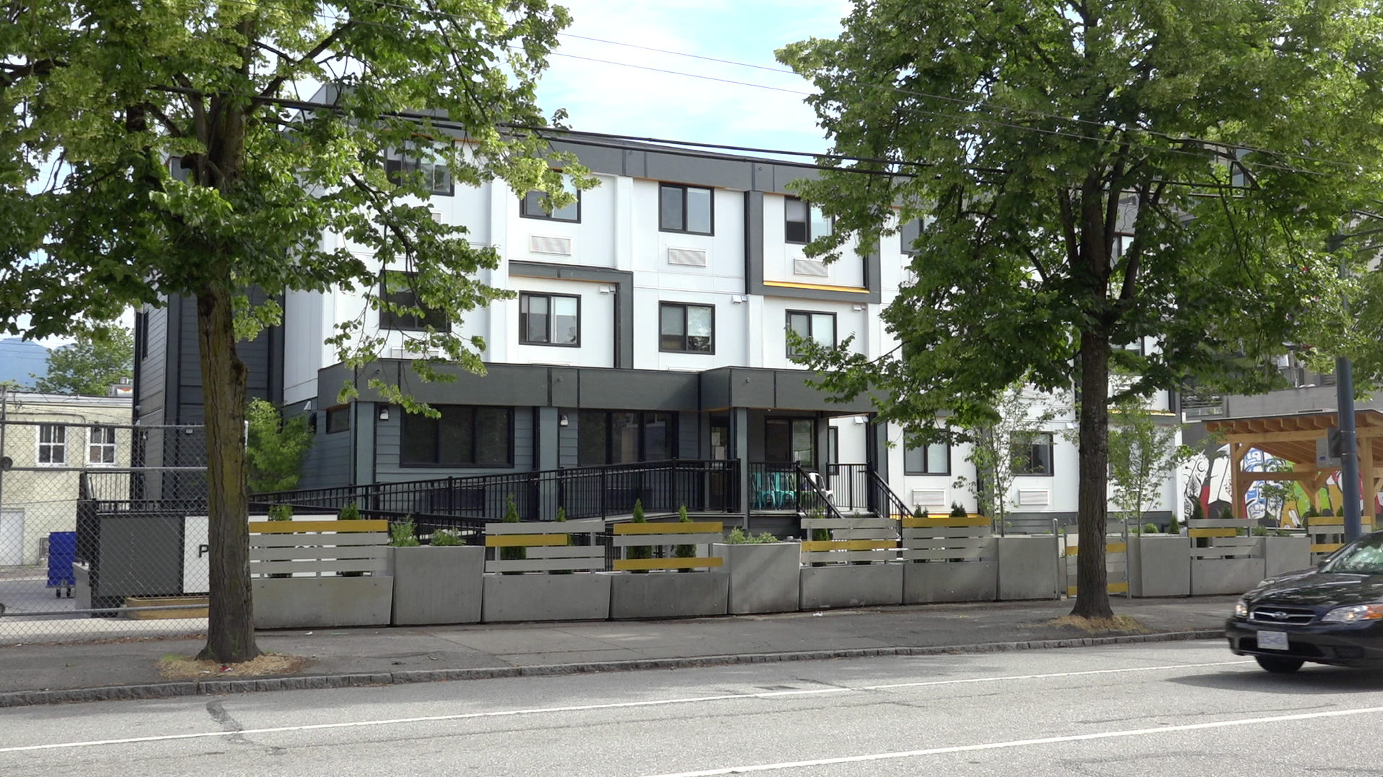
Modular supportive housing (cont’d)
Notes:
Source: BC Housing. URL: https://www.flickr.com/photos/bc_housing/

Slide 11
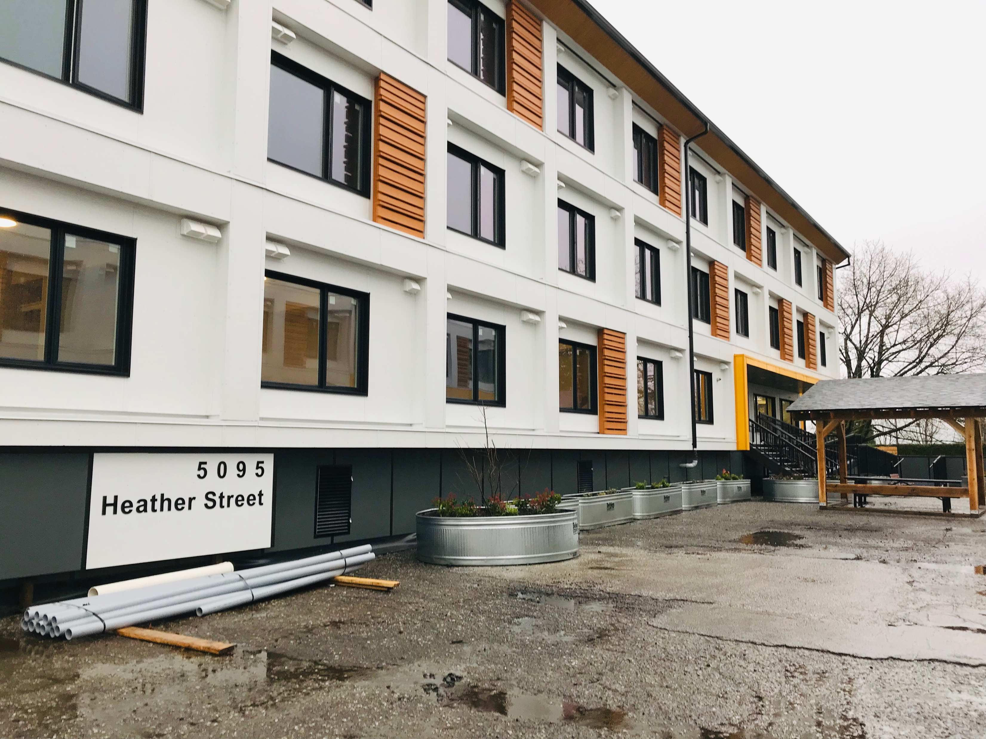
Modular supportive housing (cont’d)
Notes:
Source: BC Housing. URL: https://www.flickr.com/photos/bc_housing/

Slide 12
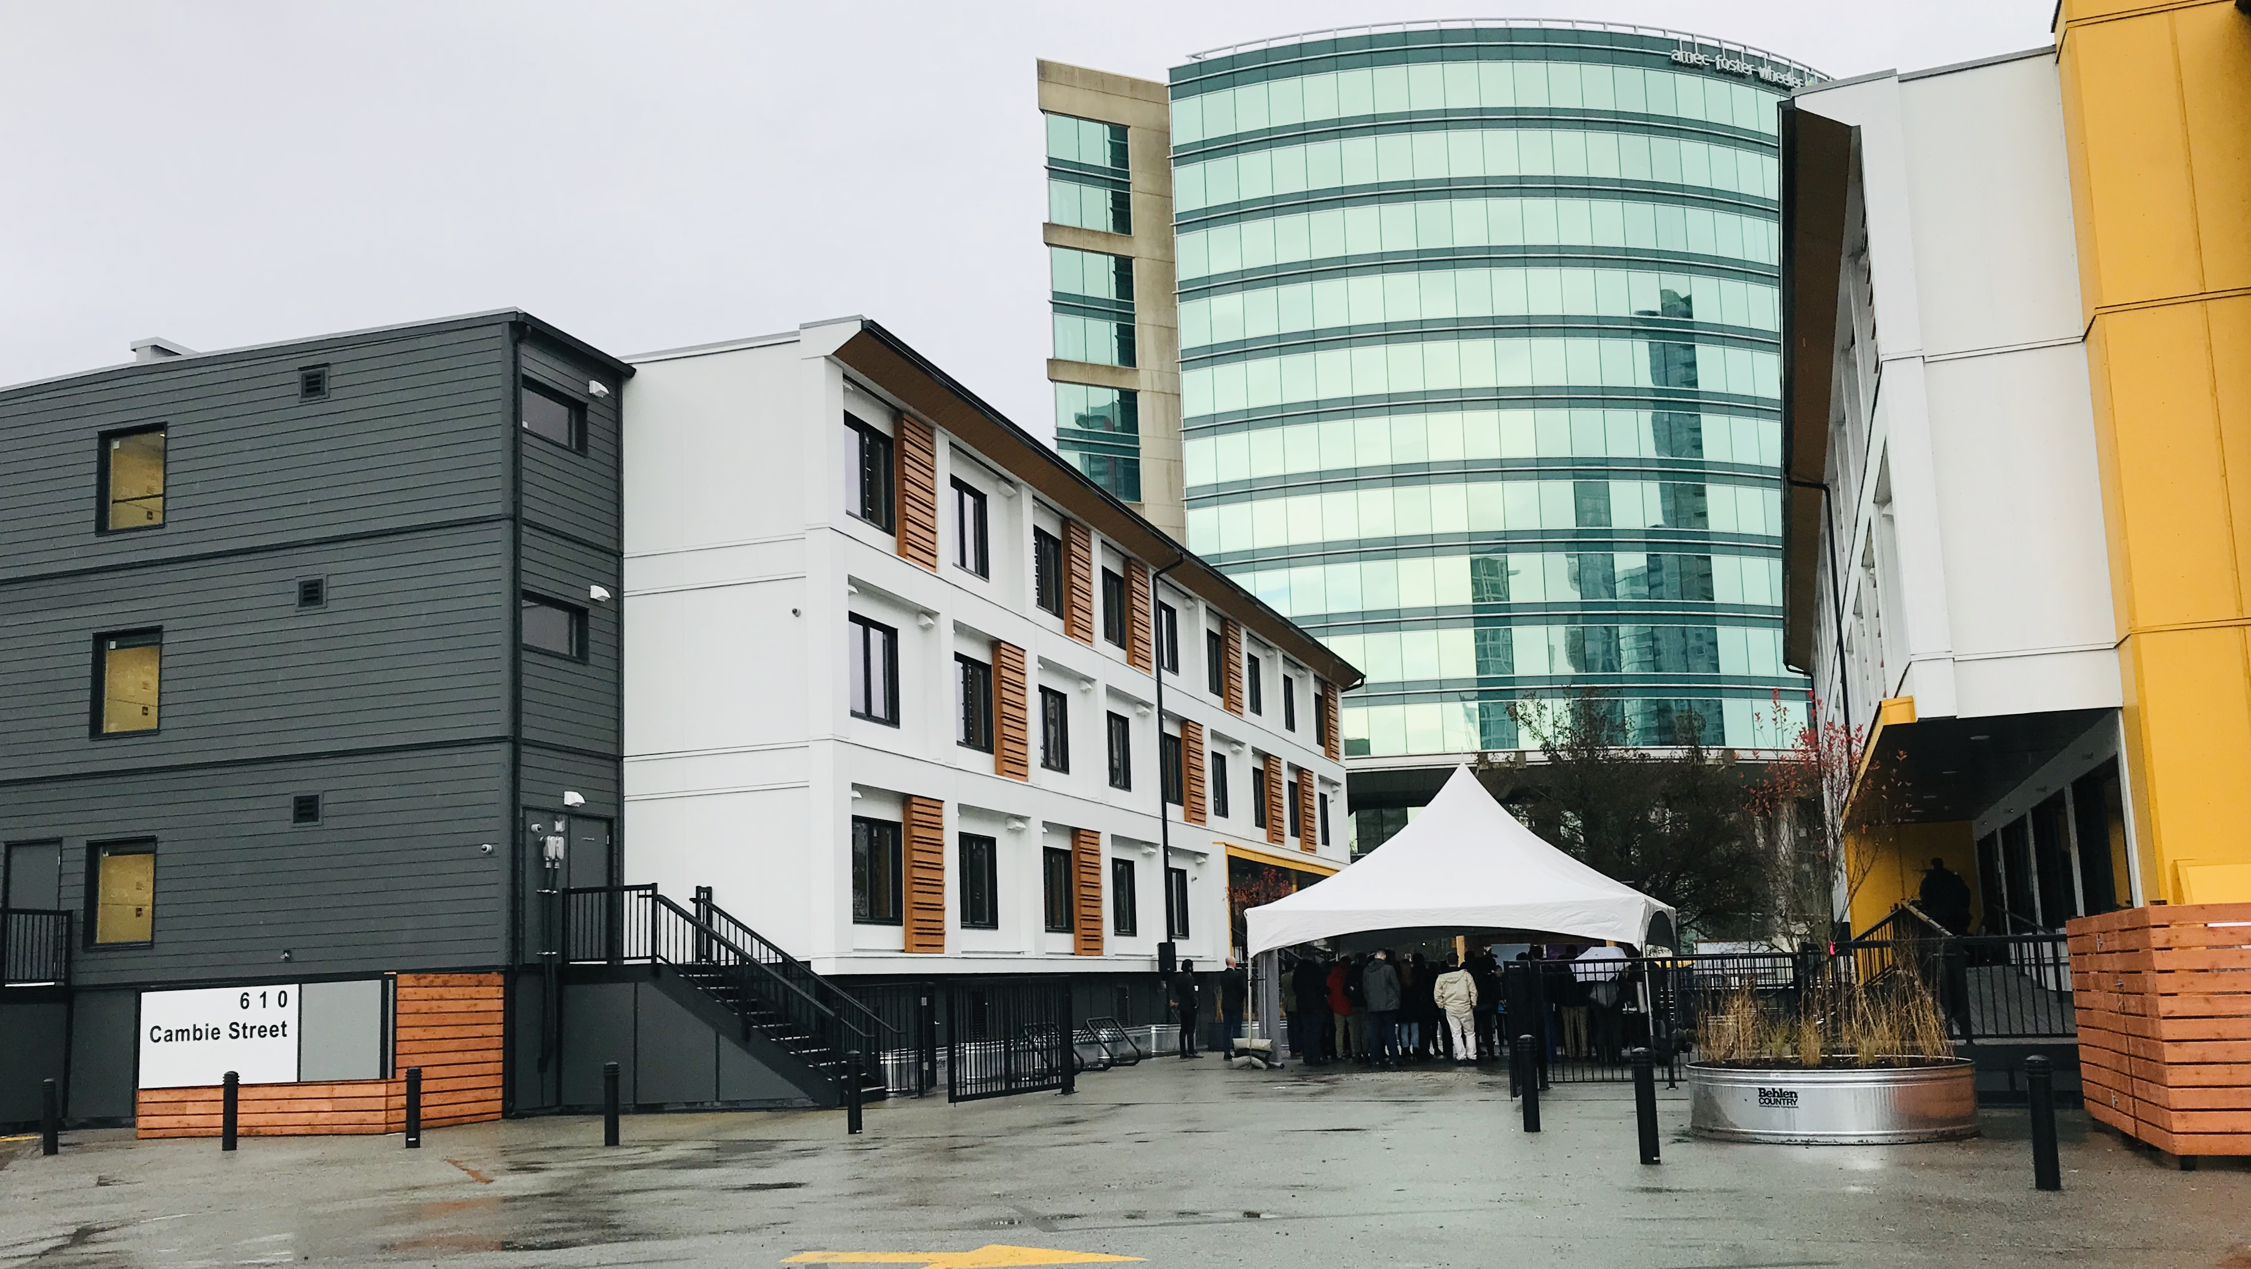
Modular supportive housing (cont’d)
Notes:
Source: BC Housing. URL: https://www.flickr.com/photos/bc_housing/

Slide 13
Modular supportive housing (cont’d)
Modular supportive housing is also gaining popularity in Toronto.
They currently have two sites operating, with five more planned.
All of Toronto’s units so far are for singles.

Slide 14
Modular supportive housing (cont’d)
With all of the Toronto units created so far, the City received Ministerial Zoning Orders (essentially a fast-tracking of zoning approvals).
The pandemic made that easier.
These orders cannot be appealed.

Slide 15
Modular supportive housing (cont’d)
The City has worked with NRB Modular Solutions, which has one factory in Grimsby and one in Cambridge.
City staff were able to bring Mayor Tory and senior city staff to the factories.
There’s a lot of pressure on these factories right now, at least in Ontario.

Slide 16
Modular supportive housing (cont’d)
One key advantage that Toronto has found is that the planning approvals can be received as the housing is being built.
Ordinarily, you’d have to get the approvals for the site before the construction begins.
You can’t start doing the construction on site until all approvals are in place.

Slide 17
Modular supportive housing (cont’d)
Another key advantage: less disruptive to community in terms of construction.

Slide 18
Modular supportive housing (cont’d)
Operating cost for one emergency shelter bed in Toronto
Pre-pandemic: $3K/month
During pandemic: $6K/month
Operating cost for one unit of modular supportive housing in Toronto
$2K/month [includes cost of wraparound supports]

Slide 19
Modular supportive housing (cont’d)
The City of Edmonton has developed 210 units of modular supportive housing.
Five sites total, 30-54 units per building.
These buildings are between 4 and 5 stories high.
Expected completion date: April 2022.

Slide 20
Modular supportive housing (cont’d)
All 210 of Edmonton’s units are geared toward people experiencing long-term homelessness.
City developed them with RHI funding (as well as some City and GoA funding as well).
Homeward Trust Edmonton helped with neighbourhood engagement.
Homeward Trust will: own the units; RFP the support services; find the tenants (via Coordinated Access).

Slide 21
Modular supportive housing (cont’d)
There were internal discussions in Edmonton as to whether each building required its own commercial kitchen (which comes at a cost).
They decided to have one commercial kitchen for the one building with the highest level of acuity.

Slide 22
Modular supportive housing (cont’d)
We’ve covered a lot of ground here.
Any initial reactions?

Slide 23
Modular supportive housing (cont’d)
I’ve thrown a lot at you.
What’s on your mind?

Slide 24
Removal of the rent cap in NWT
This innovation was led by a territorial government.
In April 2018, the ‘rent cap’ for single social assistance recipients without dependants was removed.
Previously, this group (but not other household types) had been allocated a maximum of $900 per month for rent from social assistance funds, making it very difficult to find rental housing.

Slide 25
Removal of the rent cap in NWT (cont’d)
But now, each social assistance recipient household is provided with a rental allowance large enough to secure a housing unit that meets nationally-accepted suitability standards.
(Specifically, the standards in question are the National Occupancy Standards determined by the Canada Mortgage and Housing Corporation.)

Slide 26
Removal of the rent cap in NWT (cont’d)
Amount is based on CMHC’s calculation for average national rent is for bedroom type in question, plus 20%.
Now, it is not unheard of for a single employable social assistance recipient without dependants to have the rent for a $1,500/month one-bedroom housing unit fully covered by the rental portion of their social assistance benefits.

Slide 27
Removal of the rent cap in NWT (cont’d)
No diagnosed disability is required.
No time limit. As long as they remain eligible for social assistance, they get the rental allowance.
This has been very positively received by many people in community (notwithstanding the fact that for-profit landlords still generally prefer to rent to tenants who are employed).

Slide 28
Removal of the rent cap in NWT (cont’d)
Thoughts?

Slide 29
Housing-focused shelters
This innovation is being led by an emergency shelter.
Over the past several years, Calgary has high rental vacancy rates, relative to other cities.

Slide 30
Housing-focused shelters (cont’d)
Prior to 2017, overnight accommodation was provided to new clients on the spot, with very few questions asked.
Many residents were never engaged with or assessed for housing.
It was also common for longer-term clients to receive preferential access to shelter beds.

Slide 31
Housing-focused shelters (cont’d)
Now, staff track each person’s path quite closely.
Most gain physical access, but they’re assigned a housing worker immediately.
A housing plan is put in place within a day.

Slide 32
Housing-focused shelters (cont’d)
DI has announced itself as a housing-focused organization.
They are now neurotically focused on housing.
Staff have lanyards.

Slide 33
Housing-focused shelters (cont’d)
Staff on a regular basis are striking up conversations with residents about where they’re at with housing searches.
Each staff has a lanyard and frequently gets a new one, with new tips on how to communicate with residents on this.

Slide 34
Housing-focused shelters (cont’d)
Direct quote:
“Anything comfortable that was making people want to stay in shelter, we shut it down. We stopped doing any and all activities not related to housing. We called this positive disruption. This was not easy internally. Culture change and change management is fundamental to this. We shut off the TVs, closed down the library. Now we call the library a housing hub. We took out all the books. We used to get 1,200 people ON each night, now it’s 700.”

Slide 35
Housing-focused shelters (cont’d)
That’s a lot of information to absorb.
What are you thinking?

Slide 36
Artificial Intelligence
This innovation is being led by university-based researchers.
Recall our earlier conversation re: uncertainty on how to respond to each type of homelessness.

Slide 37
Artificial Intelligence (cont’d)
Artificial Intelligence (AI) is a type of computing that either simulates behaviour or performs tasks traditionally assigned to humans, with the purpose of completing such tasks more efficiently or accurately.

Slide 38
Artificial Intelligence (cont’d)
It allows computers to perform human tasks.
It can be used to provide advice or guidance.
AI can provide the probability of a certain approach to homelessness having a successful outcome, based on the past experiences of thousands or tens of thousands of similar people having been in similar situations in the past.

Slide 39
Artificial Intelligence (cont’d)
In the homelessness sector, all examples of AI are in the research stage for now.
Computer scientists are typically involved in this.
Recommendations for person’s care are made based on past successes (based on what worked with other people with similar characteristics).

Slide 40
Artificial Intelligence (cont’d)
Person could never do the math that quickly.
Also, some persons don’t reason very well, and have cognitive biases.
There’s a very good book on cognitive biases called “Thinking, Fast and Slow” (Daniel Kahneman). It’s a 2012 book.

Slide 41
Artificial Intelligence (cont’d)
Dr. Geoff Messier (U of Calgary) mines databases at the Calgary Drop-In for key words and look for trends.
He’s been processing some raw data in the hope of developing tools to spot clients who might not be getting noticed by staff.

Slide 42
Artificial Intelligence (cont’d)
This database includes data on approx. 40,000 different clients over the past 20 years.
Over 5.6 million entries.
He’s looking for patterns, based on historical data.

Slide 43
Artificial Intelligence (cont’d)
Dr. Messier wants to identify the small minority who will end up being chronic shelters users.
Maybe they’ll find that an EMS call in a resident’s first seven days is correlated with chronic homelessness.
Maybe if a resident is barred within the first two weeks, they’re likely to become chronically homeless.

Slide 44
Artificial Intelligence (cont’d)
Official definitions of homelessness often require a person staying in a shelter more than 100 days before they can be prioritized for funding.
But he’s asking if there are events happening sooner that are correlated with eventual chronicity.

Slide 45
Artificial Intelligence (cont’d)
Ideally, on a Monday morning, we’d say to staff: “Hey, here are six people who’ve experienced X in the past few weeks and we predict they’ll become chronically homeless.”
The decision would not be automated.
Dr. Messier is clear that staff should use AI to complement staff decision-making, not replace it.

Slide 46
Artificial Intelligence (cont’d)
That’s a lot of info to absorb.
What are your thoughts?

Slide 47
Adaptive Case Management
This innovation, introduced in 2015, is being led by the Calgary Homeless Foundation (CHF).
CHF funds agencies to support clients experiencing homelessness and get them into housing quickly.
ACM is just for families (i.e., households with at least one dependant under age 18).

Slide 48
Adaptive Case Management (cont’d)
It’s an alternative to Intensive Case Management (ICM).
Key question CHF was asking: are you sure you need to take this much time with in providing case management for families?
One desired outcome of ACM: don’t over-support families. Focus on getting them into housing and only support as necessary.

Slide 49
Adaptive Case Management (cont’d)
With ICM, non-profit gets between $17K/yr. and $18K/yr. in advance, per family (to cover case management and financial assistance for household, once housed).
With ICM, non-profit does not receive an additional amount once family is housed. Money flows to non-profit with or without housing placement.

Slide 50
Adaptive Case Management (cont’d)
ACM provides $2,500 to the non-profit for damage deposit. This $ is only received after the family is housed.
With ACM, CHF also provides $715/month to non-profit once family is housed for rent and incidentals. But that amount too only goes to non-profit after family is housed.
With ACM, CHF provides non-profit with $40/hr. for case management, even if there isn’t a housing placement.

Slide 51
Adaptive Case Management (cont’d)
Calgary has seen considerable success in housing families via ACM.
Compared with ICM, families in ACM get housed a bit more quickly.
Also, families housed in ACM remain housed for about as long as those housed via ICM.

Slide 52
Adaptive Case Management (cont’d)
ACM targets any acuity level of families.
Acuity levels of families are comparable between ACM vs. ICM.
ACM uses scattered site approach.

Slide 53
Adaptive Case Management
Lots of info has just been presented.
What’s on your mind?

Slide 54
STARS
The City of Toronto has heard a considerable amount of criticism from its stakeholders about existing common assessment tools.
Stakeholders weren’t digging the idea of a one-time assessment assigning a person a score that would then provide worthwhile information about a referral to housing and other supports.

Slide 55
STARS (cont’d)
Also, many argue that SPDAT and VAT don’t capture the distinct vulnerabilities of racialized persons and women.
Wilkey, Catriona et al. October 2019. Coordinated Entry Systems Racial Equity Analysis of Assessment Data. https://assets.documentcloud.org/documents/6469681/CES-Racial-Equity-Analysis-Oct112019.pdf
Cronley, Courtney. 2020. "Invisible intersectionality in measuring vulnerability among individuals experiencing homelessness – critically appraising the VI-SPDAT." Journal of Social Distress and Homelessness, DOI: 10.1080/10530789.2020.1852502
Pathways PtH Housing First, Inc. and The Centre for Research on Educational and Community Services (CRECS), University Of Ottawa Final Report of the Vulnerability Assessment Tool (VAT) Evaluation: Narrative Summary of Quantitative Results and Qualitative Findings. January 2017. Prepared For BC Housing. https://homelesshub.ca/sites/default/files/Pathways_VAT.pdf

Slide 56
STARS (cont’d)
So the City started to develop its own tool back in 2015.
They City has since developed Service Triage, Assessment and Referral Support (STARS).
The goal is to (eventually) have it fully integrated into the City’s Shelter Management Information System.
STARS has three components to it.

Slide 57
STARS (cont’d)
Component #1: Intake and triage.
The person’s basic demographic info goes into the database system.
This happens once a person agrees to be helped and agrees to start providing such info.

Slide 58
STARS (cont’d)
Component #2: Housing Assessment.
This starts within seven days of intake into shelter, as stipulated in the City of Toronto’s Shelter Standards.
This does take some time to complete though, in light of requirements for ID and the person’s CRA Notice of Assessment for the most recent tax year.

Slide 59
STARS (cont’d)
Component #3: Comprehensive Assessment.
This component is still in development.
This would cover supports related to mental health, substance use, physical health and employment.
Person will also get asked what kinds of supports they’re already getting in these respects.

Slide 60
STARS (cont’d)
STARS is more qualitative than quantitative.
It does not focus on prioritization or ranking.
So how does the local Coordinated Access system function?

Slide 61
STARS (cont’d)
City’s Coordinated Access system has no formal wait list.
Prioritization (still in development) depends in part on which persons have been using the most shelter beds for an extended period. Database automatically calculates chronicity based on the Reaching Home definition.
Exceptions get made to such prioritization, including for youth and for Indigenous persons (the latter tend to experience more episodic homelessness).

Slide 62
STARS (cont’d)
With the City’s Coordinated Access system, there is a rotating system whereby one City-funded organization will be approached at once, often with 1-2 housing units available at once.
City gives the organization a ‘short list’ from their data, and asks the organization to work with the City on the referrals. Organization might dispute the list, and provide alternative persons.

Slide 63
STARS (cont’d)
What do you think of STARS at this point?

Slide 64
Thank you
We’ve covered a lot of ground.
What’s on your mind?

