Slide 1
staffing
By Nick Falvo, PhD
Homelessness 101
Prepared for Canadian Housing &
Renewal Association
Apr 25, 2022

Slide 2
Overview
Waegemakers Schiff and Lane, 2019
Advice from Brandy Payne

Slide 3
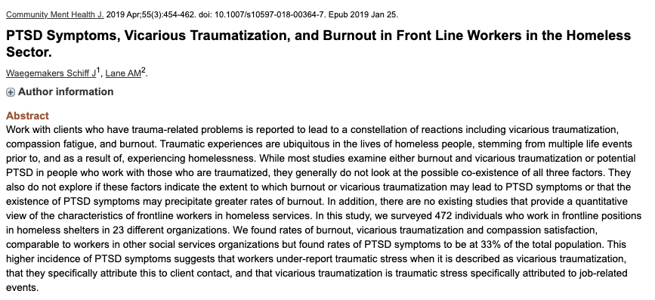
Waegemakers Schiff and Lane, 2019

Slide 4
Waegemakers Schiff and Lane, 2019 (cont’d)
Researchers conducted surveys with 472 frontline workers in homelessness serving sector.
Across 23 organizations in Calgary and Edmonton.
Study found higher rates of PTSD than among other human-services workers (including higher than police, paramedic and ER nurses).

Slide 5
Possible factors
Considerable # of staff with lived experience (meaning that events can be triggering).
“Porous personalities”
Lots of time with the same client (day after day).

Slide 6
Possible factors (cont’d)
Staff working multiple jobs (and long hours).
Inadequate work-leisure balance (e.g., weekend and vacation time).
Feeling helpless (in part due to insufficient housing).

Slide 7
So…what can be done to addressed this?

Slide 8
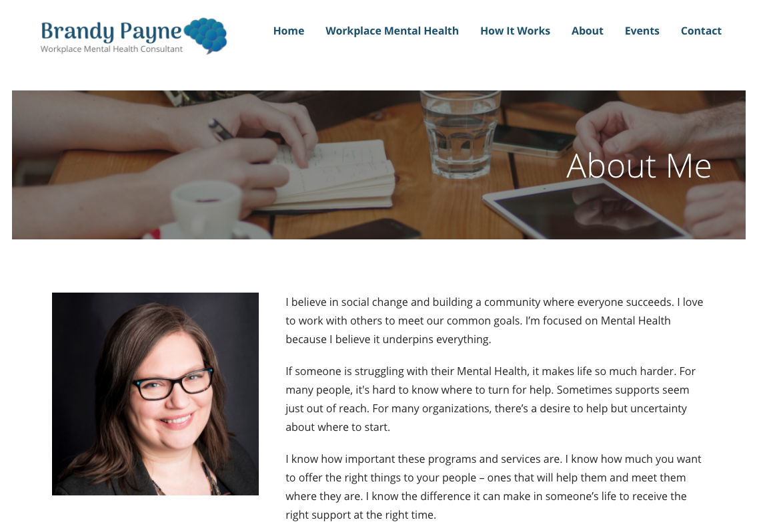
Brandy Payne, Workplace Mental Health Consultant

Slide 9
Brandy Payne, Workplace Mental Health Consultant (cont’d)
1. Talk about it.
Talk about the fact that trauma in this sector is the norm, not the exception (and that it needs the right kind of support).
Talk about the research.

Slide 10
Brandy Payne, Workplace Mental Health Consultant (cont’d)
Normalize it.
And normalize the fact that prevention and support is essential.
Talk about it like the risk of physical injury in professional sports.

Slide 11
Brandy Payne, Workplace Mental Health Consultant (cont’d)
2. Create awareness of existing supports
Does your organization have extended benefits plans (including psychological supports and Employee Assistance Programs)?

Slide 12
Brandy Payne, Workplace Mental Health Consultant (cont’d)
Does your organization have Sick Days, Personal Days, Return to work policies for short-term or long-term disability.
Does your organization have workplace accommodations for mental health concerns (we often offer modified duties for physical injuries - do you have something for mental injuries?)

Slide 13
Brandy Payne, Workplace Mental Health Consultant (cont’d)
If you have such supports, make sure staff know about them and track their usage (many employers don’t track their use).
For example, are your employees calling your EAP program? Your benefit provider can tell you all of this.

Slide 14
Brandy Payne, Workplace Mental Health Consultant (cont’d)
3. Create awarenesss of EAP
Employee Assistance Program (EAP) provides telehealth for mental health challenges and stress.
EAP is typically done via telephone.

Slide 15
Brandy Payne, Workplace Mental Health Consultant (cont’d)
Most extended benefits plans include an EAP, but many of them are underused.
Some have people trained in trauma support.
It’s important to emphasize that EAP is indeed confidential (it doesn’t name names).

Slide 16
Brandy Payne, Workplace Mental Health Consultant (cont’d)
Check the hours of your individual provider, and share that with staff.
Have someone from your leadership team call the number and find out what the process is like for staff who call, so that you can communicate it.

Slide 17
Brandy Payne, Workplace Mental Health Consultant (cont’d)
Maybe bump up your EAP.
See if you can add access to a Trauma Specialist to your EAP - a number of providers have added this as an option and it may be worth the added investment to ensure your team has the support they need.

Slide 18
Other considerations
Have paid sick days (basic employment standards don’t require paid sick days).
Maintain adequate staffing levels.
Promote wellness (e.g., gym).
Adequate training.

Slide 19
Thank you
We’ve covered a lot of ground here.
What’s on your mind?

