Slide 1
system planning
By Nick Falvo, PhD
Homelessness 101
Prepared for Canadian Housing &
Renewal Association
Apr 25, 2022

Slide 2
Overview
Nichols & Doberstein 2016
Doberstein 2016
Calgary

Slide 3
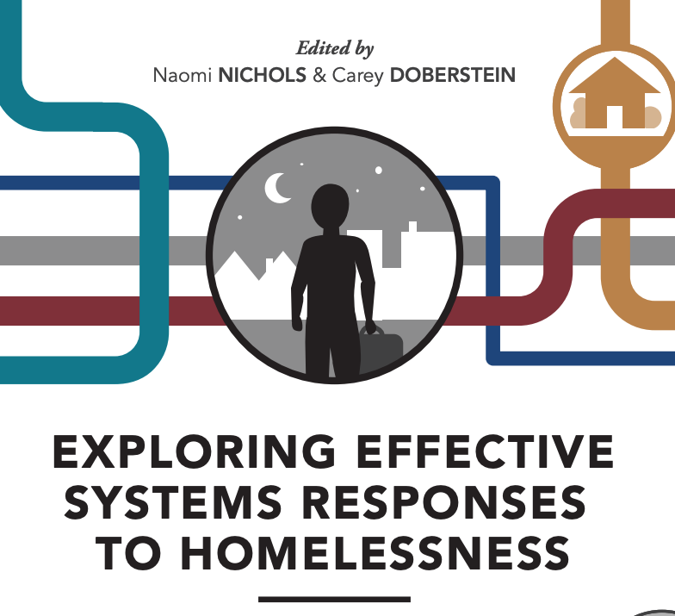
Nichols & Doberstein 2016

Slide 4
Nichols & Doberstein 2016
In the book’s introductory chapter, the co-editors note that a “key problem” in the homelessness sector “is that most services and programs within this realm have been developed incrementally and have evolved in parallel: housing separate from social services which are separate from health services, corrections, mental health or employment and each has a separate funding stream...”

Slide 5
Nichols & Doberstein 2016
The resulting patchwork of services can be replete with gaps and inefficiencies that undermine efforts to help citizens exit from homelessness, no matter how well each program may function individually” (p. 9).

Slide 6
Nichols & Doberstein 2016 (cont’d)
Writing about Calgary in the same book, Dressler notes:
“Prior to the implementation of [Calgary’s coordinated access] program in 2013, the numerous homeless-serving agencies and programs in Calgary were operating relatively independently of one another, with little coordination regarding client intake or shared clients.

Slide 7
Nichols & Doberstein 2016 (cont’d)
Agencies and programs in the system of care included emergency shelters and programs offering transitional housing, permanent housing, rapid rehousing, prevention, outreach, affordable housing and support services. Combined, they did not resemble a system, but rather a fragmented collection of agencies and programs...

Slide 8
Nichols & Doberstein 2016 (cont’d)
Homeless individuals were often being served by multiple agencies and sat on multiple waitlists for housing, each of which was accessible only through the program itself.”
She continues…

Slide 9
Nichols & Doberstein 2016 (cont’d)
“Not only was this fragmented system difficult for clients to navigate—and potentially re-traumatizing because it required them to tell their story over and over again—but agency and program accountability was also lacking. Agencies had the ability to refuse to serve clients based on their own assessment of programmatic fit, or if the client’s needs were too complex.
[The quote continues…]

Slide 10
Nichols & Doberstein 2016 (cont’d)
This practice is known in the homeless-serving sector as ‘cherry-picking’ or ‘cream-skimming,’ i.e. picking clients who are easier to serve and thus more likely to be successful in agency programs and produce more positive outcomes. Agencies could assume that another agency or program would serve the client, but this left many clients under-served when in fact they were the clients requiring the most support.”

Slide 11
Pushback
Reasons people sometimes push back on creating a more efficient system planning framework:
What’s the point of doing all of this sophisticated system planning when need far outstrips supply in virtually all jurisdictions?
Resources are required to undertake good system planning. This can detract from core supports.

Slide 12
Question for you
Do those passages resonate with you?

Slide 13
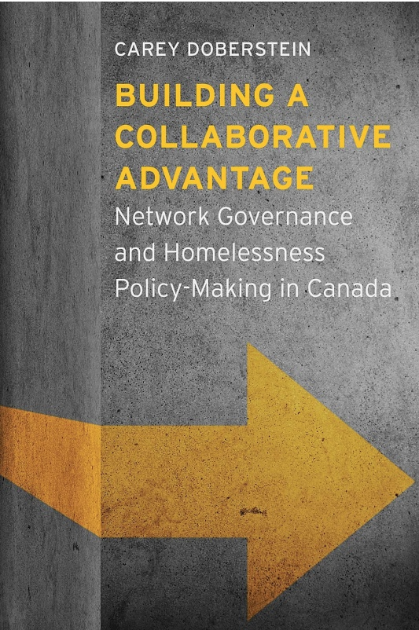
Doberstein 2016

Slide 14
Doberstein 2016
Doberstein: Calgary, Toronto and Vancouver “differ dramatically” in how they undertake system planning.

Slide 15
Doberstein 2016 (cont’d)
According to Doberstein, multiple stakeholders play important roles in homelessness decision-making in both Vancouver and Calgary, more so than in Toronto.
Vancouver and Calgary both have community advisory bodies that meet regularly and where members engage in important debate that leads to decisions pertaining to the disbursement of homelessness funding from the federal and provincial governments.

Slide 16
Doberstein 2016 (cont’d)
By contrast, Toronto has a community advisory body that advises Toronto’s municipal government on how to direct federal homelessness funding; however, it meets just once or twice a year, and “essentially functions as a rubber stamp for the [municipal] bureaucracy’s homelessness agenda” (p. 95).

Slide 17
Calgary
The Calgary Homeless Foundation (CHF) calls itself the System Planner for Calgary’s Homeless-Serving System of Care (HSSC).
This entails several functions, including disbursing approximately $50M annually to non-profits in Calgary’s homeless-serving sector; monitoring performance of funded programs; identifying service gaps; brokering partnerships between non-profit entities in the homeless-serving sector; and facilitating community dialogue.

Slide 18
Thank you
What’s on your mind?

