Slide 1
The basics
By Nick Falvo, PhD
Homelessness 101
Prepared for
Canadian Housing & Renewal Association
Apr 25, 2022

Slide 2
Overview
Causes
Categorization
Solutions

Slide 3
What causes homelessness?

Slide 4
Structural causes
What factors make the rate of per-capita homelessness higher in one community than in another?
I’m going to call such factors structural causes of homelessness.
Notes:
Source: Falvo, N. (2020). The long-term impact of the COVID-19 Recession on homelessness in Canada: What to expect, what to track, what to do. Report commissioned by Employment and Social Development Canada. https://nickfalvo.ca/

Slide 5
Structural causes (cont’d)
The most fundamental structural cause of homelessness is a lack of alignment between how much it costs to rent housing and how much low-income households can afford to pay for rent.
The housing market simply doesn’t cater well to low-income households.

Slide 6
Structural causes (cont’d)
Why is this the case?
The precise answer to this question depends on how one views the world.
Here are some explanations offered by some practitioners, researchers and advocates:

Slide 7
Structural causes (cont’d)
Rules and regulations make it too difficult for private developers to create rental housing.
Govt does an inadequate job of regulating rent levels.
Govt does an inadequate job of preserving what little low-cost rental housing already exists.

Slide 8
Structural causes (cont’d)
Most govts don’t invest enough in social housing.
There’s too much poverty.
Income assistance programs, esp. social assistance, are inadequate.

Slide 9
Structural causes (cont’d)
All of these points have a certain degree of merit.
The extent to which each is responsible for a lack of affordable housing depends largely on context,
Also, different ppl emphasize different factors (depending on how they view the world).

Slide 10
Structural causes (cont’d)
CAVEAT
Even in a community with very good availability of affordable housing, some homelessness is still inevitable.

Slide 11
Individual-level risk factors
Whether a community has a little homelessness or a lot of homelessness, it can often be predicted which types of persons become homeless.
The characteristics that increase the vulnerability of some persons to homelessness are known as individual-level risk factors.

Slide 12
Individual-level risk factors (cont’d)
If officials can understand these, they can:
Target prevention programs specifically at such individuals; and
Design programs uniquely tailored to such individuals that can help them after they become homeless.

Slide 13
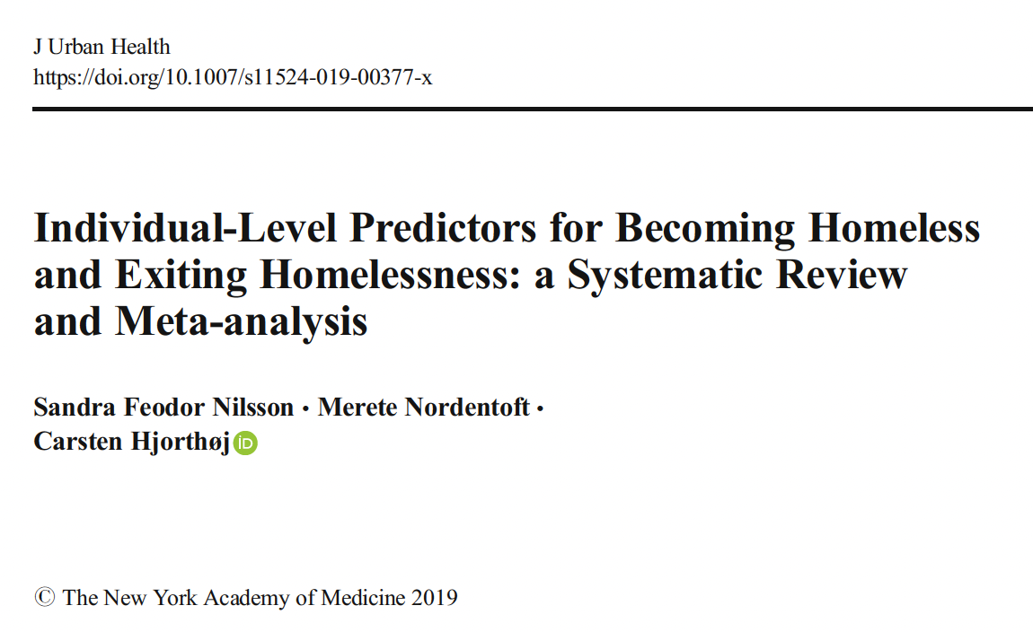
Individual-level risk factors (cont’d)

Slide 14
Individual-level risk factors (cont’d)
The Nilsson et al. article provides odds ratios.
The odds ratios refer to how many times more likely such a person is to experience homelessness than somebody without the characteristic in question (based on the cited study).

Slide 15
Individual-level risk factors (cont’d)
Factors | Odds ratio
History in foster care | 3.7
Having previously attempted suicide | 3.6
History of running away | 3.3
History of criminal behaviour | 3.0
Physically abused as a child | 2.9

Slide 16
Individual-level risk factors (cont’d)
Persons with such risk factors should not be blamed for having them.
For example, children do not choose to be in foster care; rather, they are there for reasons beyond their own control.
And in many cases, a lack of housing affordability itself is a reason for some of these risk factors.

Slide 17
Systems failures
Here I refer to publicly-funded systems working together in ways that are poorly-designed, poorly-implemented, or both.
These systems failures have the unintended consequence of exacerbating homelessness.

Slide 18
Systems failures (cont’d)
One example of a systems failure is a correctional facility discharging persons directly into homelessness without working proactively with local homelessness officials to create a ‘soft landing.’

Slide 19
Systems failures (cont’d)
Another example pertains to youth ‘aging out of care.’
While the child welfare system offered structure, suddenly the youth must fend for themselves on a low income.
Housing secured by such youth is often shared (the youth might rent room in a house with complete strangers).

Slide 20
Systems failures (cont’d)
They might struggle in their dealings with both housemates and a landlord.
Perhaps not surprisingly, one recent study has found that youth who are permitted to stay longer in foster care are less likely to end up homeless.

Slide 21
Categorization of persons experiencing homelessness

Slide 22
Who is homeless?
Where people are sleeping.
Level of acuity or vulnerability according to an assessment tool.
The ones that are going to require case management support their whole lives vs. the ones who won’t.

Slide 23
Who is homeless (cont’d)?
Household type/size (e.g., one-person household, families, etc.)
Age of individuals (e.g., youth, older adults, etc.).
Ethnicity (e.g., Indigenous).

Slide 24
Who is homeless (cont’d)?
Traumatic experience (e.g., family violence, veterans, torture survivor).
Status in Canada (e.g, refugee claimant).

Slide 25
Reaching Home Directives
You are chronically homeless if you are currently experiencing homelessness and meet at least 1 of the following criteria:
You’ve had a total of at least 180 days of homelessness over the past year.
You have recurrent experiences of homelessness over the past 3 years, with a cumulative duration of at least 18 months

Slide 26
Reaching Home Directives (cont’d)
Definitions of absolute homelessness found in Reaching Home’s Directives are based largely on definitions arrived at by the Canadian Observatory on Homelessness.

Slide 27
Cluster analysis
Kuhn and Culhane (1998) did ground-breaking research in this area.

Slide 28
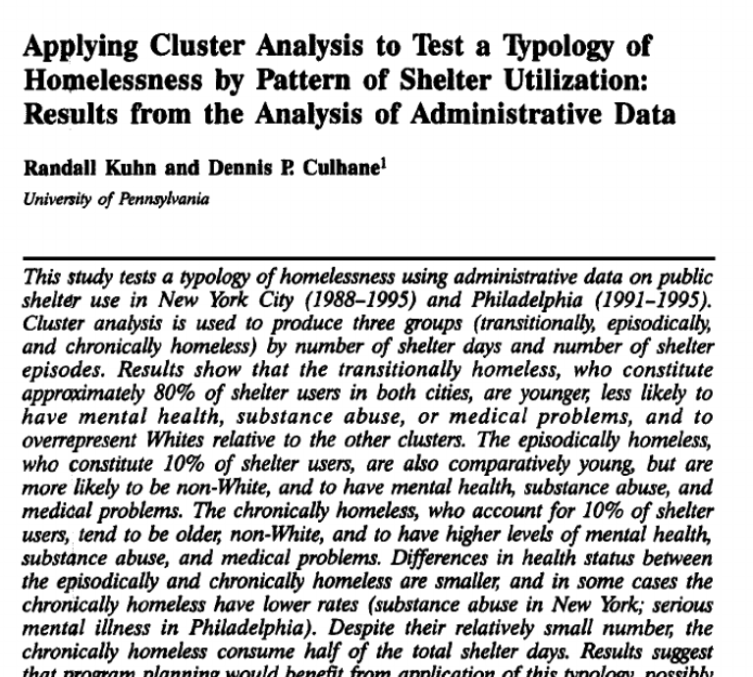
Cluster analysis (cont’d)

Slide 29
Cluster analysis (cont’d)
They developed a typology of shelter stay patterns based on length of stay + rate of readmission.
Their work focused on single homeless adults in New York City (1988 to 1995) & Philadelphia (1991 to 1995).
They found three distinct patterns of stays, and termed them ‘transitional,’ ‘episodic,’ or ‘chronic.’

Slide 30
Cluster analysis (cont’d)
Transitional shelter users = small # of episodes of homelessness over multi-year period.
Episodic users = frequent episodes, cycling through shelter system, jail, hospital, treatment centres.
Chronic shelter users = fewer, yet longer episodes of homelessness than episodic folks.

Slide 31
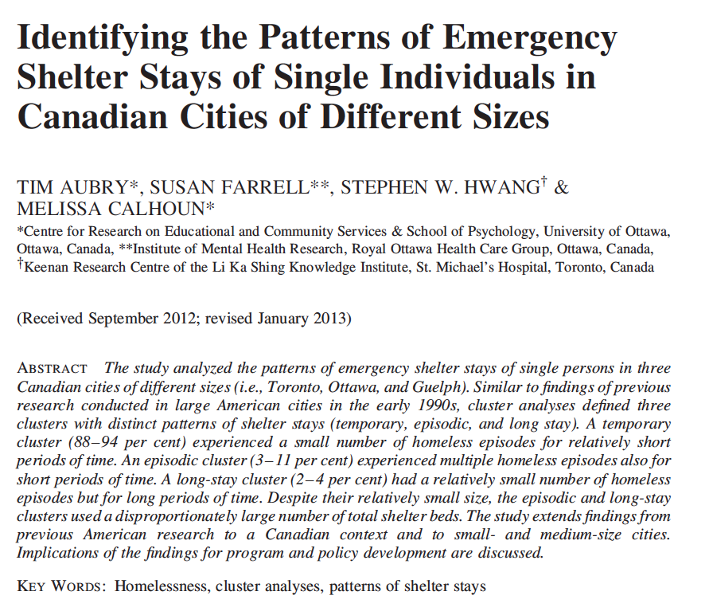
Cluster analysis (cont’d)

Slide 32
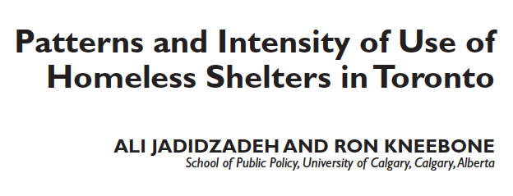
Cluster analysis (cont’d)

Slide 33
Solutions

Slide 34
Solutions
Limited resources result in a lot of debate.
There’s messiness in all of this.
We all try to simplify.
There’s no recipe book.

Slide 35
Solutions (cont’d)
Reasons why people become homeless differ, so solutions should too.
It’s not clear we have such a strong level of sophistication in our homeless-serving systems of care to have ready-made solutions to each type of homelessness.
Fundamentally, everyone needs affordable housing.

Slide 36
Solutions (cont’d)
There are unique pathways into homelessness, and unique pathways out.
It’s reasonable to suggest higher acuity and longer shelter stay mean more intensive supports.
Key question: how many resources do you put into the various policy responses.

Slide 37
Solutions (cont’d)
Some clients will always need social work support. Some will not.
Some system-planning organizations are trying to do more with less. Experimentation—e.g., Adaptive Case Management (to which we’ll return on Oct 26).

Slide 38
Solutions (cont’d)
Various levels of staff support
Various models (e.g., scattered site vs. place-based)
Various lengths of support (e.g., temporary, permanent)
Non-housing options

Slide 39
Solutions (cont’d)
Staff often learn a great deal about people after they’ve been housed. Then, there can be course correction. That process is key.
Ideally, your policy response should be flexible. It should be able to change with time, as you course correct.

Slide 40
Solutions (cont’d)
The Calgary Homeless Foundation funds permanent place-based supportive housing (highest acuity) $35-$40K per person per year, and that does not include capital cost (i.e. up front costs on building).
This cost also doesn’t include social assistance.

Slide 41
Solutions (cont’d)
By contrast, Adaptive Case Management (which we’ll discuss later) would pay $5K per year for some people and get them housed (e.g., move-in costs, including damage deposit, some rent supp $).

Slide 42
Taking it all in
We’ve covered a lot of ground in this module.
What’s on your mind?

