Slide 1
Social and economic factors associated with homelessness
By Nick Falvo and Ali Jadidzadeh
Research commissioned by
Infrastructure Canada’s Homelessness Policy Directorate
March 21, 2024

Slide 2
Introduction
Infrastructure Canada’s Homelessness Policy Directorate (HPD) has requested
    A review of economic and social factors associated with homelessness
      a literature review
      an assessment of the availability of Canadian data
    The identification and estimation of key factors associated with Canadian homelessness.
      we plan to turn the statistical analysis into a journal article
We present regression analysis, where key factors were identified in the literature to estimate their respective contributions to homelessness in Canada.

Slide 3
The lit review
We wrote a 36-page lit review (a stand alone document).
We’d like to make it a public document in the near future, probably with a blog post inviting the reader to dive into it.
It has sections on structural causes, systems failures, and individual-level risk factors.

Slide 4
The lit review (cont’d)
Rent levels are consistently found to be predictors of high rates of homelessness (though most of that research is American).
Problems with people leaving public systems; however, very little quant analysis.

Slide 5
The lit review (cont’d)
Cross-country, cross-provincial/territorial and cross-municipal comparisons of all of the causes of homelessness is virtually non-existent, with a lack of comparable (i.e., apples to apples) data being a major barrier to such research.

Slide 6
The assessment of data
We’ve written a 19-page stand alone document.
Essentially, if a researcher or team of researchers (or grad student) wants to do a regression analysis of the type we’ve done, what data would they use?
This document sheds light on that.

Slide 7
The assessment of data (cont’d)
Kudos to Infrastructure Canada for wanting us to create such a document for others!
We’d be happy to make this available at the appropriate time (perhaps when there’s a public release of the regression results).

Slide 8
The regression analysis
North American research has consistently found the major structural cause of homelessness to be a lack of alignment between the availability of low-cost housing and incomes.
However, how this is measured varies across studies, and other factors also play important roles.

Slide 9
Objective
In this study of shelter admissions in Canada, we uncover a complex web of relationships between socio-economic factors and emergency shelter utilization.
    Monthly data from January 2012 to December 2019
    Three regions: Ontario, Atlantic provinces, and Western provinces
Socio-economic factors include:
    Labour market factors
    Housing market factors
    Social assistance services
    Weather-related factors

Slide 10
Data
Shelter Admissions:
  Monthly time series from January 2012 to December 2019 (T=96)
  The number of distinct admissions in Ontario, the Atlantic provinces, and the Western provinces
      Single adult shelters: Ontario and the Atlantic provinces (NL, PEI, NS, NB)
      Single adults and family shelters: Western provinces (MB, SK, AB, BC)
  Age breakdowns:
      Youth (ages 16 to 24 years)
      Single adults (ages 25 years and older)

Slide 11
Data
Monthly Flow of Emergency Shelter Utilization in Ontario: January 2012 - December 2019
Notes:
Talk about averages, minimum and maximum admissions

Slide 12
Data
Monthly Flow of Emergency Shelter Utilization in Atlantic Provinces (NL, PEI, NS, NB): January 2012 - December 2019
Notes:
Talk about averages, minimum and maximum admissions

Slide 13
Data
Monthly Flow of Emergency Shelter Utilization in Western Provinces (MB, SK, AB, BC): January 2012 - December 2019
Notes:
Talk about averages, minimum and maximum admissions

Slide 14
Data
Socio-Economic Variables
  labour market
      Unemployment rate (%)
      Duration of unemployment (weeks)
      Real minimum wage ($CND)
  Housing market
      Real linearly interpolated bachelor/one bedroom rent, 1st quartile ($CND)
      Interpolated vacancy rate for bachelor/one-bedroom units (%)
  Social assistance services
      Real social assistance income, ($CND/month)
      Social assistance case load rate (%)
  Weather-related variables
      days with negative temperature
      days with negative temperature and positive precipitation

Slide 15
Data
Summary Statistics for Socioeconomic Factors in Ontario: January 2012 - December 2019
 | Mean | Std. Deviation | Minimum | Maximum
Labour market
Unemployment rate (%) | 6.69 | 0.88 | 5.20 | 8.20
Duration of unemployment (weeks) | 19.82 | 2.35 | 14.60 | 23.60
Real minimum wage ($CND) | 8.98 | 0.78 | 8.08 | 10.51
Social services
Real social assistance income, ($CND/month) | 578.28 | 17.66 | 549.29 | 603.48
Social assistance case load rate (%) | 5.42 | 0.05 | 5.30 | 5.52
Housing market
Real linearly interpolated bachelor rent, 1st quartile ($CND) | 535.29 | 19.05 | 490.20 | 576.20
Interpolated vacancy rate for bachelor units (%) | 2.40 | 0.22 | 1.90 | 3.08
Weather
Days with negative temperature each month | 8.63 | 10.44 | 0.00 | 29.00
Days with negative temperature and positive precipitation each month | 4.54 | 6.04 | 0.00 | 20.00

Slide 16
Data
Summary Statistics for Socioeconomic Factors in Atlantic Provinces (NL, PEI, NS, NB): January 2012 - December 2019
 | Mean | Std. Deviation | Minimum | Maximum
Labour market
Unemployment rate (%) | 10.38 | 0.64 | 8.78 | 11.65
Duration of unemployment (weeks) | 16.99 | 1.30 | 14.18 | 20.98
Real minimum wage ($CND) | 8.13 | 0.15 | 7.85 | 8.47
Social services
Real social assistance income, ($CND/month) | 538.17 | 13.08 | 523.93 | 572.39
Social assistance case load rate (%) | 4.00 | 0.15 | 3.66 | 4.33
Housing market
Real linearly interpolated bachelor rent, 1st quartile ($CND) | 399.17 | 7.96 | 375.23 | 412.34
Interpolated vacancy rate for bachelor units (%) | 4.50 | 0.91 | 2.71 | 5.70

Slide 17
Data
Summary Statistics for Socioeconomic Factors in Western Provinces (MB, SK, AB, BC): January 2012 - December 2019
 | Mean | Std. Deviation | Minimum | Maximum
Labour market
Unemployment rate (%) | 5.75 | 0.53 | 4.73 | 7.00
Duration of unemployment (weeks) | 17.06 | 1.75 | 14.15 | 20.90
Real minimum wage ($CND) | 8.45 | 0.43 | 7.85 | 9.39
Social services
Real social assistance income, ($CND/month) | 1,226.52 | 74.72 | 1,129.10 | 1,351.58
Social assistance case load rate (%) | 2.53 | 0.19 | 2.28 | 2.82
Housing market
Real linearly interpolated bachelor rent, 1st quartile ($CND) | 601.27 | 14.45 | 566.40 | 620.52
Interpolated vacancy rate for bachelor units (%) | 3.60 | 1.22 | 1.94 | 5.10

Slide 18
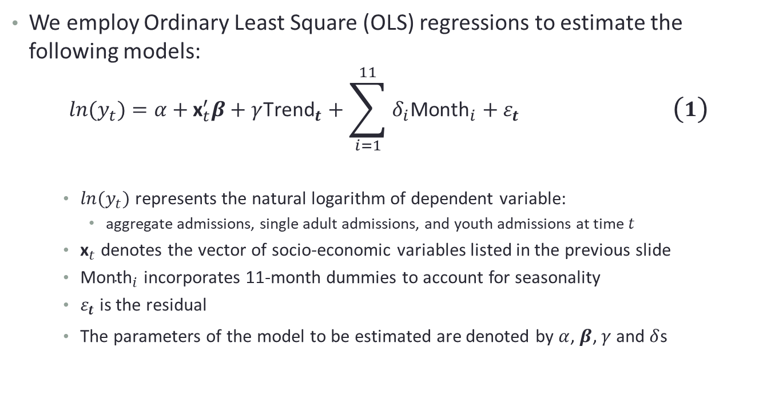
Regression Model
We employ Ordinary Least Square (OLS) regressions to estimate the following models:
$$ln(y_{t})=α+{\text{x}}_{t}^{′}β+γ{\text{Trend}}_{t}+\sum_{i=1}^{11}{δ_{i}{\text{Month}}_{i}}+ε_{t} \left(1\right)$$
    $ln(y_{t})$ represents the natural logarithm of dependent variable:
      aggregate admissions, single adult admissions, and youth admissions at time $t$
    ${\text{x}}_{t}$ denotes the vector of socio-economic variables listed in the previous slide
    ${\text{Month}}_{i}$ incorporates 11-month dummies to account for seasonality
    $ε_{t}$ is the residual
    The parameters of the model to be estimated are denoted by $α$, $β$, $γ$ and $δ$s

Slide 19
Empirical Evidence: Ontario

Slide 20
Empirical Evidence: Atlantic Provinces

Slide 21
Empirical Evidence: Western Provinces

Slide 22
Conclusion
The labour market factors, including the unemployment rate, duration of unemployment, and real minimum wage, do not exhibit a consistent impact across regions and populations.
We consider social assistance services, which encompass monthly real social assistance income and the social assistance case load rate. These factors have substantial impacts on the number of admissions.
Analyzing the impact of the housing market on admissions reveals notable regional differences. The housing market variables includes monthly real rent for affordable units and vacancy rate.
Regarding weather-related factors, they all exhibit a minor negative influence on shelter admissions across different groups.

Slide 23
Appendix

Slide 24
Empirical Evidence: Total Admissions

Slide 25
Empirical Evidence: Admissions for single adults

Slide 26
Empirical Evidence: Admissions for youth

