Slide 1
public policy and homelessness
#1 of 3 Slide Decks Prepared for Certificate in Working with Homeless Populations
January 24, 2017
By: Nick Falvo

Slide 2
Acknowledgement
This slide deck is a modified version of a slide presentation I recently prepared in collaboration with my co-worker, Chidom Otogwu. That presentation was prepared for Calgary Homeless Foundation Annual Board Retreat.

Slide 3
Three major contributing factors to the size of a city’s homeless population
Macroeconomic factors (e.g., price of oil, strength of US economy, Global Financial Crisis).
Public policy (e.g., job creation, jobless benefits, social assistance benefits, availability of non-profit housing, rental supply).
System responses (e.g. role played by System Planners such as CHF, Edmonton Homeward Trust, City of Toronto).

Slide 4
The Federal Picture

Slide 5
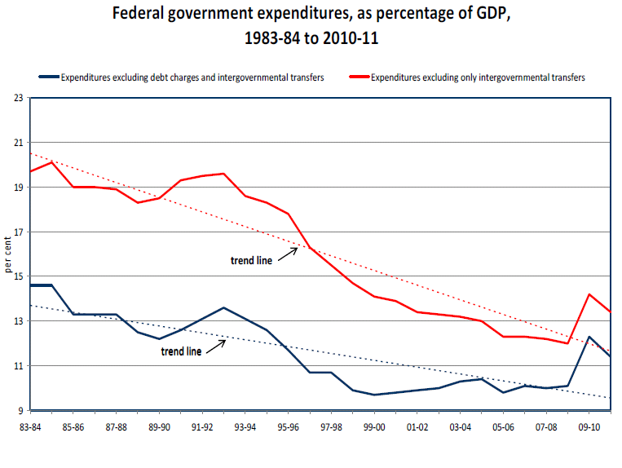
Notes:
Source: Mendelson, M. (2012). Is Canada (still) a fiscal union? Retrieved from Caledon Institute of Social Policy website: www.caledoninst.org/Publications/PDF/998ENG.pdf.
Note: The above image has been copied and pasted directly from page 2 of the report.

Slide 6
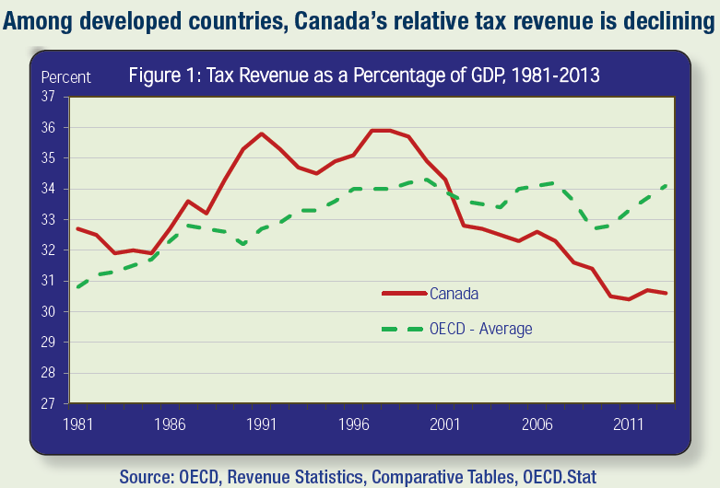
Notes:
Source: Citizens for Public Justice. (2015). Taxes for the common good: A public justice primer on taxation (Fact Sheet Series). Retrieved from Citizens for Public Justice website: http://www.cpj.ca/sites/default/files/docs/files/Taxes-for-the-Common-Good-FINAL.pdf
Note: “The data in the graph is OECD total revenue: it includes all levels of government” (M. Veall, personal communication, September 15, 2015).

Slide 7
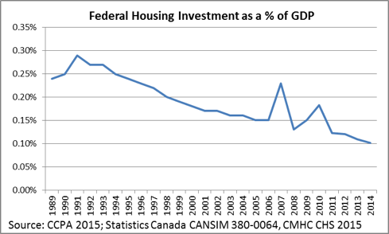
Notes:
Source: Wellesley Institute. (2015, September 22). Access to housing – HEIA in the federal election. Retrieved from http://www.wellesleyinstitute.com/housing/access-to-housing-heia-in-the-federal-election/

Slide 8
Rental Housing Production
Notes:
Source: Pomeroy, S. (2013, May). The fundamentals of housing policy & governance: A condensed, one-day course. Carleton University, Ottawa.
Note: This slide has been copied and pasted directly from Mr. Pomeroy’s slide deck. It appeared as Slide #24 in his deck.

Slide 9
The Alberta Picture

Slide 10
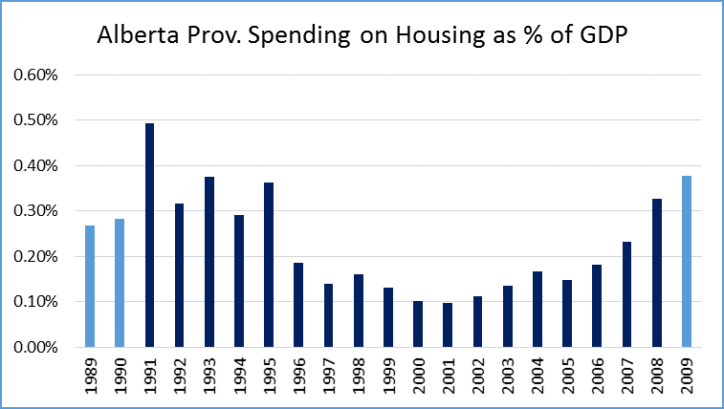
Notes:
Source: Statistics Canada. CANSIM Tables 385-0002 (1989-2008), 384-0047 (2009-2014) and 384-0038 (GDP data).

Slide 11
Social Assistance
In 1993, the Alberta government brought in strict welfare reforms.
Several researchers (including Ron Kneebone) have written about how difficult provincial officials made it for people to qualify for social assistance in the province.
And as you’ll see shortly, the annual value of benefit levels for those who did quality for social assistance eroded over time.
Notes:
Source: Kneebone, R., & White, K. (2009). Fiscal retrenchment and social assistance in Canada. Retrieved from Canadian Public Policy website.

Slide 12
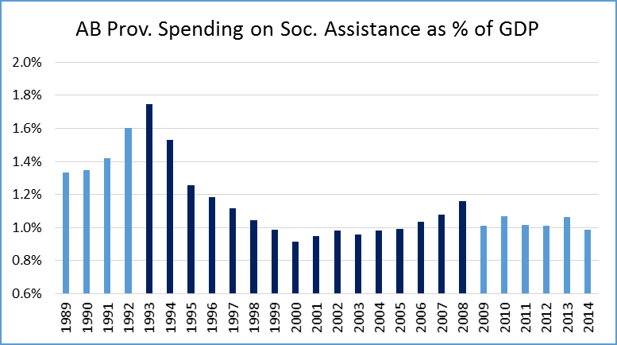
Notes:
Source: Statistics Canada. CANSIM Tables 385-0002 (1989-2008), 384-0047 (2009-2014) and 384-0038 (GDP data).

Slide 13
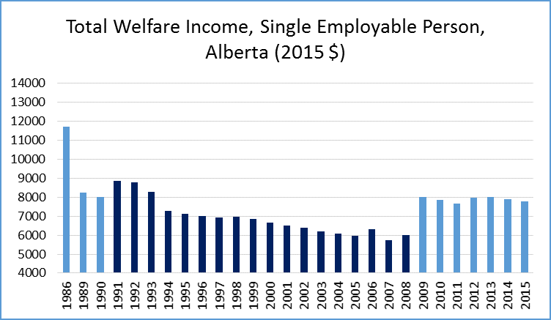
Notes:
Source: Tweddle, A., Battle, K., & Torjman, S. (2016). Welfare in Canada, 2015. Retrieved from Canada Social Report website: http://www.canadasocialreport.ca/WelfareInCanada/2015%2Epdf

Slide 14
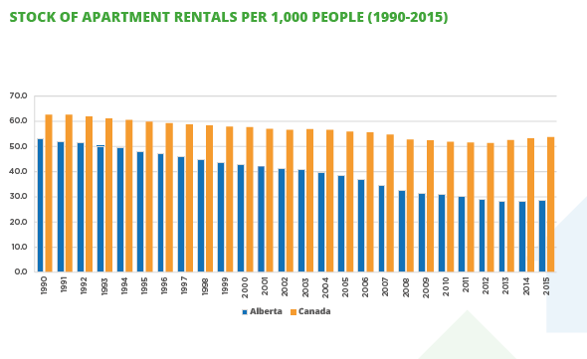
Notes:
Source: Calgary Homeless Foundation. (2016). National Housing Strategy Brief. Retrieved from Calgary Homeless Foundation web site.
Note: Visual has been copied directly from Appendix 3 of brief, where all data sources are listed.

Slide 15
Notes:
Note: This is a modified version of a bar graph that has been generously provided to me from Professor Ron Kneebone.

Slide 16
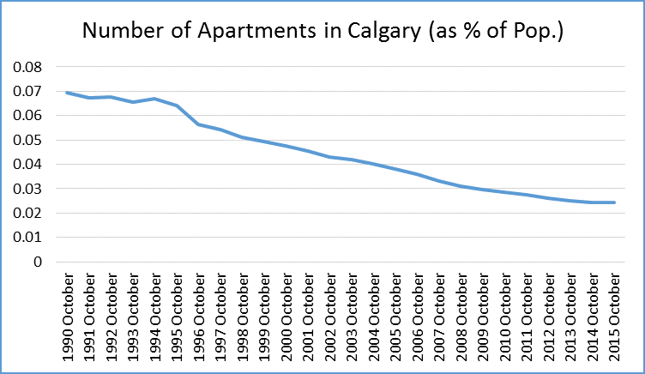
Notes:
Source: CMHC Rental Market Survey (Historical Universe by Bedroom Type).
Note: Data Provided by Ron Kneebone.

Slide 17
Homelessness in Calgary

Slide 18
Calgary Drop-In Centre, 1992-2014
Notes:
Source: I’ve taken this visual directly from Professor Ron Kneebone’s February 2016 slide presentation titled Homelessness in Calgary: What we can Learn from Time Series Data? In that slide presentation, the line graph above appears on slide #23.

Slide 19
Calgary’s Homeless Population Over Time (bw 2008 & 2016, per capita decrease of 26%)
Notes:
Source: Calculations above have been made by Dr. Ali Jadidzadeh.

Slide 20
Takeaways
The role of System Planners (i.e. Calgary Homeless Foundation, Edmonton Homeward Trust, City of Toronto) matters.
But so does public policy.
We should always be mindful of the important role played by public policy in both creating and ending homelessness.

Slide 21
Thank You

