Slide 1
Overview
By Nick Falvo, PhD
Homelessness 101
Prepared for
Healthcare Excellence Canada
Oct 8-9, 2024

Slide 2
Land acknowledgement
I wish to acknowledge that I am on the traditional territories of the people of the Treaty 7 region in Southern Alberta. The City of Calgary is also home to Métis Nation of Alberta, District 5 and 6 of Battle River Territory.

Slide 3
Overview
Part 1: Taking stock
The basics
Health conditions and health care
The National Housing Strategy and Reaching Home
Emerging themes

Slide 4
Overview (cont’d)
Part 2: What to do about it
System planning
Staffing
Harm reduction
Innovative practices

Slide 5
Overview (cont’d)
About me.
Genesis of this course.
Thank you Amber Heyd.
Please try to hold questions until the end of each module.

Slide 6
Overview (cont’d)
Please feel free to email me after the course with any follow up questions (e.g., can you tell me more about X, or can you send me resources on Y?).
Email: falvo.nicholas@gmail.com

Slide 7
The basics
By Nick Falvo, PhD
Homelessness 101
Prepared for
Healthcare Excellence Canada
Oct 8-9, 2024

Slide 8
Overview
Causes
Categorization
Solutions

Slide 9
What causes homelessness?

Slide 10
Structural causes
What factors make the rate of per-capita homelessness higher in one community than in another?
I’m going to call such factors structural causes of homelessness.
Notes:
Source: Falvo, N. (2020). The long-term impact of the COVID-19 Recession on homelessness in Canada: What to expect, what to track, what to do. Report commissioned by Employment and Social Development Canada. https://nickfalvo.ca/

Slide 11
Structural causes (cont’d)
The most fundamental structural cause of homelessness is a lack of alignment between how much it costs to rent housing and how much low-income households can afford to pay for rent.
The housing market simply doesn’t cater well to low-income households.

Slide 12
Structural causes (cont’d)
Why is this the case?
The precise answer to this question depends on how one views the world.
Here are some explanations offered by some practitioners, researchers and advocates:

Slide 13
Structural causes (cont’d)
Rules and regulations make it too difficult for private developers to create rental housing.
Govt does an inadequate job of regulating rent levels.
Govt does an inadequate job of preserving what little low-cost rental housing already exists.

Slide 14
Structural causes (cont’d)
Most govts don’t invest enough in social housing.
There’s too much poverty.
Income assistance programs, esp. social assistance, are inadequate.

Slide 15
Structural causes (cont’d)
All of these points have a certain degree of merit.
The extent to which each is responsible for a lack of affordable housing depends largely on context,
Also, different ppl emphasize different factors (depending on how they view the world).

Slide 16
Structural causes (cont’d)
CAVEAT
Even in a community with very good availability of affordable housing, some homelessness is still inevitable.

Slide 17
Individual-level risk factors
Whether a community has a little homelessness or a lot of homelessness, it can often be predicted which types of persons become homeless.
The characteristics that increase the vulnerability of some persons to homelessness are known as individual-level risk factors.

Slide 18
Individual-level risk factors (cont’d)
If officials can understand these, they can:
Target prevention programs specifically at such individuals; and
Design programs uniquely tailored to such individuals that can help them after they become homeless.

Slide 19
Individual-level risk factors (cont’d)

Slide 20
Individual-level risk factors (cont’d)
The Nilsson et al. article provides odds ratios.
The odds ratios refer to how many times more likely such a person is to experience homelessness than somebody without the characteristic in question (based on the cited study).

Slide 21
Individual-level risk factors (cont’d)
Factors | Odds ratio
History in foster care | 3.7
Having previously attempted suicide | 3.6
History of running away | 3.3
History of criminal behaviour | 3.0
Physically abused as a child | 2.9

Slide 22
Individual-level risk factors (cont’d)
Persons with such risk factors should not be blamed for having them.
For example, children do not choose to be in foster care; rather, they are there for reasons beyond their own control.
And in many cases, a lack of housing affordability itself is a reason for some of these risk factors.

Slide 23
Systems failures
Here I refer to publicly-funded systems working together in ways that are poorly-designed, poorly-implemented, or both.
These systems failures have the unintended consequence of exacerbating homelessness.

Slide 24
Systems failures (cont’d)
One example of a systems failure is a correctional facility discharging persons directly into homelessness without working proactively with local homelessness officials to create a ‘soft landing.’

Slide 25
Systems failures (cont’d)
Another example pertains to youth ‘aging out of care.’
While the child welfare system offered structure, suddenly the youth must fend for themselves on a low income.
Housing secured by such youth is often shared (the youth might rent room in a house with complete strangers).

Slide 26
Systems failures (cont’d)
They might struggle in their dealings with both housemates and a landlord.
Perhaps not surprisingly, one recent study has found that youth who are permitted to stay longer in foster care are less likely to end up homeless.

Slide 27
Categorization of persons experiencing homelessness

Slide 28
Who is homeless?
Where people are sleeping.
Level of acuity or vulnerability according to an assessment tool.
The ones that are going to require case management support their whole lives vs. the ones who won’t.

Slide 29
Who is homeless (cont’d)?
Household type/size (e.g., one-person household, families, etc.)
Age of individuals (e.g., youth, older adults, etc.).
Ethnicity (e.g., Indigenous).

Slide 30
Who is homeless (cont’d)?
Traumatic experience (e.g., family violence, veterans, torture survivor).
Status in Canada (e.g, refugee claimant).

Slide 31
Reaching Home Directives
You are chronically homeless if you are currently experiencing homelessness and meet at least 1 of the following criteria:
You’ve had a total of at least 180 days of homelessness over the past year.
You have recurrent experiences of homelessness over the past 3 years, with a cumulative duration of at least 18 months

Slide 32
Reaching Home Directives (cont’d)
Definitions of absolute homelessness found in Reaching Home’s Directives are based largely on definitions arrived at by the Canadian Observatory on Homelessness.

Slide 33
Cluster analysis
Kuhn and Culhane (1998) did ground-breaking research in this area.

Slide 34
Cluster analysis (cont’d)

Slide 35
Cluster analysis (cont’d)
They developed a typology of shelter stay patterns based on length of stay + rate of readmission.
Their work focused on single homeless adults in New York City (1988 to 1995) & Philadelphia (1991 to 1995).
They found three distinct patterns of stays, and termed them ‘transitional,’ ‘episodic,’ or ‘chronic.’

Slide 36
Cluster analysis (cont’d)
Transitional shelter users = small # of episodes of homelessness over multi-year period.
Episodic users = frequent episodes, cycling through shelter system, jail, hospital, treatment centres.
Chronic shelter users = fewer, yet longer episodes of homelessness than episodic folks.

Slide 37
Cluster analysis (cont’d)

Slide 38
Cluster analysis (cont’d)

Slide 39
Solutions

Slide 41
Solutions (cont’d)
It’s reasonable to suggest higher acuity and longer shelter stay mean more intensive supports.
Key question: how many resources do you put into the various policy responses.
Some clients will always need social work support. Some will not.

Slide 42
Taking it all in
We’ve covered a lot of ground in this module.
What’s on your mind?

Slide 43
health conditions and health care
By Nick Falvo, PhD
Homelessness 101
Prepared for
Healthcare Excellence Canada
Oct 8-9, 2024

Slide 44
Overview
AV material
The Street Health Report 2007

Slide 45
Street Health Stories
http://www.nfb.ca/film/street_health_stories/
9 min’s

Slide 47
The Street Health Report

Slide 48
Mental health

Slide 49
Mental health (cont’d)

Slide 50
Victimization

Slide 51
Compared w general pop.

Slide 52
Pain

Slide 53
Mortality
“Homeless people in their forties and fifties often develop health disabilities that are more commonly seen only in people who are decades older.”
— Stephen Hwang

Slide 54
Contributing factors
Low income
Trauma
Exposure to the elements
Congregate living

Slide 55
Contributing factors (cont’d)
Sleep deprivation
Theft and assault
Lack of primary care
Lack of health insurance

Slide 56
Contributing factors (cont’d)
Inappropriate discharge planning
Stigma

Slide 57
Promising practices
Medical respite
Case management
Harm reduction
Health care at emergency facilities
Improved hospital discharge

Slide 58
Further reading

Slide 59
End of Module
What’s on your mind?

Slide 60
the national housing strategy and reaching home
By Nick Falvo, PhD
Homelessness 101
Prepared for
Healthcare Excellence Canada
Oct 8-9, 2024

Slide 61
Overview
The NHS
Reaching Home
COVID responses
Recent federal budgets

Slide 62
The funding landscape
Across Canada, federal funding for homelessness remains rather modest.
Prior to COVID, for each $1 invested federally, $13 was invested by other sources (mostly provincial and municipal dollars).
What’s more, less than 10% of new funding under the NHS has been earmarked towards the Trudeau government’s goal of ending chronic homelessness.

Slide 63
The funding landscape (cont’d)
In the 2016 federal budget, the Trudeau govt announced substantial (but time-limited) increases in funding for housing and homelessness.
Then, the National Housing Strategy was unveiled in 2017.

Slide 64
National Housing Strategy
Not a very large focus on homelessness per se.
Less than 10% of new funding under the NHS has been earmarked towards the Trudeau government’s goal of ending chronic homelessness.

Slide 65
National Housing Strategy (cont’d)
The NHS did set the goal of a 50% reduction in chronic homelessness over 10 years—a subsequent Throne Speech then upped that to 100%.
Difficult to gauge success due to lack of systematic, national-level tracking of chronic homelessness with methodological rigour.

Slide 66
National Housing Strategy (cont’d)
Supportive housing refers to specialized housing for vulnerable populations that features professional (i.e., social work) staff support.
This is especially helpful for people who have experienced long-term homelessness.
The NHS contains no specific provisions for supportive housing, even though the current government has committed to ending chronic homelessness.

Slide 67
Canada Housing Benefit
Central to the NHS was the planned launch of a Canada Housing Benefit (CHB).
This benefit will consist of financial assistance to help low-income households afford the rent in both private and social housing units.
Estimated: cost $4B over 8 years (w ½ of costs coming fed govt and half from P/Ts.

Slide 68
Canada Housing Benefit (cont’d)
It involves a partnership w provinces.
It was supposed to take effect on 1 April 2020.
As of 31 December 2020, however, just 7 provinces and territories had signed agreements, and just 5 were actually dispersing funds to households in need.

Slide 69
Canada Housing Benefit (cont’d)
The 2021 federal budget announced an additional $315.4M over seven years for the Canada Housing Benefit, starting in 2021-22.

Slide 70
Canada Housing Benefit (cont’d)
Research I did in May 2021 finds that cities have typically targeted it to a combination of households experiencing homelessness and to households at risk of experiencing homelessness.
Several provinces have incorporated it into existing housing affordability schemes (and have hopefully not used it as a substitute for previous provincial or territorial funding).

Slide 71
Canada Housing Benefit (cont’d)
In Sep 2022, the GoC announced a one-time $500 top up to the CHB, in order to help with inflation.
Requires an application to CRA.

Slide 72
Reaching Home
Reaching Home is the name of Canada’s new homelessness strategy. Fed govt framed this as being part of the NHS.
Released in June 2018.
It replaces the Homelessness Partnering Strategy.
Reaching Home officially launched on 1 April 2019.

Slide 73
Reaching Home (cont’d)
New communities (beyond the previous 61 Designated Communities) can now apply for Reaching Home funding.
They are as follow: Abbotsford, BC; Chilliwack, BC; Cowichan Valley, BC; Lambton County, ON; Cochrane District (Timmins), ON; Kenora, ON.
Notes:
Source: https://www.canada.ca/en/employment-social-development/services/funding/homeless/expansion-designated-communities.html

Slide 74
Reaching Home (cont’d)
Reaching Home encourages communities to use better triage (e.g., CAA) and better data collection. All communities will be required to have CAA.
Federal funding will be provided to Designated Communities to help them with this.
This will help communities to demonstrate progress against outcomes.

Slide 75
Reaching Home (cont’d)
Communities that already had an HMIS system in place were allowed to keep it.
New communities or communities without an HMIS are required to adopt HIFIS.

Slide 76
Reaching Home (cont’d)
In terms of eligible activities, Reaching Home will be considerably more flexible than was HPS.
Communities aren’t as strictly policed on HF as previously.
For example, there will be increased flexibility to channel funding to prevention.

Slide 77
COVID measures
The Government of Canada’s COVID-19 Economic Response Plan, announced on 13 March 2020, includes an additional $157.5M in one-time funding for Reaching Home.
Further, on 21 Sep 2020, the Government of Canada announced an additional $236.7M for Reaching Home (another one-time enhancement).

Slide 78
COVID measures (cont’d)
These COVID-19 funding enhancements came with much more flexibility than previous Reaching Home funding (e.g., with respect to stipulation about provincial areas of responsibility).
The “COVID flexibilities” will stop as of 31 March 2023.

Slide 79
Recent budgets
In nominal terms, annual federal funding for homelessness has nearly doubled since Trudeau became Prime Minister (not including COVID measures).
When Trudeau came to power in 2015, annual funding for this initiative was just $119 million.
Reaching Home’s base funding for 2023-24 (not including COVID-related funding) is $237 million.

Slide 80
Recent budgets (cont’d)
An additional $1.3B in new $$ was announced for Reaching Home over four years, including $250 million in new funding over two years for “encampments and unsheltered homelessness.”
According to the budget document, the encampment funding “will require provinces and territories to cost-match federal investments, leveraging a total of $500 million.”

Slide 81
Rapid Housing Initiative

Slide 82
Rapid Housing Initiative
In Sep 2020, the Government of Canada announced $1B for new modular housing, the acquisition of land, the conversion of existing non-residential buildings, and the reclamation of closed or derelict properties.
This is called the Rapid Housing Initiative (RHI).

Slide 83
Rapid Housing Initiative (cont’d)
Very fast grant application
Capital costs fully covered.
Some of the people being housed via the RHI have been experiencing homelessness (but a lack of operating $ will make it challenging to support person who’ve been chronically homeless).

Slide 84
Rapid Housing Initiative (cont’d)
RHI projects include a broad list of eligible target populations (one of which is persons experiencing homelessness).
The City of Toronto aims to target most of its RHI units to persons experiencing chronic homelessness.
RHI is viewed as being the best federal housing initiative right now to target chronic homelessness.
Notes:
See pp. 4-5 of this document: https://assets.cmhc-schl.gc.ca/sites/cmhc/nhs/rapid-housing-initiative/nhs-rhi-highlight-sheet-en.pdf?rev=220618ab-2719-401a-af24-51e20d7696fb

Slide 85
Rapid Housing Initiative (cont’d)
Many projects are still awaiting word on whether their respective prov got will provide operating $, which will in turn determine what kinds of social work support can be provided (and which specific households can be accommodated).
Some approved projects have received commitments of municipal support, typically in the form of waived fees, free land or discounted land.

Slide 86
Rapid Housing Initiative (cont’d)
The 2021 federal budget announced an additional $1.5B for the RHI for 2021-22.
The 2022 federal budget announced another $1.5B over two years for RHI.

Slide 87
More from 2022 federal budget
The 2022 federal budget also announced $62.2M over 3 yrs (beginning in 2024-25) for a new Veteran Homelessness Program “that will provide services and rent supplements to veterans experiencing homelessness…;”
It further announced $18.1M over 3 yrs for research on chronic homelessness.

Slide 88
End of Module
What’s on your mind?

Slide 89
emerging themes
By Nick Falvo, PhD
Homelessness 101
Prepared for
Healthcare Excellence Canada
Oct 8-9, 2024

Slide 90
Overview
Rise in outdoor sleeping
Overdose crisis
Aging population
Indigenous peoples

Slide 91
Rise in outdoor sleeping
Visible outdoor sleeping appears to have increased in many cities (stemming in part from concern over disease transmission) though most cities lack a rigorous method of enumeration of rough sleepers.
This has turned into a thorny political issue, especially in light of fire hazards, complaints from neighbours, and forcible clearings.
Especially prominent during warmer weather.

Slide 92
Rise in outdoor sleeping: Calgary data

Slide 93
Rise in outdoor sleeping (cont’d)
In Alberta, we’ve seen the provincial government work directly with Edmonton’s Police Chief to expedite the clearing of encampments.
This has resulted in Navigation and Support Centre in Edmonton (and now one in Calgary as well).

Slide 94
Rise in outdoor sleeping (cont’d)
A technological innovation worthy of attention is the City of Ottawa’s new GIS mapping system, used to both identify encampments and keep case notes pertaining to encampment residents (in order to provide better services).

Slide 95
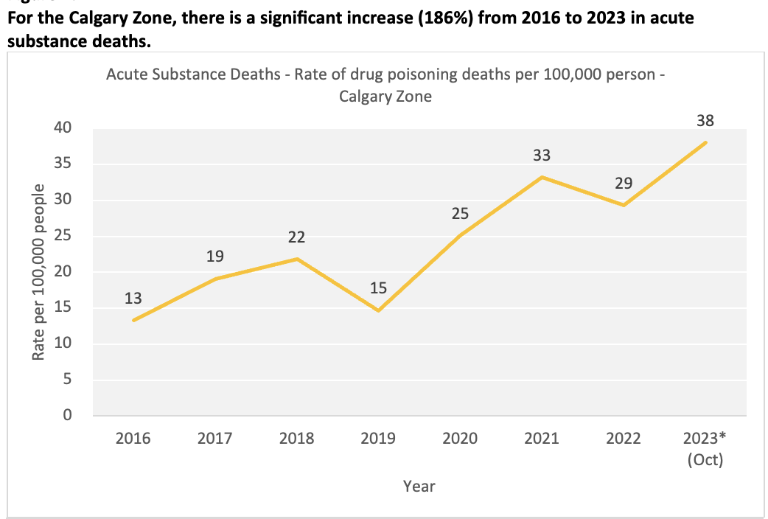
Overdose crisis

Slide 96
Overdose crisis (cont’d)

Slide 97
Overdose crisis (cont’d)

Slide 98
Overdose crisis (cont’d)

Slide 99
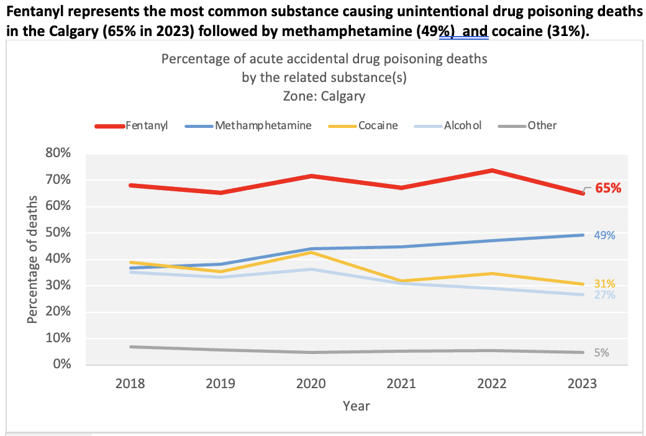
Overdose crisis (cont’d)

Slide 100
Aging population
Every OECD country has an aging population—a trend not expected to taper off until at least 2040.
Four main factors are behind this: 1) the Baby Boom; 2) the Baby Boom Echo (i.e., children of Baby Boomers); 3) low fertility rates in OECD countries; and 4) people in OECD countries living longer.

Slide 101
Aging population (cont’d)
Health care spending for seniors is higher than for other age groups, as older people have more chronic health conditions (both physical and mental health conditions).
Higher health care spending on seniors makes this age group a high priority for provincial and territorial governments.

Slide 102
Aging population (cont’d)
Use of emergency shelters by older people is on the rise across Canada, including in Calgary.
In Calgary’s homeless shelter system, adults aged 55 and over accounted for just 9% of all bed spaces in 2008; by 2017, this figure had risen to 19% (these figures apply to singles without dependants).

Slide 103
Aging population (cont’d)
Across Canada, seniors stay in homeless shelters longer than any other age group.
Recently-published research by Ali Jadidzadeh and Nick Falvo found that tenants in CHF-funded Housing First programs have lower graduation rates than other age groups.

Slide 104
National Shelter Study
Notes:
Source: https://www.canada.ca/en/employment-social-development/programs/homelessness/reports-shelter-2016.html#h6

Slide 105
Indigenous peoples
Greater prominence
Rising rates of PSE participation
Part of this is because PSE institutions are offering more access opportunities (financial aid).

Slide 106
Indigenous peoples (cont’d)
Federal acceptance of UNDRIP.
This has implications for policy-making in Canada, treaty interpretation in particular.
There are hundreds of unresolved land claims in Canada.

Slide 107
Indigenous peoples (cont’d)
Notes:
Source: https://www150.statcan.gc.ca/n1/daily-quotidien/171025/cg-a001-eng.htm

Slide 108
Indigenous peoples (cont’d)
Some policy options:
Massive funding injections
On-site cultural programming
Access to Elders
Staffing training/guest presentations
Indigenous staffing
Partnerships
Ongoing evaluation and oversight

Slide 109
Further reading

Slide 110
Analysis of shelter data
The Canadian Press recently gained access to results of analysis of the use of homeless shelters across Canada by Indigenous peoples.
The results are summarized in a March 2019 slide presentation obtained through an Access to Information and Privacy (ATIP) request.

Slide 111
Analysis of shelter data (cont’d)
Indigenous shelter users experience more shelter stays each year, and are less likely to exit a shelter because of finding a residence.
Indigenous peoples (compared with non-Indigenous peoples) tend to cycle in and out of shelters with high frequency, rather than stay for long periods of time.

Slide 112
Analysis of shelter data (cont’d)
The analysis finds that, while Indigenous men are more than 10X more likely to use a homeless shelter over the course of a year than non-Indigenous men, Indigenous women are more than 15X more likely to use a homeless shelter than non-Indigenous women over the course of a year.

Slide 113
End of Day 1 - Thank you!
What’s on your mind?

