Slide 1
Homelessness advocacy
#3 of 3 Slide Decks Prepared for Certificate in Working with Homeless Populations
January 24, 2017
By: Nick Falvo

Slide 2
Overview
Grassroots advocacy
Direct action
Rights-based advocacy
Government-to-government advocacy
Advocacy within Parliament
Professionalized advocacy
Policy-based advocacy

Slide 3
What is advocacy?
Definition
For the purpose of today’s presentation, I’ll define is collective effort to bring about changes to legislation, regulations or policies.

Slide 4
Grassroots Advocacy
Definition: Run on a shoestring budget. Informal, internal working relationships. Strong volunteer component.
Examples:
Calgary: Client Action Committee (Calgary Homeless Foundation)
Vancouver: Carnegie Community Action Project
Toronto: Housing Action Now
Montreal: Front d’action populaire en réaménagement urbain (FRAPRU)
Montreal: Réseau d'aide aux personnes seules et itinérantes de Montréal (RAPSIM)

Slide 5
Direct Action
Definition: Very willing and capable of being disruptive (i.e. sit-ins, protest, civil disobedience). Little effort made to charm or cajole their audience. Such tactics often receive a considerable amount of media attention.
Examples:
CLAC-Montréal
Ontario Coalition Against Poverty

Slide 6
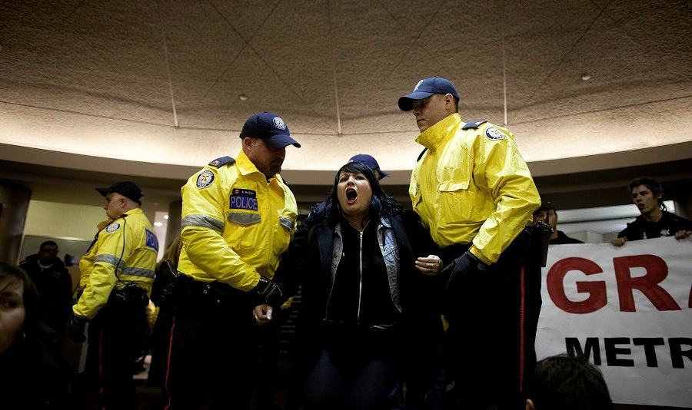
Direction Action (cont’d)
Notes:
Note: Zoe Dodd, protesting shelter conditions in Toronto. Photo was taken in March 2013 at a Metro Hall protest. I copied and pasted the photo from Dodd’s Facebook status update on 5 April 2013.
Background: http://www.thestar.com/news/city_hall/2013/04/04/toronto_council_tells_city_to_aim_for_more_homeless_shelter_space.html

Slide 7
Rights-Based Advocacy
Definition: Main argument is that individuals should receive a social benefit because it’s their legal right to have it. Among other things, this means challenging interpretations of the Canadian Charter of Rights and Freedoms and international law.
Examples:
Canada Without Poverty
The Right to Housing Coalition (organized by the Advocacy Centre for Tenants Ontario)

Slide 8
Government-to-Government Advocacy
Definition: This is self-explanatory
Examples:
Federation of Canadian Municipalities
Federal-Provincial-Territorial Ministers' Forum on Housing
Assembly of First Nations

Slide 9
Advocacy within Parliament
Definition: This is self-explanatory.
Examples:
Question Period
Debates
Committee work
Private Member’s bills

Slide 10
Professionalized Advocacy
Frequent meetings with elected officials—sometimes elected officials even seek out the group in question.
Such groups typically have multiple paid staff and sufficient resources to plan large events (such as conferences), hire consultants, commission research and produce web-based resources.
Such organizations often provide services to their members (e.g. webinars, trainings).

Slide 11
Professionalized Advocacy (cont’d)
Also, big emphasis on positive messaging with government (i.e. praising good behaviour, positive reinforcement). For example, they might emphasize how exciting and innovative Housing First is, or they might emphasize how many people have been housed recently.
They might also emphasize what the homeless sector can do better (not just what senior orders of government can do better).

Slide 12
Professionalized Advocacy (cont’d)
Examples:
Canadian Alliance to End Homelessness
Canadian Housing and Renewal Association
Housing Partnership Canada
Ontario Non-Profit Housing Association

Slide 13
Policy-Based Advocacy
Definition: A bunch of dorks like myself use a specific policy or funding pitch to galvanize attention and lobby government.
Examples:
1% Solution
Alternative Federal Budget

Slide 14
Glass half-full vs glass half-empty

Slide 15
Change in tone
Beginning in the mid-2000s, I observed a change in tone in terms of how many homelessness advocates began making their cases to senior orders of government in Canada.
Suddenly, advocates talked about what could be done rather than what wasn’t being done. This approach was especially popular among those practising the professionalized approach; it has not been popular within the direct action movement.

Slide 16
Change in tone (cont’d)
“By saying the problem keeps getting worse, we weren’t getting resources. By focusing on solutions, we got more resources.”
— Nan Roman

Slide 17
Ex’s Glass Half Empty Messages
Waiting lists for social housing are very long!
Social assistance benefit levels are too low!
Not enough affordable housing is being created!

Slide 18
Ex’s of Glass Half Full Messages
Let’s have a “plan to end homelessness!”
Let’s start doing Housing First!
Let’s keep tabs on how many homeless persons are placed into housing each month!
Let’s start using a new kind of wait list!
Let’s end veterans’ homelessness!

Slide 19
Room for all approaches
There’s no inherent reason why all of these approaches can’t co-exist.
Not only do they not need to compete; they can actual complement and reinforce each other.
I would argue, for example, that direct action approaches ‘create space’ for professionalized approaches.
What’s more, some people and groups may choose to practise a variety of these approaches.

Slide 20
A Great Documentary
Shelter from the Storm
URL: http://hotdocslibrary.ca/en/detail.cfm?filmId=1662
Year: 2001
60 min’s

Slide 21
Thank You

