Slide 1
Recent and Emerging themes in homelessness
#2 of 2 Slide Decks Prepared for Certificate in Working with Homeless Populations
January 24, 2017
By: Nick Falvo

Slide 2
Overview
Housing First
Recent initiatives from government
Five themes to watch

Slide 3
Housing First
The principle of providing a homeless person with immediate access to permanent housing has been embraced and promoted by some advocates since homelessness became a pressing public policy issue in North America in the 1980s.
For example, supportive housing became very popular in Ontario beginning in the 1980s.
Alberta does not have this rich history with supportive housing.
Notes:
Source on first two bullets: Falvo, N. (2009). Homelessness, program responses, and an assessment of Toronto’s Streets to Homes program. Retrieved from Canadian Policy Research Networks website: http://www.cprn.org/documents/50981_EN.pdf
Source on Alberta: J. Waegemakers Schiff, personal communication, January 17, 2017.

Slide 4
Housing First (cont’d)
Housing First (as a term) started to enter into the mainstream lexicon with New York City’s Pathways program in the 1990s.
And it became popular in Canada with the advent of Toronto’s Streets to Homes program, which began in 2005.
It was around this time that Housing First started to catch on in Calgary.
Notes:
Source on first two bullets: Falvo, N. (2009). Homelessness, program responses, and an assessment of Toronto’s Streets to Homes program. Retrieved from Canadian Policy Research Networks website: http://www.cprn.org/documents/50981_EN.pdf
Source on Alberta: J. Waegemakers Schiff, personal communication, January 17, 2017.

Slide 5
Housing First (cont’d)
In 2007, the Calgary Homeless Foundation approached the Alex Community Health Centre and requested that it develop a Housing First (HF) program. It hired a director and spent considerable resources getting senior staff trained.
This is believed to be the first example of HF in Alberta.
A few years later, Edmonton Homeward Trust initiated a similar program in Edmonton in partnership with Boyle McCauley Health Centre.
Notes:
Source on Alberta: J. Waegemakers Schiff, personal communication, January 17, 2017.

Slide 6
Housing First (cont’d)
Previously, advocates typically said: “In order to reduce homelessness, we must reduce poverty. We must build a lot more social housing and provide more generous social assistance benefits, etc.”
I think that intimidated elected officials.

Slide 7
Housing First (cont’d)
By contrast, Canada’ most outspoken and visible HF proponents do not put quite as much emphasis on the need to build more social housing or increase social assistance benefit levels.
Rather, I find they tend to focus their public messaging on how innovating and exciting HF is.

Slide 8
Housing First (cont’d)
Telling elected officials that homelessness exists because bureaucrats and non-profit organizations haven’t managed it effectively (and then proposing a more efficient way to manage it) has been palatable to elected officials.
The latter approach does not sound expensive or socialist or left.
Rather, it sounds ‘business friendly,’ cost-effective and fiscally responsible.

Slide 9
Housing First (cont’d)
Canada’s federal government, and possibly all provincial/territorial governments, have publicly supported the HF philosophy.
But that does not mean that any government in Canada has committed to acting with the scale necessary (i.e. with a sufficient amount of resources) to end homelessness at any point in the future.

Slide 10
Housing First (cont’d)
This is consistent with my suggestion that HF is popular in part because it’s an effective narrative (as opposed to being popular because government suddenly has a genuine interest in providing immediate access to housing for all those in need).

Slide 11
At Home/Chez Soi Study

Slide 12
At Home/Chez Soi Study
Very favourable results re: Housing First.
Relatively deep monthly rent supplements ($400-$600) + professional staff support.
Across all participants, every $1 invested in housing and supports yielded $0.75 in savings on health, justice-related and social services.
Notes:
Source: N Falvo. (2014, April 24). 10 ‘take aways’ from the final report of the At Home/Chez Soi Study [Web log post]. Retrieved from http://www.homelesshub.ca/blog/10-%E2%80%98take-aways%E2%80%99-final-report-homechez-soi-study

Slide 13
AHCS Results (cont’d)
However: “the department that pays and the department that saves are often not the same department.”
And note: 16% of members of AHCS treatment group were not able to remain housed “for any significant length of time.”
Hence, a key question: what’s the appropriate policy response for people for whom HF does not work?
Notes:
Source: N Falvo. (2014, April 24). 10 ‘take aways’ from the final report of the At Home/Chez Soi Study [Web log post]. Retrieved from http://www.homelesshub.ca/blog/10-%E2%80%98take-aways%E2%80%99-final-report-homechez-soi-study

Slide 14
Recent Budgetary Announcements

Slide 15
Federal Budget, 2016/17
Substantial new investments were announced for housing for First Nations, Inuit and Northern communities (approx. $370M annually for two years).
Annual funding for the Investment in Affordable Housing Initiative was doubled (for 2016/17 and 2017/18).
$100M in new annual funding for seniors housing was also announced (also for two years).

Slide 16
Federal Budget, 2016/17 (cont’d)
New funding for renovations of existing social housing was announced.
Approx. $55M in new annual funding was announced for the Homelessness Partnering Strategy (also for two years).

Slide 17
Alberta Budget, 2016/17
In the 2016/17 Alberta budget, the Notley government announced the almost doubling of annual provincial spending for housing.

Slide 18
Five Themes to Watch

Slide 19
1. 10-Year Plans Will Start to Sunset

Slide 20
Plans to End Homelessness
Beginning in the late-2000s, several Canadian jurisdictions made plans to “end homelessness.”
Most were 10-year plans; and those 10-year ‘deadlines’ are nearing.
Chicken are coming home to roost, as it were.
Very recently, the City of Victoria announced it was pushing its ‘deadline’ back by three years.
Notes:
Read more: http://www.640toronto.com/syn/112/259845/city-of-victoria-pushes-back-goal-to-end-homelessness?platform=hootsuite

Slide 21
Plans to End Homelessness (cont’d)
In 2008, Gregor Robertson was elected Mayor of Vancouver on a pledge to “end street homelessness” by 2015.
Yet, there is still a considerable amount of street homelessness in Vancouver.
What’s more, homelessness as a whole has increased by almost 20% in Vancouver since Mayor Robertson was elected.
Notes:
Source: Hrvatin, V. (2017, January 19). Cities should be more realistic about homelessness: report. The Globe and Mail. Retrieved from http://www.theglobeandmail.com/

Slide 22
Plans to End Homelessness (cont’d)
An October 2016 report—authored by well-known researchers—argues that such plans are overly ambitious and ill-advised without substantial new funding from senior orders of government.
That report can be downloaded here:
https://www.stmichaelshospital.com/pdf/news/20161010.pdf

Slide 23
Plans to End Homelessness (cont’d)
I think the ‘glass half full’ belief that communities can “end homelessness” with a ‘can do’ attitude is starting to wear thin.
For some observers, 10-year plans are starting to look like empty promises.
I therefore predict we’ll see advocates place increased emphasis on the need for deep-seated changes to public policy in future years.

Slide 24
2. Expiring Operating Agreements

Slide 25
CHRA Video
https://www.youtube.com/watch?v=fxNIM6eyVNA
2 min’s

Slide 26
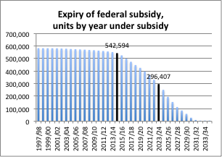
Annual Funding is Declining
Notes:
Source: Data for this bar graph was derived by Focus Consulting Inc, from schedules to each PT agreement, with interpolation for missing provinces/territories. It was shared with me by Steve Pomeroy.

Slide 27
3. Canada’s National Housing Strategy

Slide 28
#LetsTalkHousing
The Trudeau government is expected to release a “national housing strategy” in 2017.
What will it look like?

Slide 29
4. Seniors experiencing homelessness

Slide 30
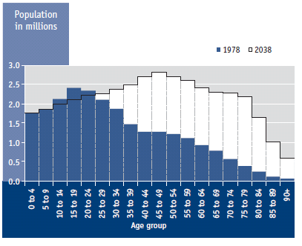
Canada’s Population, 1978 and 2038
Notes:
Source: Butler-Jones, David. 2010. Growing Older: Adding Life to Years. The Chief Public Health Officer’s Report on the State of Public Health in Canada 2010. Primary Data Source: Statistics Canada. Note: The 2038 figures refer to projected population. This figure has been copied-and-pasted from p. 14 of the report.

Slide 31
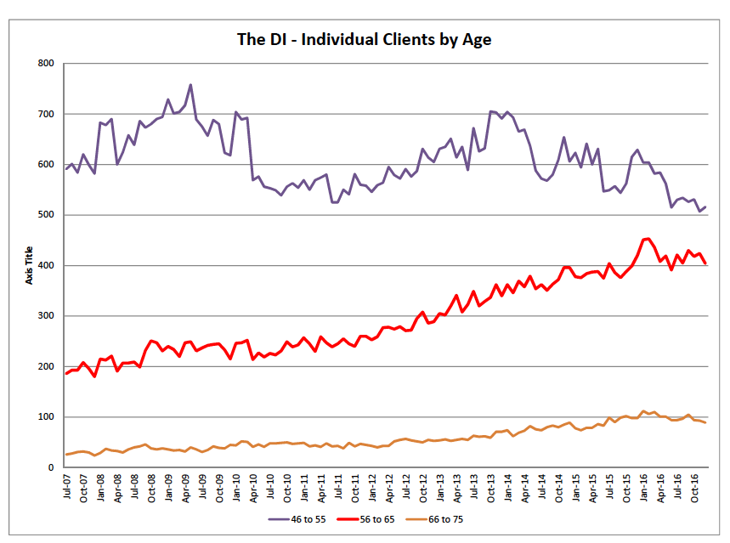
Notes:
Note: This visual was provided to the author by John Rowland. This data represent the total number of unique individuals in the age group in question who accessed the services of the DI in a month (any shelter service, including apartments) . Each data point is for one month.

Slide 32
5. Calgary’s volatile housing market

Slide 33
Calgary’s volatile housing market
Calgary’s economy is very dependent on the price of oil. As a result, it has a volatile rental housing market; workers migrate in and out of the city in large numbers depending on job prospects (and Calgary has very few rental housing units).
In October 2014, Calgary’s rental vacancy rate was a mere 1.4%. As of October 2016, it was 7.0%.
What will happen to the price of oil in 2017?
Notes:
Source: Canada Mortgage and Housing Corporation.

Slide 34
Thank You

