Slide 1
Cost considerations
By Nick Falvo, PhD
The intersection of housing and homelessness
Prepared for CHRA
April 29, 2025

Slide 2
Overview
Some current examples of wrapround costs
Some cost offset research
Does Housing First literally “save” tax dollars?

Slide 3
Let’s consider some present-day cost examples…

Slide 4
New place-based supportive housing in Toronto
What follow (on the next several slides) are some recent City of Toronto figures that apply to tenants who have experienced chronic homelessness.
The funding in question has come from a combination of federal and provincial sources.
Notes:
Source: Email correspondence with Michael Lyster (Homes First Society), Meredith Kratzmann (City of Toronto), and Matt Hilder (City of Toronto). Feb 2025. Any errors are mine, and not theirs. For detailed information, please contact the City of Toronto.

Slide 5
New place-based supportive housing in Toronto (cont’d)
$30K/yr - $36K/yr per unit for wraparound support
+
$13K/yr per unit for rental assistance (for operating costs)
______________________________________
TOTAL: $43K/yr - $49K/yr per tenant
Notes:
Source: Email correspondence with Meredith Kratzmann (City of Toronto) and Matt Hilder (City of Toronto). Feb 2025. Any errors are mine. For detailed information, please contact the City of Toronto.

Slide 6
New place-based supportive housing in Toronto (cont’d)
Wraparound support:
Province provides the $20K for wrapround support.
This typically covers 24-hr staffing, case management, the cost of a meal program, programming, activities (precise programming varies by program and provider).
“City of Toronto’s supportive housing programs operate within a Housing First approach, although strict fidelity to Pathways Housing First has not been assessed.”
Notes:
Source: Email correspondence with Meredith Kratzmann (City of Toronto). Feb 2025. Any errors are mine. For detailed information, please contact the City of Toronto.

Slide 7
New place-based supportive housing in Toronto (cont’d)
Rental assistance (cont’d):
The $13K/yr per tenant for rental assistance comes from a variety of sources.
City of Toronto provides a rental supplement, covering the gap between the tenant’s shelter portion and 80% AMR.
Rent paid by tenant (i.e., the shelter portion of their income assistance benefits) usually comes from some form(s) of government income assistance.
Notes:
Source: Email correspondence with Michael Lyster (Homes First Society), Meredith Kratzmann (City of Toronto), and Matt Hilder (City of Toronto). Feb 2025. Any errors are mine. For detailed information, please contact the City of Toronto.

Slide 8
New place-based supportive housing in Toronto (cont’d)
Rental assistance (cont’d):
Rental revenues (i.e., rent supplement combined with rent paid by tenant) is supposed to support the typical costs associated with operating a building (e.g., maintenance, repairs, waste removal, utilities).
Note: Subsidies discussed here do not include any capital costs (i.e., up-front costs of land or construction).
Notes:
Source: Email correspondence with Michael Lyster (Homes First Society), Meredith Kratzmann (City of Toronto), and Matt Hilder (City of Toronto). Feb 2025. Any errors are mine. For detailed information, please contact the City of Toronto.

Slide 9
H1FY in Calgary
In Calgary, Trellis takes a Housing First for Youth (H1FY) approach.
This essentially means Pathways Housing First adapted for youth (with more focus on family reunification than would be the case with adults).
Stephen Gaetz has written extensively on H1FY.
Notes:
Source: Email and Zoom correspondence with Kim Ledene (Jan 2025)

Slide 10
H1FY in Calgary (cont’d)
Trellis operates three H1FY programs.
Annual per-client operating costs (including wraparound supports and rental subsidy) for those three programs range from $21,141 to $28,110.
Figures do not include capital costs (H1FY operated by Trellis is mostly scattered site).
There are no formal fidelity reviews (having said that, Trellis is considered a leading-edge provider of H1FY).
Notes:
Source: Email and Zoom correspondence with Kim Ledene (Jan 2025)

Slide 11
H1FY in Calgary (cont’d)
The reason for the range of costs from one program to another relates to the intensity of supports.
For example, their Home Fire program is for Indigenous youth. This program has lower caseloads (7 youth per case manager) as well as cultural supports.
Notes:
Source: Email and Zoom correspondence with Kim Ledene (Jan 2025)

Slide 12
H1FY in Calgary (cont’d)
Trellis also operates place-based supportive housing for youth with severe addictions and mental health challenges.
Their place-based approach involves 24-hr staffing (two staff on at all times). It also has a mental health therapist working on site, as well as cultural supports.
Their place-based model costs $108,554 per client per year (for operating costs, includes wrapround supports + rent subsidy). Figures do not include capital costs.
Notes:
Source: Email and Zoom correspondence with Kim Ledene (Jan 2025)

Slide 13
H1FY in Calgary (cont’d)
Two of the three H1FY programs operated by Trellis are funded by the Calgary Homeless Foundation (which has used both provincial and federal $).
The other one (for Indigenous youth) is funded via the Indigenous stream of Reaching Home (i.e., federal money).
Their place-based supportive housing site is funded by two provincial ministries.
Notes:
Source: Email and Zoom correspondence with Kim Ledene (Jan 2025)

Slide 14
H1FY in Calgary (cont’d)
Other models for supporting youth in Calgary are more expensive.
The youth shelter operated by Trellis costs $73,448 per client per year in operating costs.
Child and Family Services Group Care (in Calgary) costs $200,750 per client per year in operating costs.
The higher costs of both of these other models stem from the need for 24-hr staffing at all times.
Notes:
Source: Email and Zoom correspondence with Kim Ledene (Jan 2025)

Slide 15
Research led by Eric Latimer
Eric Latimer is first author on two cost studies using data from the At Home/Chez Soi study.
A 2019 article was published on the ICM stream, and a 2020 article on the ACT stream.

Slide 16
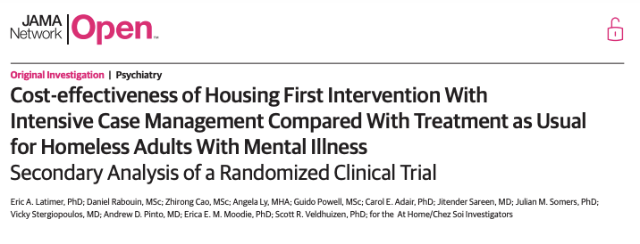
Latimer et al. 2019 (HF with ICM)

Slide 17
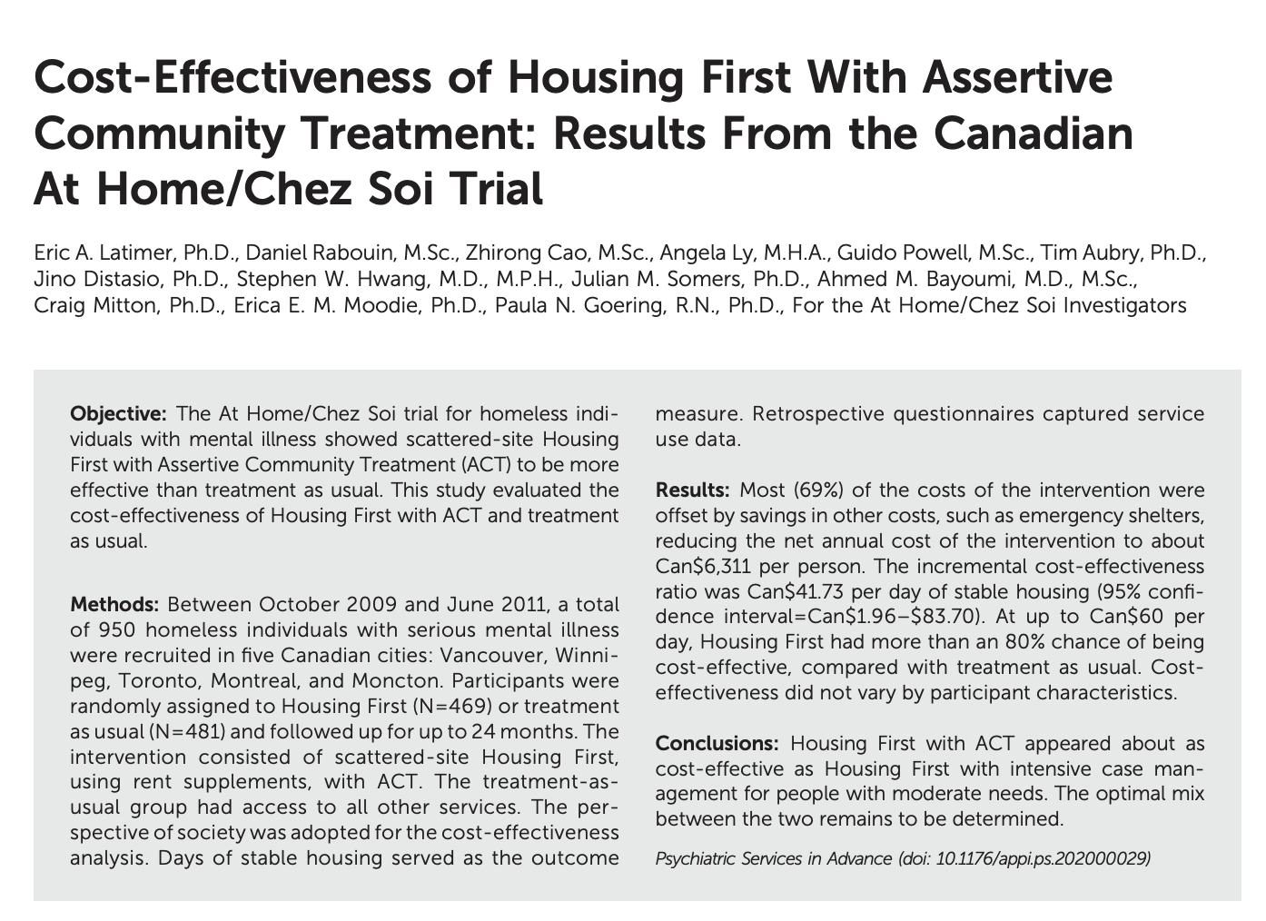
Latimer et al. 2020 (HF with ACT)

Slide 18
HF with ICM
AHCS participants with moderate levels of need.
Approx. 17 participants per case manager.
Cost of intervention: $14,496/person annually

Slide 19
HF with ICM (cont’d)
The mean total cost of HF participants ($14,496 annually) exceeded that of TAU by $7,868.
Thus, 46% of the cost of ICM intervention was offset.
“Cost offsets on a wide range of other services reduced the net cost to $7,868…” (p. 8).
Those “other services” included costs associated with shelters, ambulatory visits, and ED visits.

Slide 20
HF with ACT
AHCS participants with high levels of need.
Approx. 10 participants per case manager.
Cost of intervention: $20,367/person annually
Associated with a 69% cost offset (i.e., reduction in other services).

Slide 21
HF with ACT (cont’d)
The mean total cost of HF participants ($20,367 annually) exceeded that of TAU by $6,311 annually.
Thus, 69% of the cost of ACT intervention was offset by cost reductions, reducing the net cost to $6,311 per person per year.

Slide 22
The AHCS economic analysis
Both the 2019 study on ICM and the 2020 study on ACT used the same methodology.
Fidelity to the Pathways Housing First model was monitored and considered good.
Figures used to calculate cost of interventions include the rent supplements.

Slide 23
The AHCS economic analysis (cont’d)
Included in the calculations were any additional costs related to social assistance benefits (i.e., compared to what the participant would have received from social assistance without the intervention).
All costs were converted into 2016 Canadian dollars.
Most of the apartments were rented from private landlords.

Slide 24
The AHCS economic analysis (cont’d)
Cost offsets were greater for higher-need (i.e., higher-cost) participants.

Slide 25
Some caveats of the AHCS figures
They’re from the 2009-2013 period (rents today are higher).
Estimated costs are based on retrospective questionnaires and have some inaccuracy.
They don’t include any medication costs.

Slide 26
Some caveats of the AHCS figures (cont’d)
Cost offsets don’t always translate into actual cost savings (due to fixed costs of those other services).
The department or ministry that pays is not always the one that benefits directly from the cost offset.
It’s sometimes even a different order of government that benefits from the cost offset.

Slide 27
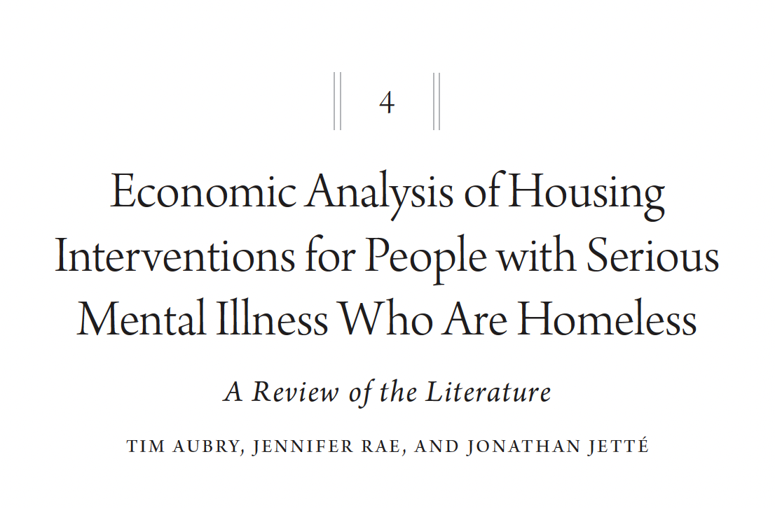
Further reading
Notes:
Source: Sylvestre, J., Nelson, G., & Aubry, T. (Eds.). (2017). Housing, citizenship, and communities for people with serious mental illness: Theory, research, practice, and policy perspectives. Oxford University Press.

Slide 28
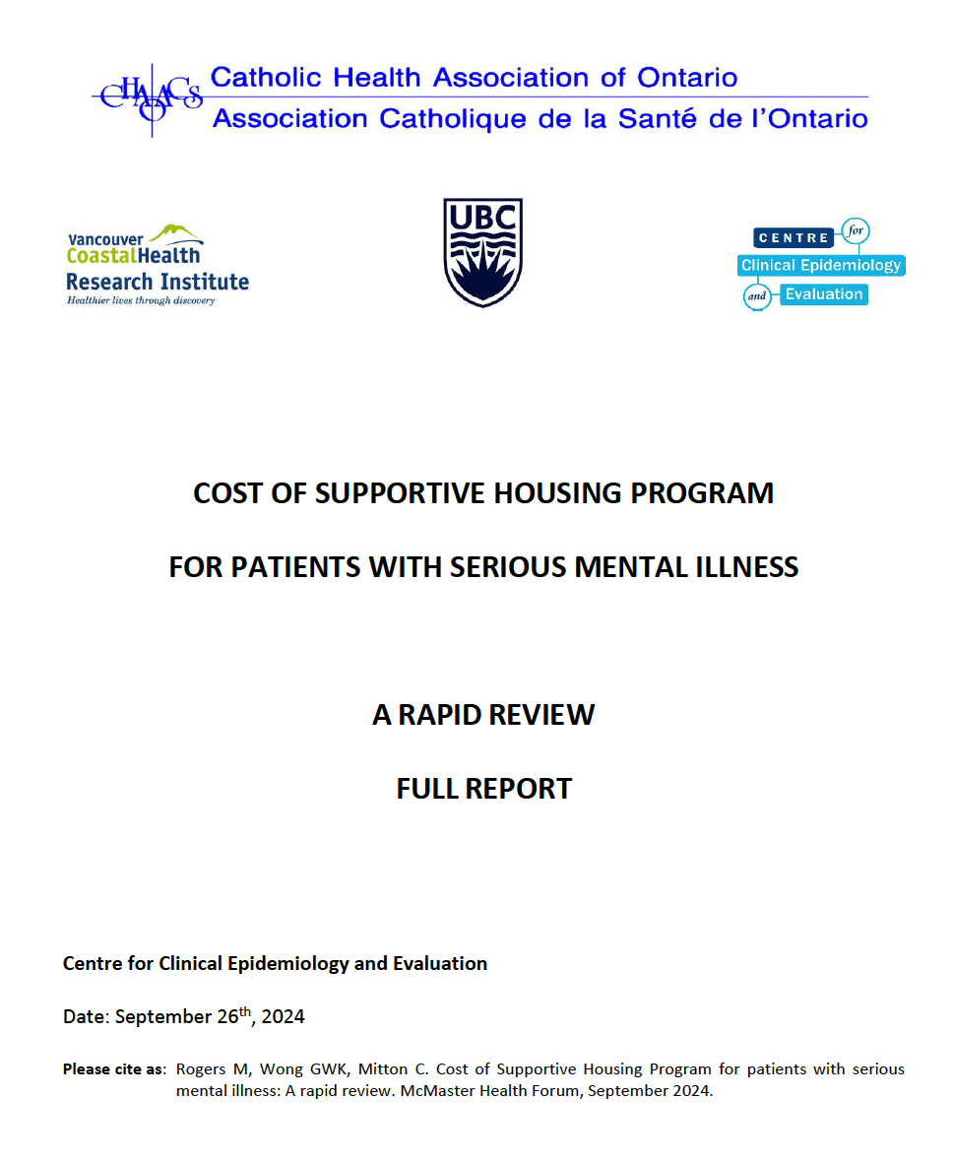
Further reading (cont’d)

Slide 29
What’s on your mind?

Slide 30
Key question
Does Housing First literally “save” tax dollars?

Slide 31
Does HF save tax dollars?
Randomized controlled studies (aka “RCT studies”) are typically considered the ‘gold standard’ of research.
RCT studies do not demonstrate cost savings to the same extent as pre-post studies.
RCT studies tend to report partial, but not complete, cost offsets.

Slide 32
Does HF save tax dollars (cont’d)?
In other words, the highest quality of research available suggests that Housing First typically does not literally pay for itself.
Admittedly, even RCT studies usually don’t measure all potential cost offsets associated with homelessness.
Costs not considered in most of this research include costs to bylaw services/encampment/outreach staffing, public transit authorities, and libraries.

Slide 33
Does HF save tax dollars (cont’d)?
And recall that even with cost offsets, you have the challenge of fixed costs associated with health and justice services.
In other words, reduced use of a service (especially in increments) does not necessarily result in less money spent on that service.

Slide 34
Word of caution
Saving money shouldn’t be the only motivator for policy-makers.
For example, if a person, once housed, starts to receive more medical attention, that may result in improved health outcomes (but higher costs).

Slide 35
Taking stock
We’ve covered lots of ground.
What’s on your mind?

