Slide 1
what supports are needed by vulnerable people in housing?
By Nick Falvo, PhD
The intersection of housing and homelessness
Prepared for CHRA
April 29, 2025

Slide 2
Overview
This is a rather short slide deck intended to talk a bit what is meant when we say that vulnerable households need “supports” once they’re in housing.

Slide 3
The word “support”
Usually means social workers (broadly defined) helping vulnerable people remain housed.
The term “wraparound support” gets used a lot (though may not mean much to someone outside the sector).
The term “case management” is also used (though that may mean something more specific to some people).

Slide 4
Some considerations
It costs money.
In Canada, the lion’s share of funding for support typically comes (at least originally) from either provincial or territorial governments.
Funders often try to fund less of it (there may be some wishful thinking out there).

Slide 5
Some considerations (cont’d)
In Canada, it’s quite uncommon for a municipality or province/territory to undertake a systematic assessment of the supports needed by vulnerable people in the municipality or province/territory in question.
Given the shortage of supports in relation to need, I suspect many senior officials worry that such an exercise would risk raising false expectations.

Slide 6
Some unresolved questions
Should vulnerable people receive it indefinitely, or should a sensible funder seek to taper it off over time?
Which entity should fund it in which context?
How well-trained and specialized do the staff persons have to be?
What exact model of support should be used?

Slide 7
Some unresolved questions (cont’d)
Which subpopulations should be prioritized for limited support funding? Historically in Canada, I think we’ve prioritized support dollars for persons with serious mental health challenges.
What kind of oversight (i.e., quality assurance) should be in place to ensure proper support is actually being provided over time?

Slide 8
Damian Collins’ research
Damian Collins is a Professor at the University of Alberta.
Professor Collins and a colleague conducted research on the implementation of Housing First in three Alberta cities during the 2014-15 period.
Their research found considerable variation in how long supports were being offered to tenants.

Slide 9
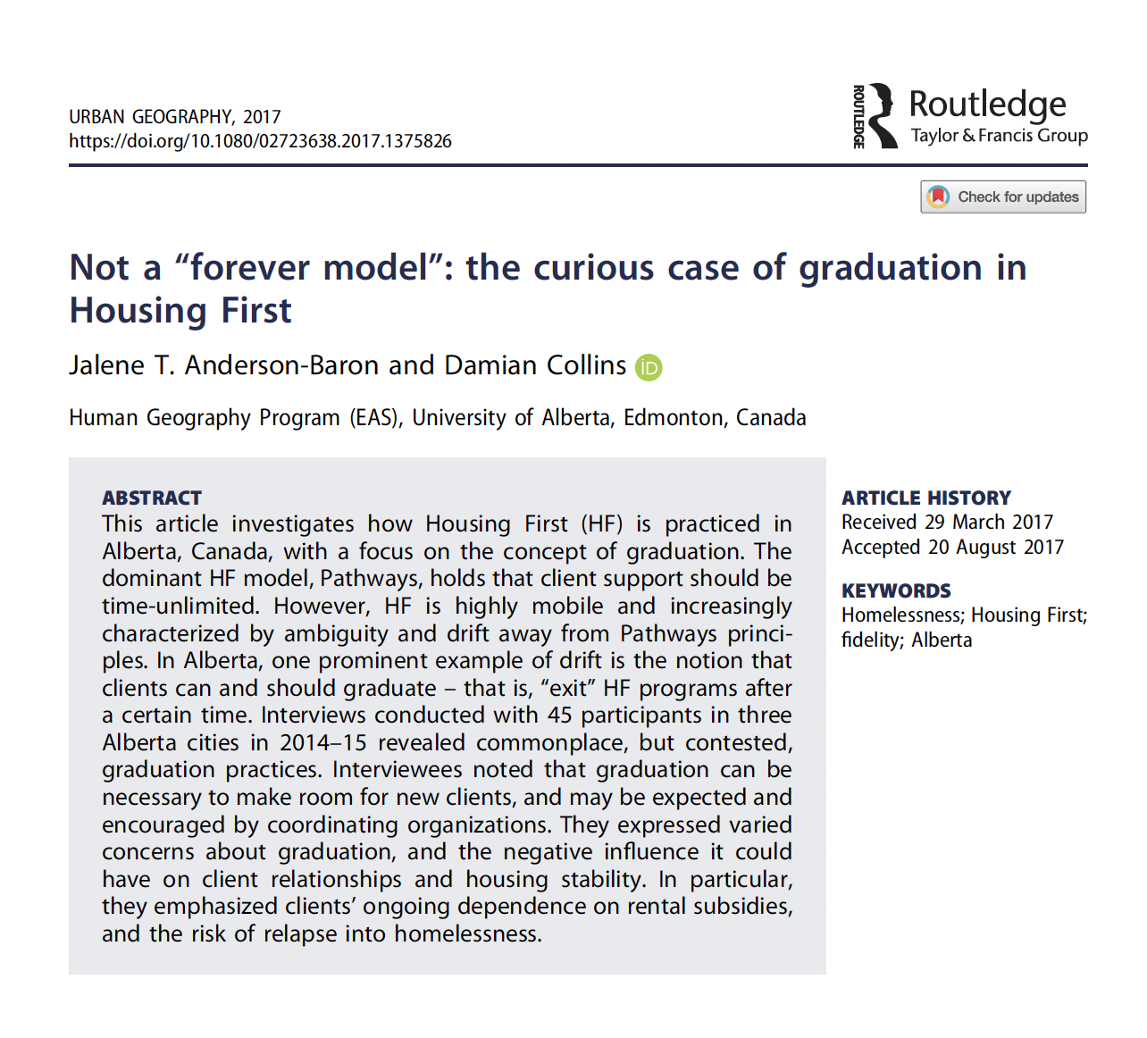
Damian Collins’ research

Slide 10
Support needs vary
Many Indigenous peoples might want on-site cultural supports (e.g., smudge, Elders).
For youth, support might include parenting support, assistance in reconnecting with family, and human trafficking support.
Seniors might need assistance with transportation and bathing.

Slide 11
Further reading
I’m writing an open access textbook on homelessness.
I upload new chapters as they become available; they’re all free of charge (i.e., no paywall).
Some chapters outline support needs of specific groups.
You can access all of book material at nickfalvo.ca

Slide 12
Taking stock
We’ve covered lots of ground.
What’s on your mind?

