Slide 1
promising practices
By Nick Falvo, PhD
The intersection of housing and homelessness
Prepared for CHRA
April 29, 2025

Slide 2
Overview
Habitat Services
DTES SRO Collaborative
Housing Focused Client Supports
Resource Centres

Slide 3
Overview (cont’d)
New Shelter Service Model
Manitoba Housing

Slide 4
Habitat Services
Toronto program, established in 1986, providing funding and oversight to private boarding homes.
Delayed response to rapid deinstitutionalization of psychiatric beds.
There were lots of private boarding homes, especially in neighbourhoods near psychiatric hospitals.

Slide 5
Habitat Services (cont’d)
The creation of Habitat Services was a key recommendation of a mayoral task force, chaired by psychologist Reva Gerstein.
Its final report was released in 1984.

Slide 6
Habitat Services (cont’d)
Without Habitat Services, might see 3 or more residents per room.
Habitat typically has 1 or 2 residents per unit.
Without Habitat, you’d see rather poor food quality.
Without Habitat, residents would have few rights.

Slide 7
Habitat Services (cont’d)
Without Habitat, there’s an annual inspection from the City for boarding homes (building, fire, food).
Habitat has weekly visits from an inspector – maybe once every two weeks. They are all unannounced inspections, with the exception of bedroom inspections (so that tenant can get 24 hours notice – that’s an RTA rule).

Slide 8
Habitat Services (cont’d)
Habitat monitors meals, bedroom areas, common spaces, access to telephones.
Habitat organizes group activities in partnership with another non-profit (Cota). For ex.: going out for coffee; going to museums; movie outings.
Twice a year, there’s a dance for entire portfolio.

Slide 9
Habitat Services (cont’d)
Each operator gets about $1,845 per tenant per month from Habitat and tenant – that’s the total subsidy they get (from both Habitat and tenant combined).
Tenant pays $543 per month for room and board (and cleaning and toiletries).
Habitat supports approx. 1,000 tenants across Toronto.

Slide 10
Habitat Services (cont’d)
Funding comes from three sources:
The Subsidy Program is funded by the Ministry of Health (80%) and the City of Toronto (20%)
The Habitat Services office and staffing is funded by Ontario Health (100%)

Slide 11
What’s on your mind?

Slide 12
The DTES SRO Collaborative
The Downtown Eastside SRO Collaborative
This is a Vancouver initiative
Focus is supporting vulnerable tenants in for-profit SRO hotels.
Approx. 3,000 units of housing have been identified.
Notes:
Source: Zoom interview (Nov 2024) and Email correspondence (Feb 2025) with Wendy Pederson (Executive Director, DTES SRO Collaborative).

Slide 13
The DTES SRO Collaborative (cont’d)
Stock is aging.
Many of these tenants are at risk of being ‘renovicted.’
Most of the tenants receive income assistance.
If tenants can be supported in place, it takes pressure off community housing.
Notes:
Source: Zoom interview (Nov 2024) and Email correspondence (Feb 2025) with Wendy Pederson (Executive Director, DTES SRO Collaborative).

Slide 14
The DTES SRO Collaborative (cont’d)
“Since 2016-2017, we’ve said ‘these are our buildings.’ We’re going to provide them some support. We won’t ask landlords’ permission. We don’t need a relationship with them. Landlords often don’t want us in their buildings.”
Increasingly, landlords are aware of the Collaborative’s work and many are now OK with involvement of Collaborative.
Notes:
Source: Zoom interview (Nov 2024) and Email correspondence (Feb 2025) with Wendy Pederson (Executive Director, DTES SRO Collaborative).

Slide 15
The DTES SRO Collaborative (cont’d)
This approach was inspired by the work of Jane McAlevey.
“We look for the well-connected tenants and try to leverage their leadership skills.”
Roles are created. Structures are created that the tenants themselves can maintain.
Notes:
Source: Zoom interview (Nov 2024) and Email correspondence (Feb 2025) with Wendy Pederson (Executive Director, DTES SRO Collaborative).

Slide 16
The DTES SRO Collaborative (cont’d)
14 Tenant Organizing Teams (TOT) support residents.
There’s one TOT for each of 14 SROs (i.e., one TOT per building).
Each TOT has 5 lead tenants.
Each lead tenant has one area of focus (e.g., overdose response, building operations, fire safety, extreme heat, outreach).
Notes:
Source: Zoom interview (Nov 2024) and Email correspondence (Feb 2025) with Wendy Pederson (Executive Director, DTES SRO Collaborative).

Slide 17
The DTES SRO Collaborative (cont’d)
Each TOT has one tenant focus on extreme heat prevention.
The Collaborative gets a grant each year from the City of Vancouver. Cases of water get delivered in the summer, in part because buildings don’t have good water. The delivery also allows for a check in with vulnerable tenants.

Slide 18
The DTES SRO Collaborative (cont’d)
Another tenant on the TOT works on eviction prevention by helping tenants who need help to clean their rooms, do small repairs and help older tenants get groceries and medical care.
Another tenant on the TOT focuses on fire safety.
Another tenant on the TOT works on harm reduction. That tenant picks up supplies on specific days.
Notes:
Source: Zoom interview (Nov 2024) and Email correspondence (Feb 2025) with Wendy Pederson (Executive Director, DTES SRO Collaborative).

Slide 19
The DTES SRO Collaborative (cont’d)
There are 15 program staff + about 120 peer staff (i.e., tenants). There are 10 other staff working in other ways (e.g., admin, research/eval, etc.).
Peer/tenant staff are paid $25/hr. It’s usually 4 hours per week, including one hour of one-on-one coaching in the Collaborative’s admin office. These are honoraria.
Notes:
Source: Zoom interview (Nov 2024) and Email correspondence (Feb 2025) with Wendy Pederson (Executive Director, DTES SRO Collaborative).

Slide 20
The DTES SRO Collaborative (cont’d)
There are Chinese-speaking tenants who do outreach with Chinese tenants.
Full-time staff are not in the building. It’s peer staff who are in the building.
Notes:
Source: Zoom interview (Nov 2024) and Email correspondence (Feb 2025) with Wendy Pederson (Executive Director, DTES SRO Collaborative).

Slide 21
The DTES SRO Collaborative (cont’d)
They’ll put up a bulletin board in a building, just for tenants.
In some cases, a room is rented from the landlord and then turned into a community room.
Notes:
Source: Zoom interview (Nov 2024) and Email correspondence (Feb 2025) with Wendy Pederson (Executive Director, DTES SRO Collaborative).

Slide 22
The DTES SRO Collaborative (cont’d)
Funders:
BC’s Ministry of Housing
City of Vancouver
Vancouver Coastal Health
Reaching Home (Government of Canada)
There are several smaller funders as well.
Notes:
Source: Zoom interview (Nov 2024) and Email correspondence (Feb 2025) with Wendy Pederson (Executive Director, DTES SRO Collaborative).

Slide 23
The DTES SRO Collaborative (cont’d)
Caveat: In order for this model to work with high-acuity tenants, additional resources would likely be required.
More information can be found at their website:
https://srocollaborative.org/
At the website, there’s an evaluation of the Collaborative’s work as well as some videos.
Notes:
Source: Zoom interview (Nov 2024) and Email correspondence (Feb 2025) with Wendy Pederson (Executive Director, DTES SRO Collaborative).

Slide 24
The DTES SRO Collaborative (cont’d)
Here’s a 4-min video from their website:
https://srocollaborative.org/wp-content/uploads/2020/01/in-our-own-homes.mp4?_=1

Slide 25
What’s on your mind?

Slide 26
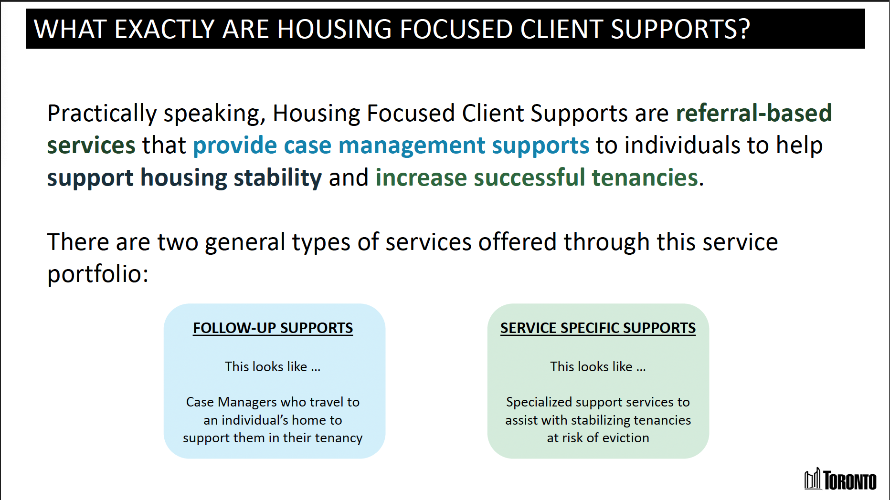
Housing Focused Client Supports
Notes:
I’ve taken this slide from a City of Toronto slide deck dated 28 Aug 2024, delivered by Lindsay Allan.

Slide 27
Housing Focused Client Supports (cont’d)
This City of Toronto initiative has two buckets:
Follow up supports layered into housing (for people leaving homelessness or at risk of homelessness)
Service-specific supports—mostly prevention (e.g., hoarding support through various community non-profits, voluntary trusteeship partners, etc.).
Notes:
Source: Zoom call with Zoom with Lindsay Allan (City of Toronto), 21 Oct 2024.

Slide 28
Housing Focused Client Supports (cont’d)
Originally, this was focused on helping people who were exiting homelessness.
But since Oct 2022, it was expanded to support persons ‘at risk’ of becoming homeless.
To qualify, a person has to either have a history of homelessness, or be living in social housing, or be at imminent risk of homelessness.
Notes:
Source: Zoom call with Zoom with Lindsay Allan (City of Toronto), 21 Oct 2024.

Slide 29
Housing Focused Client Supports (cont’d)
City tries to focus on persons at greatest risk.
History of homelessness is a factor.
Person must go through the City’s Coordinated Access process (STARS) in order to access this.
Notes:
Source: Zoom call with Zoom with Lindsay Allan (City of Toronto), 21 Oct 2024.

Slide 30
Housing Focused Client Supports (cont’d)
Once referral takes place, City can reach out to the referring worker within a few weeks—on average, 2-3 weeks from time of referral to start of work with client.
Ergo: the wait time for this initiative is much shorter than the wait time involved with Housing First (housing + wrapround support).
At any given time, approx. 2,000 people can be supported through this initiative.
Notes:
Source: Zoom call with Zoom with Lindsay Allan (City of Toronto), 21 Oct 2024.

Slide 31
Housing Focused Client Supports (cont’d)
This is a short-term service: 12-18 months is the average (however, the voluntary trusteeship component is indefinite).
Elsewhere in the city, there are long-term wrapround support programs with lengthy waiting lists.
Notes:
Source: Zoom call with Zoom with Lindsay Allan (City of Toronto), 21 Oct 2024.

Slide 32
Housing Focused Client Supports (cont’d)
Both general and specialized (mostly short-term) wraparound support is offered through this initiative.
COTA and Reconnect are considered experts in working with high-need clients.
519 and Fife House provide specific supports.
Various Indigenous-led initiatives as well.
Notes:
Source: Zoom call with Zoom with Lindsay Allan (City of Toronto), 21 Oct 2024.

Slide 33
Housing Focused Client Supports (cont’d)
City refers to the appropriate agency, based on STARS assessment. It’s typically a referral to one agency only.
City of Toronto provides operational oversight.
Notes:
Source: Zoom call with Zoom with Lindsay Allan (City of Toronto), 21 Oct 2024.

Slide 34
What’s on your mind?

Slide 35
Resource Centres
Partnership between Ottawa Community Housing (OCH) and Options Housing (formerly Options Bytown).
Options Housing has staff on site in 8 OCH buildings.
Generally one FTE staff in each building (on the ground floor of the building).
Staff are visible to tenants during business hours (M-F).

Slide 36
Resource Centres (cont’d)
All tenants know about this (new tenants get told about it in their welcome kits).
It’s framed to tenants as “whatever you need help with.”
Some tenants may need to fax something to their social assistance office.
Others may need access to food.
Notes:
Source: Zoom call with Notes from Zoom with Catharine Vandelinde (Executive Director, Options Housing), 11 Sep 2024.

Slide 37
Resource Centres (cont’d)
Other tenants may be in crisis.
Lots of income tax assistance.
Assistance with annual reviews of eligibility subsidized housing (i.e., “RGI eligibility”).
This initiative has been in place for approx. 15 years.
Notes:
Source: Zoom call with Notes from Zoom with Catharine Vandelinde (Executive Director, Options Housing), 11 Sep 2024.

Slide 38
Resource Centres (cont’d)
It’s officially framed as homelessness prevention.
About 1,000 unique individuals access resource centres (all 8 of them) each month.
On average, about 60% of tenants in a building will access the centre in a year.
Notes:
Source: Zoom call with Notes from Zoom with Catharine Vandelinde (Executive Director, Options Housing), 11 Sep 2024.

Slide 39
Resource Centres (cont’d)
Nine staff in total, plus a manager.
Funded through the City of Ottawa (using federal money as of Sep 2024 – used to be funded by Province).
Aging in Place is a local non-profit that does similar work in some OCH seniors buildings.
Ottawa Salus is a local non-profit that does similar work in other OCH buildings.
Notes:
Source: Zoom call with Notes from Zoom with Catharine Vandelinde (Executive Director, Options Housing), 11 Sep 2024.

Slide 40
What’s on your mind?

Slide 41
New Shelter Service Model
Shortly before the pandemic, the City of Toronto mandated that all City-funded shelters focus on housing their residents as much as possible.
The New Shelter Service Model (NSSM) was developed in conjunction with some providers.
Under the NSSM, case managers and Housing Help Workers are used to help clients get into housing.
Notes:
Source: Zoom call with Michael Potvin (Homes First Society), 1 Oct 2024.

Slide 42
New Shelter Service Model (cont’d)
Case managers: 20 clients each.
Role of case manager: to build working relationships with clients, and get them ready to access housing.
Case managers help clients complete various forms of documentation and help them them access medical supports.
Notes:
Source: Zoom call with Michael Potvin (Homes First Society), 1 Oct 2024.

Slide 43
New Shelter Service Model (cont’d)
Under the NSSM, there is also (typically) one Housing Help Worker for every 3 case managers.
Then, one supervisor (who may also work with clients a bit).
The role of the Housing Help Worker is to deal with landlords, help clients connect with landlords, and support unit viewings.
Notes:
Source: Zoom call with Michael Potvin (Homes First Society), 1 Oct 2024.

Slide 44
New Shelter Service Model (cont’d)
Also under NSSM, there’s an intake with new clients. They do STARS assessment (developed by the City of Toronto).
Clients get triaged at intake. People get categorized: High, medium or low needs. High or med get case manager; low typically doesn’t get case manager.
Clients can redo the intake as well. If a staff thinks a client has been mis-categorized, it can be redone.
Notes:
Source: Zoom call with Michael Potvin (Homes First Society), 1 Oct 2024.

Slide 45
New Shelter Service Model (cont’d)
City of Toronto does quarterly audits.
An Agency Review Officer (ARO) will randomly select client files and look at them to make sure there are assessments, case plans and work plans.
Notes:
Source: Zoom call with Michael Potvin (Homes First Society), 1 Oct 2024.

Slide 46
New Shelter Service Model
City staff come to a shelter once per quarter.
There are four different audits each year – case management is once a year.
Harm reduction audit is once a year.
There are two other audits as well.
Notes:
Source: Zoom call with Michael Potvin (Homes First Society), 1 Oct 2024.

Slide 47
What’s on your mind?

Slide 48
Manitoba Housing
Manitoba Housing is working to develop a Housing First stream within their broader social housing program.
Back in 2016, they made a change to their point rating system. Prior to that, a tenant got prioritized if they were experiencing gender-based violence. In 2016, “experiencing homelessness” was added. Maximum points now go to those two groups.
Now, 70% of tenants who move into a Manitoba Housing unit are from one of those categories.
Notes:
Source: 18 Sep 2024 Zoom with Carolyn Ryan (CEO of Manitoba Housing)

Slide 49
Manitoba Housing (cont’d)
Admittedly, they’re treating “experiencing homelessness” in a very broad way—it can include ‘couch surfing,’ staying at a shelter or rough sleeping.
Previously, if there were supports provided by external agencies when a tenant moved in, those supports tended to ‘disappear’ shortly after the person was housed (that’s a Manitoba-wide problem re: long-term supports).
Notes:
Source: 18 Sep 2024 Zoom with Carolyn Ryan (CEO of Manitoba Housing)

Slide 50
Manitoba Housing (cont’d)
Manitoba Housing has a total of about 12,000 community housing units. They want about 2,000 to have intensive supports.
This may entail changes to visitor policies (e.g., sign in, sign out).
There will be harm reduction.
Notes:
Source: 18 Sep 2024 Zoom with Carolyn Ryan (CEO of Manitoba Housing)

Slide 51
Manitoba Housing (cont’d)
They also feel this probably isn’t enough.
Manitoba Housing feels it needs an additional 6,000 units with a medium level of intensity of supports.
They’d also like to have some 20-unit buildings.
“We’re saying we want to be more of a supportive housing provider. It will be like a subprogram.”
Notes:
Source: 18 Sep 2024 Zoom with Carolyn Ryan (CEO of Manitoba Housing)

Slide 52
What’s on your mind?

