Slide 1
What lies ahead for Community-level homelessness planning in alberta?
By Nick Falvo, PhD
9 April 2025
Keynote address:
Earth and Atmospheric Sciences Research Symposium
University of Alberta

Slide 2
Overview
Some background
Alberta’s CBO model
The Dec 20 announcement
What may lie ahead?

Slide 3
Some background
In the 1980s, various provincial and municipal governments in Canada began focusing on homelessness (and supportive housing).
Direct federal support began in 2000 with launch of the Supporting Communities Partnership Initiative (SCPI), providing $135M per year across Canada for homelessness services and support programs
The Housing First narrative began to gain currency across Canada shortly after this.

Slide 4
Some background (cont’d)
In Jan 2008, the GoA announced the establishment of the Alberta Secretariat for Action on Homelessness (the “Secretariat”).
It had a mandate to develop a 10‑year provincial strategic plan outlining a coordinated approach to addressing homelessness – including goals, timelines and financial requirements.

Slide 5
Some background (cont’d)
In 2009, Alberta became the first Canadian province to commit to a 10-year plan to end homelessness.
The plan outlined priorities, goals, objectives and timelines.
Secretariat would oversee implementation of the Plan. Recommended initiatives included supporting the creation of a homeless management information system.

Slide 6
Some background (cont’d)
Housing First (HF) was strongly embedded in the Plan.
While HF has many definitions, it generally puts strong emphasis on providing immediate access to permanent housing (without requiring abstinence/sobriety) as well as to various forms of professional staff support.
Such staff support is often referred to as ‘wrapround support.’

Slide 7
Alberta’s CBO model
Since at least 2009-10, Alberta’s seven largest cities have used both federal and provincial homelessness funding to address homelessness.
The federal $$$ is now called Reaching Home funding.
The provincial $$$ is now called Outreach and Support Services Initiatives (OSSI).
As of 2024, Calgary was receiving approx. $42M provincially and approx. $21M federally.

Slide 8
Alberta’s CBO model (cont’d)
Across the seven municipalities in question, both Reaching Home Funding and OSSI funding has been ‘funneled through’ large entities—in some cases municipalities, in some cases public agencies, and in some cases non-profit entities.
They are listed on the next slide.

Slide 9
Alberta’s CBO model (cont’d)
Notes:
Source: https://www.7cities.ca/

Slide 10
Alberta’s CBO model (cont’d)
Most of the funding ultimately goes to smaller non-profits that directly serve persons experiencing homelessness.
Each Community-Based Organization (CBO)—i.e., each larger entity—has a significant amount of say as to where the funding flows.

Slide 11
Alberta’s CBO model (cont’d)
With OSSI spending across Alberta:
The major focus has been on providing operating funding to house vulnerable people (including both affordability and wraparound supports).
Until recently [more on this later] the GoA has been quite flexible in terms of how CBOs have used this funding within those broad parameters.

Slide 12
Alberta’s CBO model (cont’d)
Each CBO has also been taking a share of the funds to operate its own organization (as well as to serve as a ‘backbone’ agency supporting data collection, analytics and triage). In effect, CBOs provide important services to community. Types of services provided have varied considerably across communities.
Province funds most emergency shelter beds directly.
Other provinces and territories have their own models. Alberta’s has generally been considered rather unique.

Slide 13
Alberta’s CBO model (cont’d)
Alberta’s CBO model has become quite famous across Canada (and internationally as well).
Alberta’s approach to homelessness governance is often viewed as a model for the rest of Canada.
Professor Carey Doberstein wrote about it in a 2017 book published by UBC Press.

Slide 14
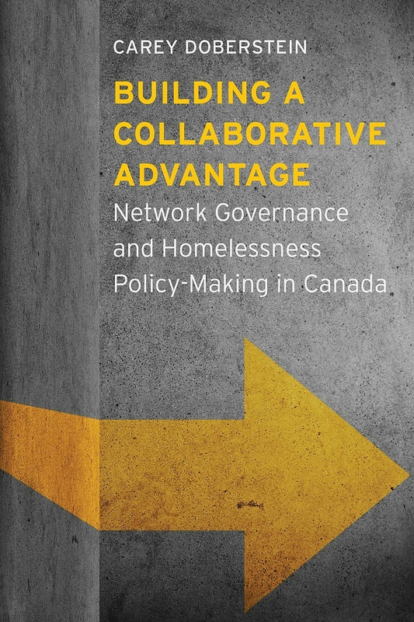

Slide 15
Doberstein’s analysis
Focuses on 1995-2015 period.
His analysis refers to the importance of having local officials having their ear to the ground (rather than simply having public servants in offices looking at data trends).
Local trends evolve quickly and aren’t always easily measurable.

Slide 16
Doberstein’s analysis (cont’d)
His analysis also discusses how slowly decisions get made at the provincial level, where proposals often have to be vetted by various agencies as well as by elected officials.
Provincial decisions can happen at a sluggish pace.
By contrast, CBOs can make decisions more quickly and with less aversion to immediate political gain or risk.

Slide 17
Doberstein’s analysis (cont’d)
In the book, Calgary’s approach to local homelessness governance is contrasted to that of Toronto’s and Vancouver’s.
Calgary’s approach is held up by Doberstein as being more engaging and responsive to local needs, especially in relation to Toronto’s approach.

Slide 18
Some personal reflections
When I worked at the Calgary Homeless Foundation:
Our CEO met regularly with CEOs of smaller non-profits in Calgary’s homeless-serving system of care.
Many of our other staff met regularly with staff in the non-profits that we funded.
CHF staff also monitored local data trends.

Slide 19
Some personal reflections (cont’d)
When I worked at the Calgary Homeless Foundation (cont’d):
We could stop in to local sites with little notice and get shown around.
We felt we could see local trends/phenomena unfold as they did.

Slide 20
Some personal reflections (cont’d)
When I worked at the Calgary Homeless Foundation (cont’d):
Put differently, we were very well-placed to allocate and adjust funding for local service providers. We could course correct on a dime, so to speak.

Slide 21
Some personal reflections (cont’d)
When I worked at the Calgary Homeless Foundation (cont’d):
Admittedly, not all local non-profits in our homeless-serving sector always loved every decision we made, especially if we weren’t funding them to the extent that they believed we ought to have been.
Local non-profits sometimes expressed this displeasure both to us and to the Province.

Slide 22
The Dec 20 announcement

Slide 23
The Dec 20 announcement (cont’d)
Announcement re: provincial funding for housing with supports.
Minister Nixon said such funding would now be provided directly to service providers by GoA.
As of 2024-25, the Minister noted the annual funding for this amount was $101.5M across all 7 communities.

Slide 24
The Dec 20 announcement (cont’d)
The Minister said this would increase accountability and oversight. He also said it would create “significant administrative efficiencies.”
He suggested it was sensible to eliminate ‘the middle man.’
He suggested the current ‘7 city’ structure may put insufficient attention on the needs of other, smaller municipalities that are seeing new homelessness.

Slide 25
The Dec 20 announcement (cont’d)
He also suggested this move might allow various ministries to work together more cohesively.
He said that some CBO money has gone to places it shouldn’t have (e.g., funding for tents, which could encourage encampments; funding for pet food banks).
Minister Nixon said there would be no funding reductions.

Slide 26
The Dec 20 announcement (cont’d)
Possible motivating factors
Desire by UCP govt to exert more direct control over funding decisions—both types of programming (e.g., less harm reduction) and funding levels received by specific non-profit agencies
Desire by UCP to get more credit for funding decisions
Desire by UCP government to have more control over the narrative (see next two slides)

Slide 27
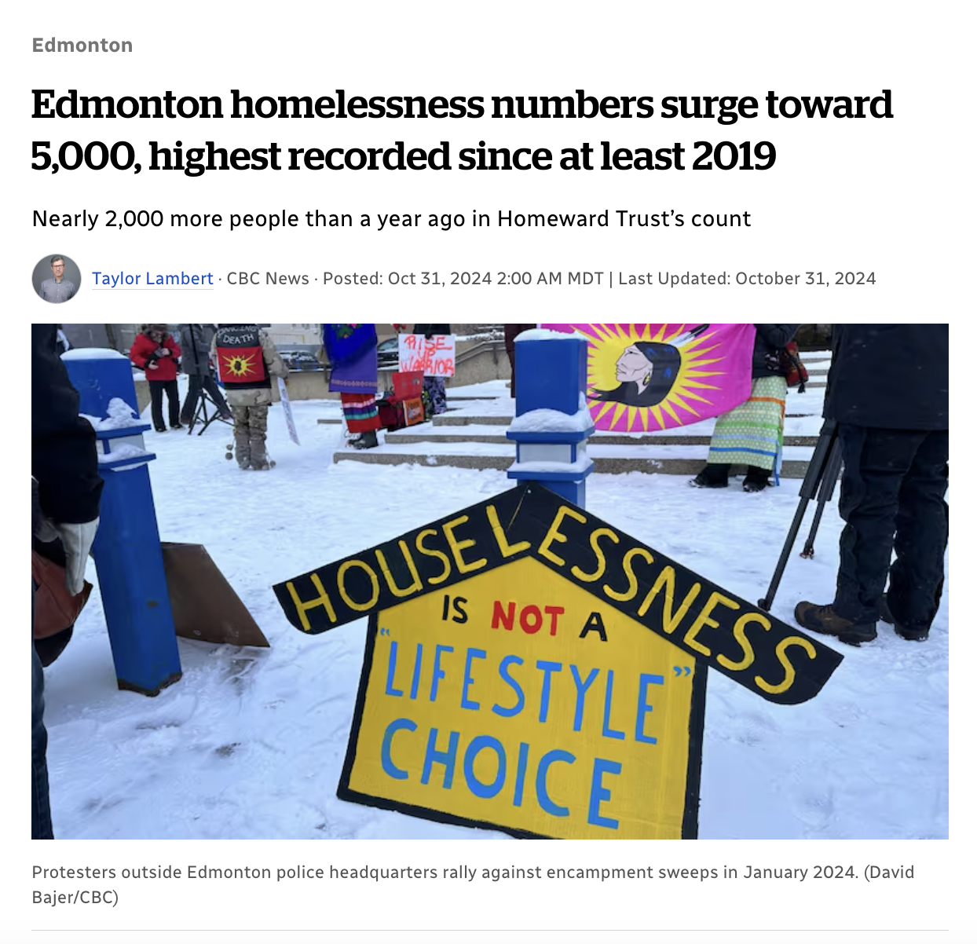
Notes:
Source: https://www.cbc.ca/news/canada/edmonton/homelessness-count-1.7368114

Slide 28
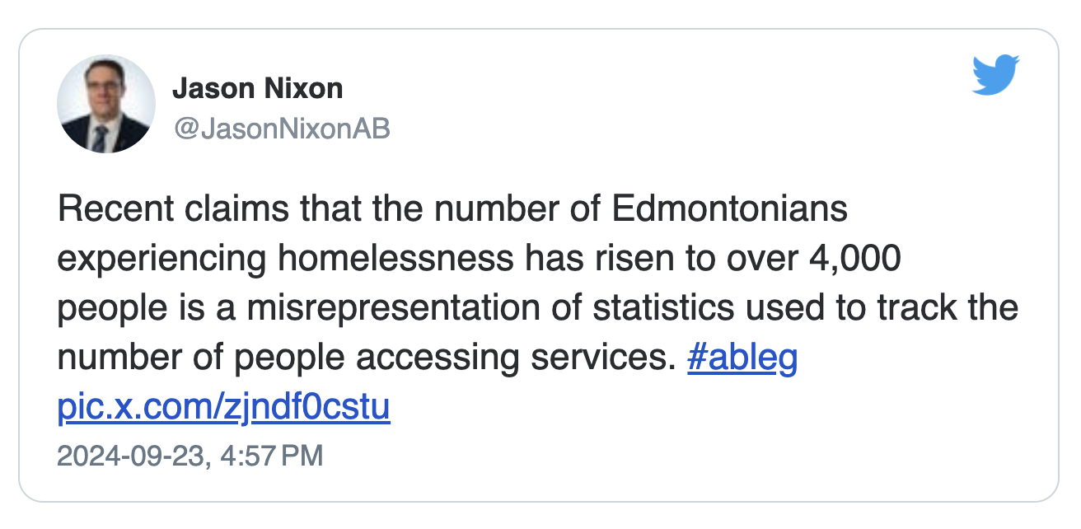

Slide 29
The Dec 20 announcement (cont’d)
So what does this mean going forward?
For Edmonton and Calgary (the two largest communities), matters are largely ‘business as usual’ until Oct 2025 (to account for their size).
With the other five CBOs, funding changes took effect on 1 Apr 2025.

Slide 30
The Dec 20 announcement (cont’d)
So what does this mean going forward (cont’d)?
We should expect to see CBOs get specific funding amounts tied to specific roles—so grants for specific functions, rather than freedom to use 10% of operating funding to use with considerable discretion.
GoA will likely fund CBOs to lead data stewardship, coordinated access, and training.

Slide 31
The Dec 20 announcement (cont’d)
So what does this mean going forward (cont’d)?
Ongoing conversations re: what CBOs will keep doing and what they’ll stop doing.
Federal Reaching Home funding directly to CBOs will continue.

Slide 32
The Dec 20 announcement (cont’d)
So what does this mean going forward (cont’d)?
Some non-profits may now have multiple contracts and multiple sets of reporting requirements (where previously they had just one).

Slide 33
What happens now?
Possible staff reductions at CBO-level across province. Will some current CBO staff become provincial public servants?
Will GoA ‘lean in’ on federal funding?
I suspect there may be less support for harm reduction (which also means less support for Housing First). So probably a greater focus on abstinence-based support.

Slide 34
What happens now?
The GoA’s lead minister on homelessness may now have more leverage to ‘lean into’ other ministries and negotiate for more inter-ministerial collaboration. Most obvious areas: health and housing.
There may now be an opportunity for a more provincially-coordinated data strategy in the sector.

Slide 35
What happens now?
Responsibility for homelessness will now be increasingly viewed as a provincial one (a classic case of ‘be careful what you wish for’).
Ergo: opposition MLAs, Mayors, City Councillors, and grassroots advocates may have a clearer target for their advocacy.

Slide 36
Thank you

