Slide 1
non-market housing 101
Changing Lives & Building Community:
How Calgary is tackling the affordable housing crisis
Event sponsored by the
Calgary Affordable Housing Foundation
Presentation by Nick Falvo, PhD
May 21, 2026

Slide 2
Overview
Non-housing outcomes of housing
Why non-profit housing?
The federal role
The provincial role

Slide 3
Non-market outcomes of housing
Meta-analysis by Steele and Kreda, 2017
Link btw physical housing and: children’s educational outcomes, child development outcomes, and physical and mental health of tenants
Link btw crowding and children’s educational outcomes, child development outcomes and on the physical and mental health of occupants
Notes:
Source: https://assets.cmhc-schl.gc.ca/sf/project/archive/publications/research_insight/69259_w.pdf

Slide 4
Non-market outcomes of housing
Meta-analysis by Steele and Kreda, 2017 (cont’d)
Link btw housing instability and health, as well as child development
Link btw affordable housing and couple stability
Link btw stability provided by non-market housing and employment outcomes
Notes:
Source: https://assets.cmhc-schl.gc.ca/sf/project/archive/publications/research_insight/69259_w.pdf

Slide 5
The non-market advantage
Non-market housing typically refers to housing owned by a public or non-profit entity.
The name refers to who owns it.
Most of the inputs into the creation of non-market housing are in from private sources.

Slide 6
The non-market advantage (cont’d)
Capital costs
Architects, cost consultants, general contractors, electrical contractors, drywall contractors, paving contractors, engineers, land surveyors, environmental consultants, soils consultants, lawyers and labourers.

Slide 7
The non-market advantage (cont’d)
Operating costs
Debt servicing over the length of a mortgage is key here.
Other operating costs include ongoing maintenance, major repairs, utilities and sometimes wraparound support.

Slide 8
The non-market advantage (cont’d)
Speaking personally, I’m a private business owner who co-owns his own house.
All of which is to say that, even with non-market housing, private entities play crucial roles.

Slide 9
The non-market advantage (cont’d)
But non-market ownership can really pay dividends.
It’s comes down largely to ‘getting in front of the market.’
Non-market housing providers also have mandates to keep rents low over the long term.
Corporate by-laws of non-profit providers forbid the non-profit provider’s board directors or members from personally profiting from increased revenue gained from increasing the rent.

Slide 10
The non-market advantage (cont’d)
If non-market housing assets are ever sold, any proceeds from the sale must be retained by the non-market housing provider (the proceeds cannot be used for personal or private gain).
Put differently, non-market housing providers preserve affordability over the long term.

Slide 11
The non-market advantage (cont’d)
Research on co-op housing:
I co-authored a 2022 report for the Co-operative Housing Federation of Canada.
Compared rents in co-op housing units to rents of similar private-sector market units in Victoria, Vancouver, Edmonton, Toronto and Ottawa for the period 2006–2021.

Slide 12
The non-market advantage (cont’d)
Research on co-op housing (cont’d):
Report compared ‘apples to apples,’ comparing buildings of similar structure (townhouse vs. apartment building) and # of bedrooms.
The study did not include co-op units that have the much lower Rent Geared to Income (RGI) rents that a minority of co-op households pay.

Slide 13
The non-market advantage (cont’d)
Research on co-op housing (cont’d):
We found co-op rents to be consistently lower than market rents for apartments and townhouses, with the gap widening over time. Co-op rents for 1- and 2-bedroom apartments were found to be approximately 25% below market (between $150 and $250 per month difference) in early part of the study period, and this widened to approximately 33% (reaching $400 to $500 difference monthly) in the later years.

Slide 14
The non-market advantage (cont’d)
Research on co-op housing (cont’d):
Note: The condition of 97% of formerly federally administered co-op housing (which constitutes the majority of co-op housing in Canada) is rated as fair to excellent.

Slide 15
Let’s shift gears
I’m going to talk now about the role of the Government of Canada.

Slide 16
The federal role
Leverage
Cost matching
They start the party, so to speak.

Slide 17
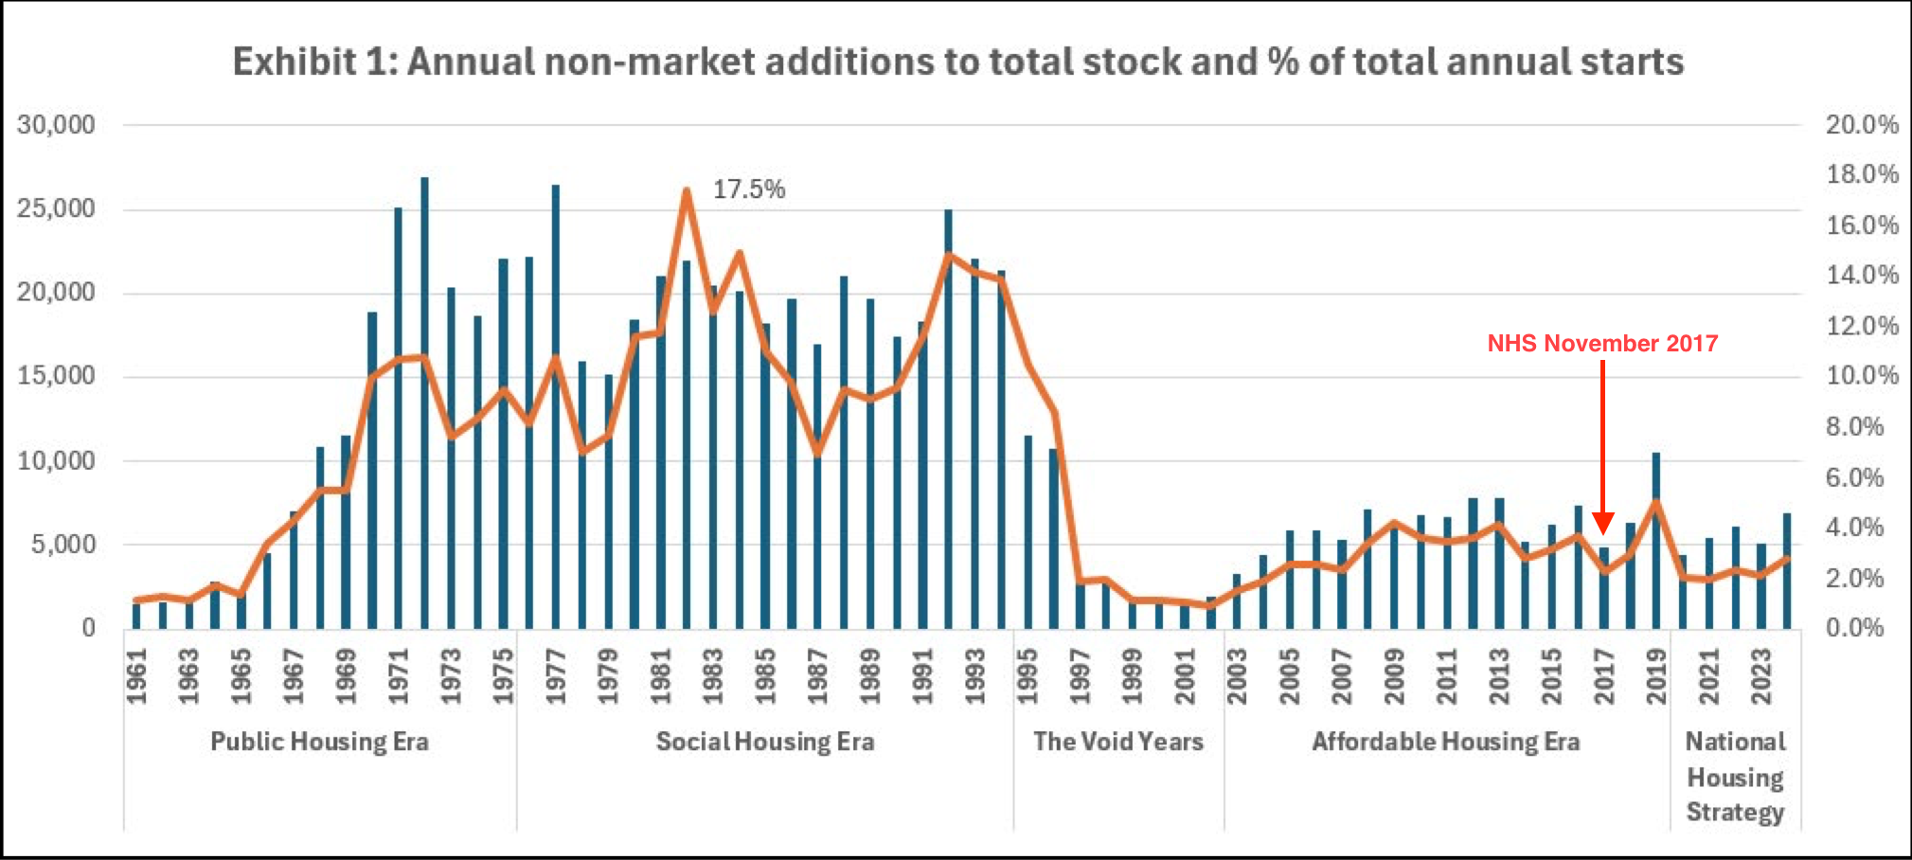
The federal role (cont’d)
Notes:
Notes: Steve Pomeroy, who also generated this chart, has defined non-market housing as “units owned and managed by a non-profit organization or government agency, where rents are below the standard market rate.” Ray Sullivan breaks down the terminology here: https://chra-achru.ca/blog_article/whats-in-a-name-get-the-job-done/. The source document for the above visual is here: https://chra-achru.ca/wp-content/uploads/2025/11/Scaling-up-non-market-housing-CHRA-report_2025.pdf.

Slide 18
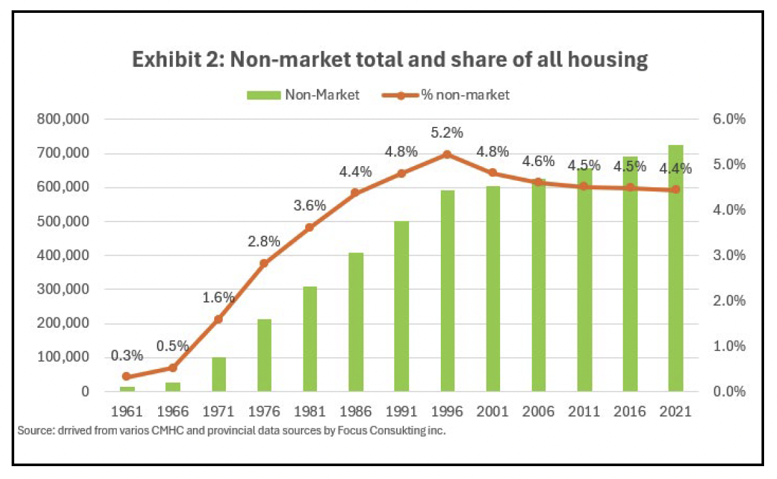
The federal role (cont’d)
Notes:
Notes: Steve Pomeroy, who also generated this chart, has defined non-market housing as “units owned and managed by a non-profit organization or government agency, where rents are below the standard market rate.” Ray Sullivan breaks down the terminology here: https://chra-achru.ca/blog_article/whats-in-a-name-get-the-job-done/. The source document for the above visual is here: https://chra-achru.ca/wp-content/uploads/2025/11/Scaling-up-non-market-housing-CHRA-report_2025.pdf.

Slide 19
The federal role (cont’d)
“Federal planned spending on housing programs is set to decline 56 per cent, from $9.8 billion in 2025-26 to $4.3 billion in 2028-29 due to the expiry of funding for existing programs and cuts set out in Budget 2025.”
— PBO (2 Dec 2025)
Notes:
Source: https://www.pbo-dpb.ca/en/publications/RP-2526-020-S--build-canada-homes-outlook-housing-programs-under-budget-2025--maisons-canada-perspectives-entourant-programmes-logement-dans-cadre-budget-2025

Slide 20
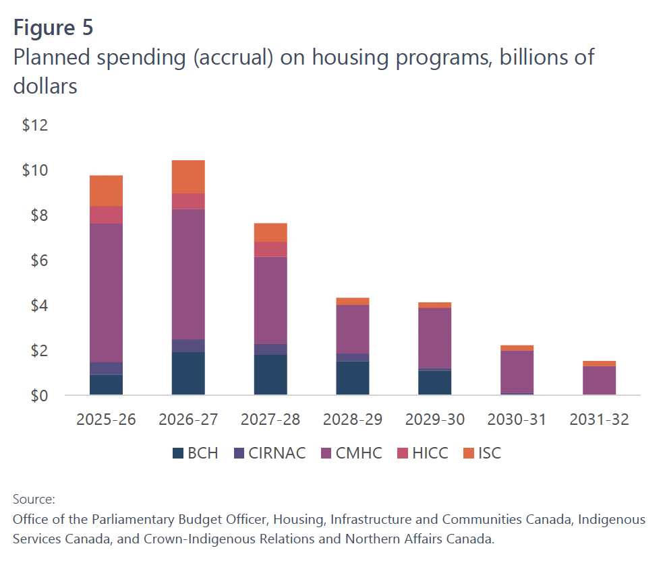
The federal role (cont’d)
Notes:
Source: https://www.pbo-dpb.ca/en/publications/RP-2526-020-S--build-canada-homes-outlook-housing-programs-under-budget-2025--maisons-canada-perspectives-entourant-programmes-logement-dans-cadre-budget-2025

Slide 21

The federal role (cont’d)

Slide 22
The federal role (cont’d)
Shannon Proudfoot (28 March 2026):
“[Carney] hasn’t charged the existing structures of the federal public service with executing on his biggest projects but has instead stood up a suite of specialized new agencies [one of which is BCH], each led by a heavy hitter from the private sector, to make big things happen fast. It’s not a public-service overhaul, it’s a workaround.”
Notes:
Source: https://www.theglobeandmail.com/politics/opinion/article-mark-carneys-strategy-for-the-public-service-becomes-clearer/

Slide 23
The federal role (cont’d)
Operating funding
On the supply side, Government of Canada hasn’t provided operating $ for any kind of new housing since the early 1990s (except for on-reserve housing).
Federal officials are rather averse to ongoing operating financing in general because it becomes a non-discretionary expenditure that they cannot control without major political cost.

Slide 24
The federal role (cont’d)
Operating funding (cont’d)
“Capital costs are in and out and simple. Operating costs, by contrast, will outstrip capital costs within 10-15 years in most cases, and those operating costs carry on forever. Not to mention the political optics when buildings begin to suffer from a lack of funding—both in terms of wraparound support and maintenance.”
— Shayne Ramsay (Ex-CEO of BC Housing)

Slide 25
Let’s shift gears again
Let’s briefly consider the role of the Province.

Slide 26
The provincial role
Provincial spending trends on housing tend to mirror federal ones (broadly speaking).
Demonstrated willingness to cost share with fed govt over time
Alberta has also had a relatively high rate of home ownership (driven largely by high incomes)

Slide 27
The provincial role (cont’d)
Historically, more keen to support public housing and demand-side approaches than non-market housing (relative to other provinces)
This may have been driven by ideology. Non-market sector at times may not have been ready for rapid growth.
This meant less tenant mix than other provinces (something changing now with Stronger Foundations).

Slide 28
The provincial role (cont’d)

Slide 29
The provincial role (cont’d)
Present day
12,000 rent supplements, with 3 streams (support varies from $200/month to $900/month).
These are supported by federal funding.
Note there are 154,000 households in core housing need in Alberta.

Slide 30
The provincial role (cont’d)
Present day (cont’d)
Affordable Housing Partnership Program
$85K/unit in capital costs (representing ~1/3 of capital costs)

Slide 31
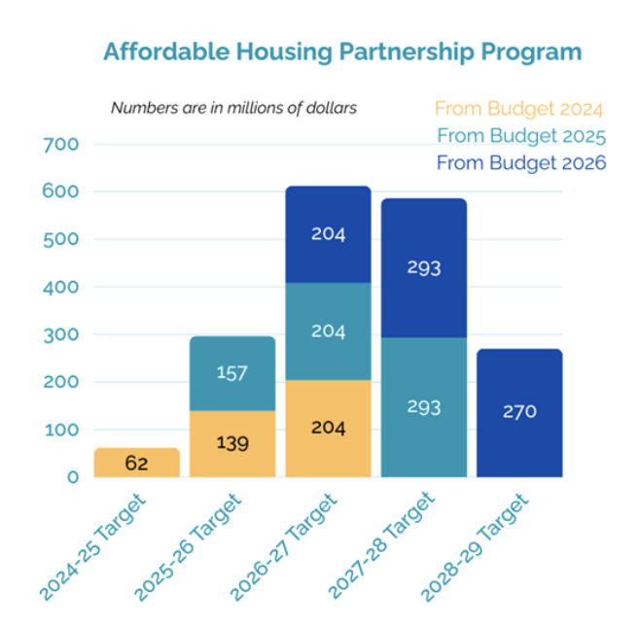
Notes:
Source: ASCHA

Slide 32
The provincial role (cont’d)
Present day (cont’d)
Province now favours ownership by non-market providers (and has supported asset transfers).
Non-market housing providers in Alberta exempt from property taxes as of Jan 2025.

Slide 33
Thank you

